Slide 1
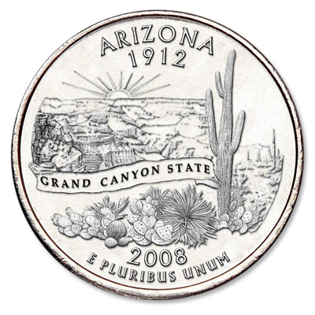
Arizona
The Grand Canyon State

Slide 2
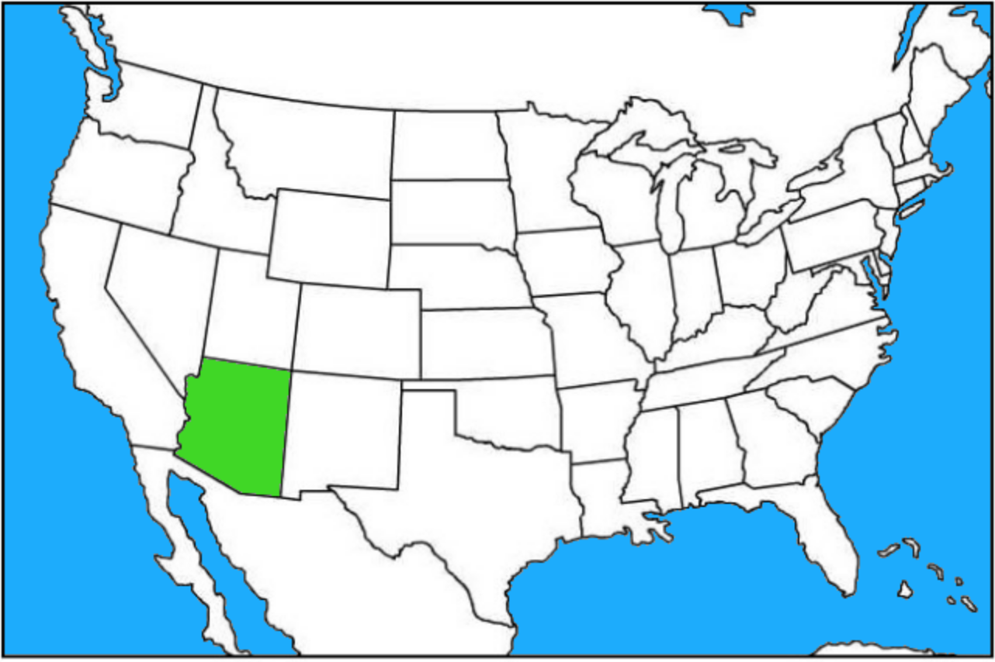
Where is Arizona?
Arizona is located in the southwestern United States.
It is west of New Mexico, south of Utah, east of California, and southeast of Oregon. It also borders Colorado and Mexico.
It is one of the “four corner” states.

Slide 3

Arizona Flag
The red and yellow beams represent the sunset over the Arizona desert. There are 13 beams to honor the original 13 colonies of America.
The copper-colored star represents Arizona’s copper mining industry.
The blue half of the flag represents the Colorado River.

Slide 4

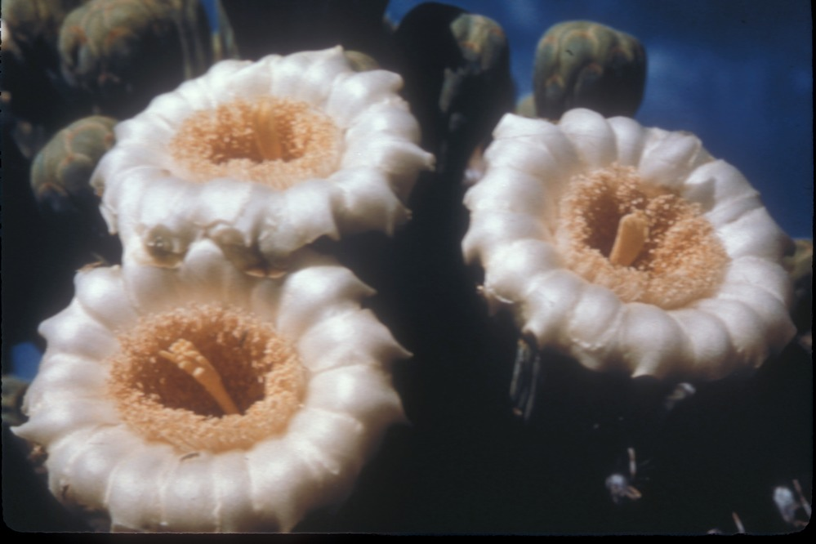
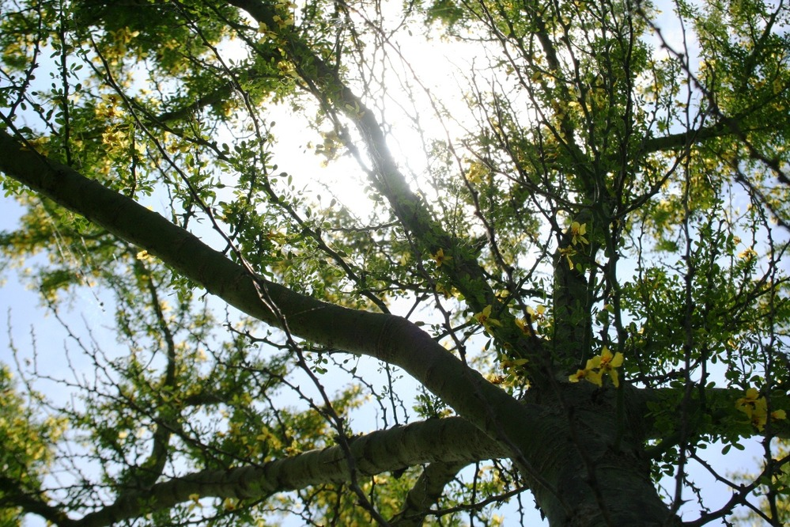
Arizona Symbols
Saguaro Bloom– state flower
Cactus Wren – Arizona state bird
Palo Verde tree– state tree

Slide 5
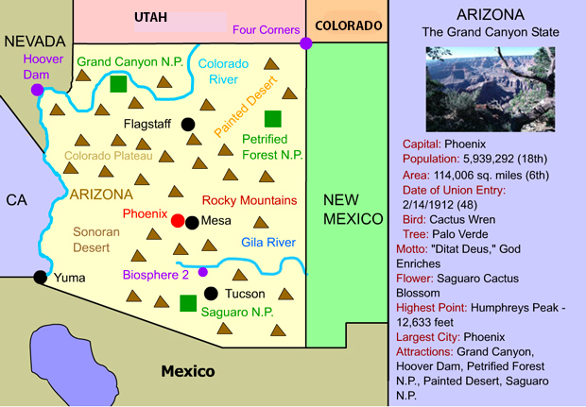
Arizona Facts
Arizona’s population is 7.01 million.
With an area exceeding 113,000 square miles, Arizona is America’s sixth largest state.
Arizona’s highest point is Humphrey’s Peak (12,633 ft.)
Arizona became a state on Valentine’s Day of 1912. It was America’s 48th state.

Slide 6
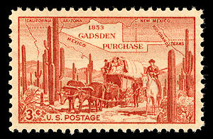
Important Dates in Arizona History
1540: Spanish explorer Francisco Coronado discovered the Grand Canyon and Colorado River.
1848: As a result of the Mexican-American War and the subsequent Treaty of Guadalupe Hidalgo, Arizona, and much of the southwest, is ceded by Mexico to the United States.
1854: Southern portions of Arizona and New Mexico are acquired by the United States from Mexico in the Gadsden Purchase.
1864: Kit Carson captures 7,000 Navajos and makes them leave Arizona in what came to be known as “The Long Walk.”
1912: Arizona becomes the 48th state.
1919: Grand Canyon National Park is founded.
1936: The Hoover Dam is finished

Slide 7
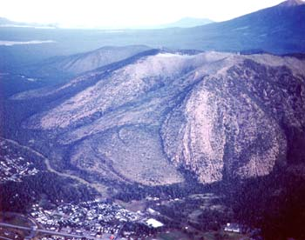
Arizona’s Landforms and Waterways
Arizona has 210 different mountain ranges
The San Francisco Mountains are located in north central Arizona and southern Utah. Humphrey’s Peak, the highest point in Arizona, is part of this range.
San Francisco Mountains

Slide 8
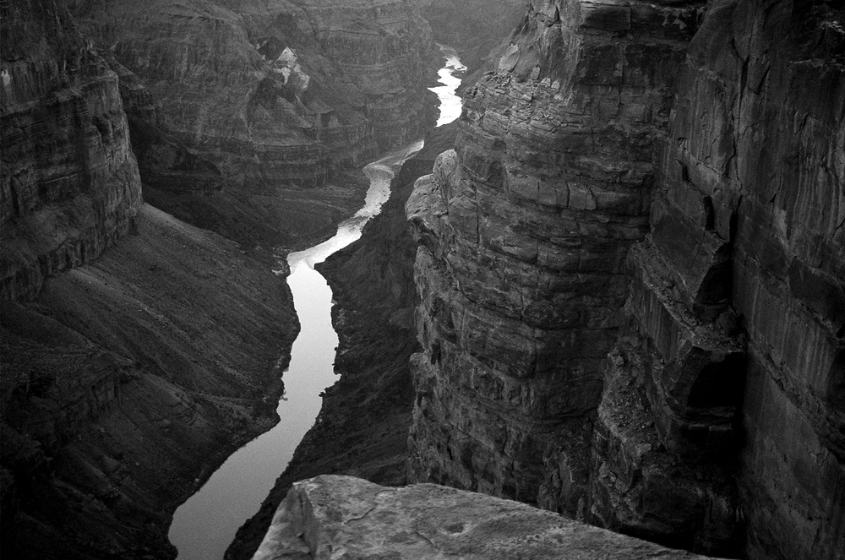
Arizona’s Landforms and Waterways
At 1,450 feet in length, the Colorado River is the longest river that runs through Arizona. It forms the borders of California and Arizona and Arizona and Nevada. It formed the famous Grand Canyon.
The Gila River is the second longest river in Arizona. It has a length of 649 miles.
Colorado River in the Grand Canyon

Slide 9
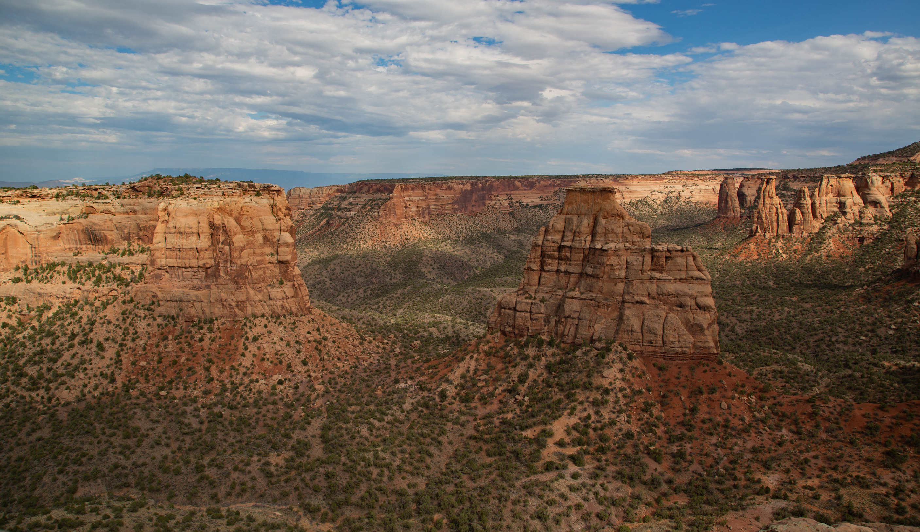
Arizona’s Landforms and Waterways
The Sonoran Desert, in southern Arizona, is one of the world’s most biologically diverse deserts. It’s the only place in the world where the Saguaro Cactus grows.
Northern Arizona is part of the Colorado Plateau – a region of deserts, scattered forests, and incredible rock formations centered in the four corners region of Arizona, Colorado, Utah, and New Mexico.
Colorado Plateau

Slide 10
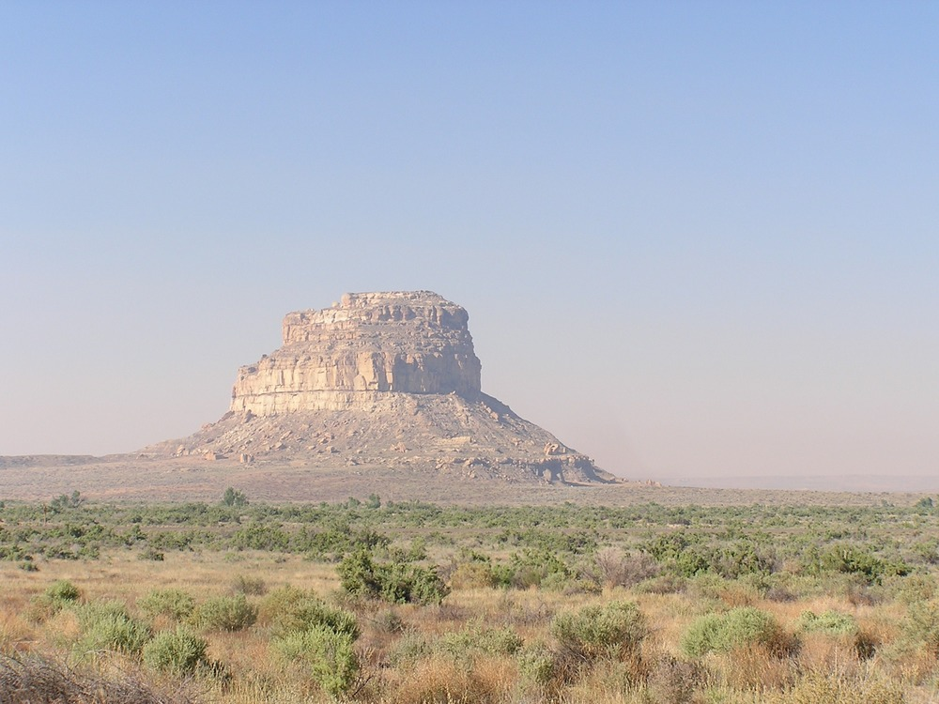
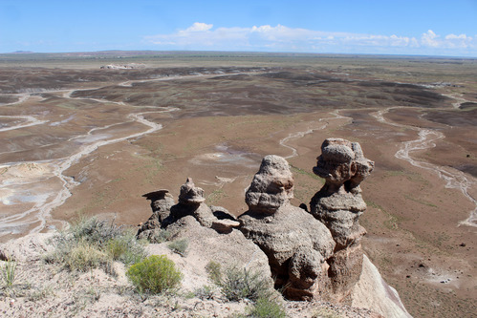
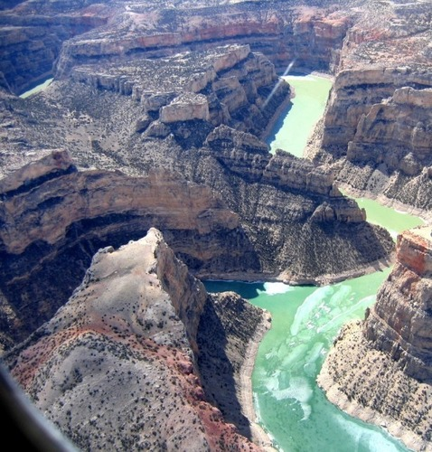
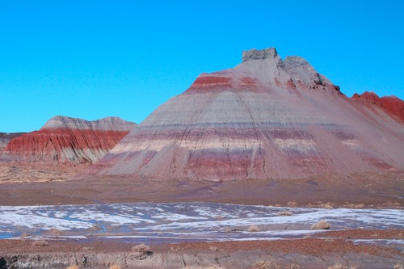
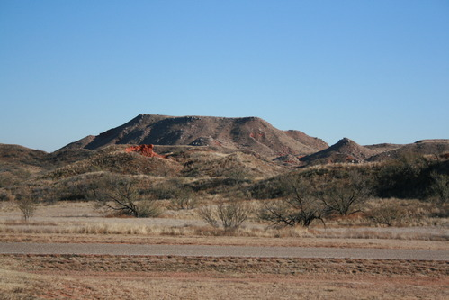
Common Arizona Landforms
Butte
Hoodoos
Canyon
Badlands
Mesa

Slide 11
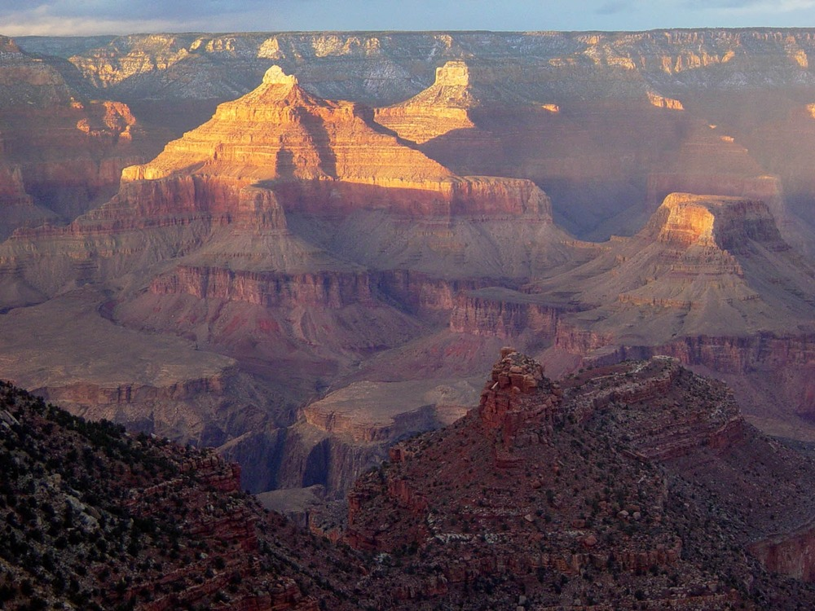
Arizona ’s National Parks – Grand Canyon
Located in northwestern Arizona.
Discovered by Francisco Coronado in 1540 and made into a national park in 1919.
Widely considered one of the world’s most spectacular sights. The canyon, carved by the Colorado River, is 18 miles at its widest.
Receives more than five million visitors per year.
Grand Canyon National Park

Slide 12
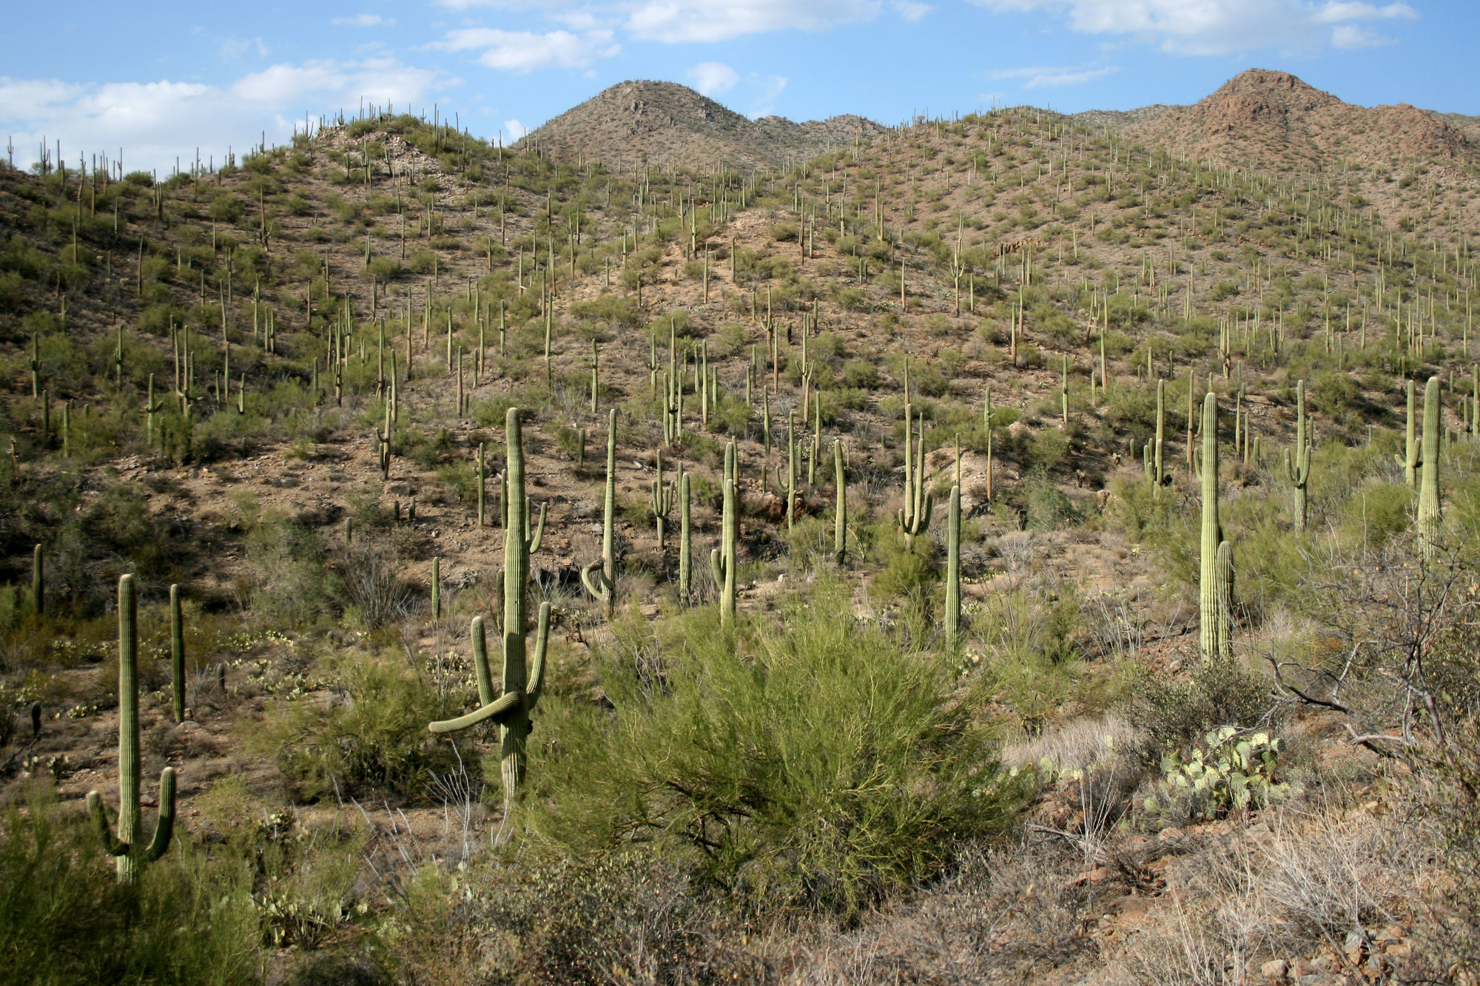
Arizona ’s National Parks – Saguaro
Located in southern Arizona.
Established in 1994.
The park preserves over 90,000 acres of the Sonoran Desert landscape, including thousands of saguaro cacti.
Saguaro National Park

Slide 13
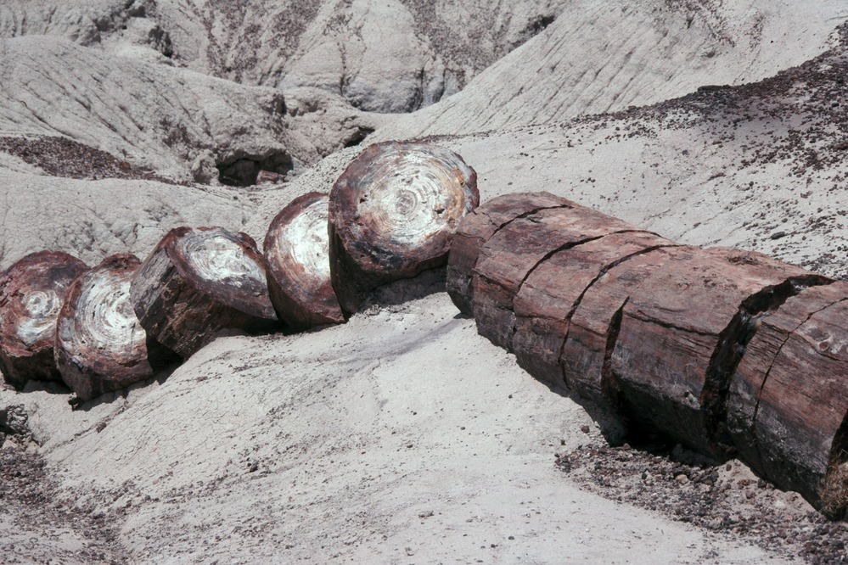
Arizona’s National Parks – Petrified Forest
Located in eastern Arizona
Features the world’s largest collection of petrified wood. Petrified wood is a type of fossil, in which the tissues of a dead plant are replaced with minerals. Petrified wood can be a range of different colors, depending on the mineral that has replaced the wood. For example, wood petrified with iron would be reddish in color.
Petrified Forest National Park

Slide 14
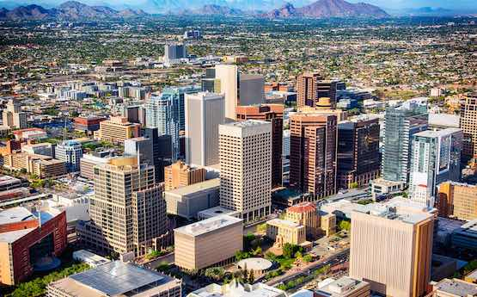
Arizona’s Capital – Phoenix
Phoenix was founded in 1868 and made capital of Arizona in 1912.
With a population of over 1.6 million, Phoenix is the largest city in Arizona, the sixth largest city in the United States, and the largest capital city in the United States.
Phoenix is one of America’s sunniest cities, receiving more than 300 days of sunshine per year.
Phoenix

Slide 15
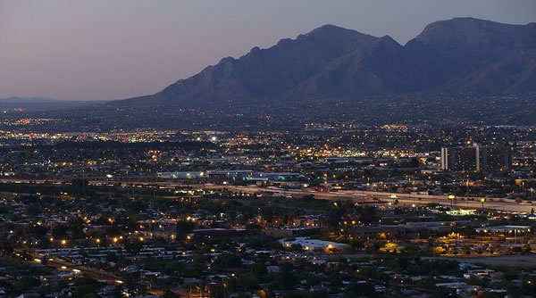
Arizona’s Cities – Tucson
Tucson, pronounced “too-sahn” is the second largest city in Arizona. It is located in southern Arizona in the Sonoran Desert.
Tucson is home to the University of Arizona and its 37,000 students.
Tucson is sometimes called “Optics Valley” because many astronomical observatories are located on its nearby peaks.
Tucson

Slide 16
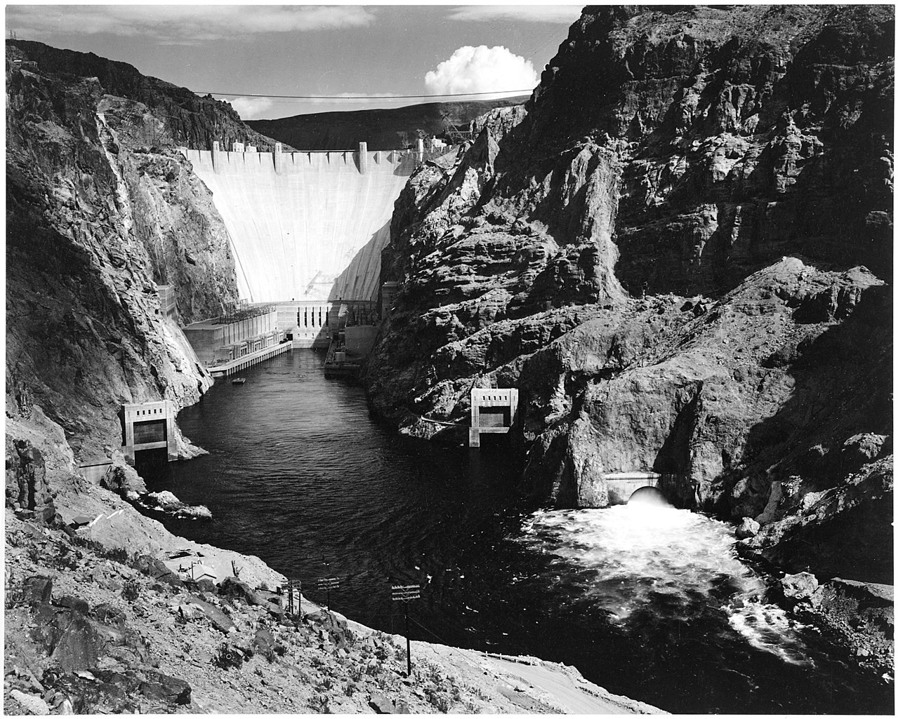
Arizona’s Important Landmarks – Hoover Dam
The Hoover Dam is located on the Arizona/Nevada border on the Colorado River. It opened in 1936 and named after former president Herbert Hoover.
It was built to control flooding and to provide hydroelectric power and irrigation water.
The dam formed Lake Mead, the largest reservoir in the United States. It can store over nine trillion gallons of water.
The Hoover Dam attracts over one million people each year.
Hoover Dam in 1942 – Ansel Adams

Slide 17
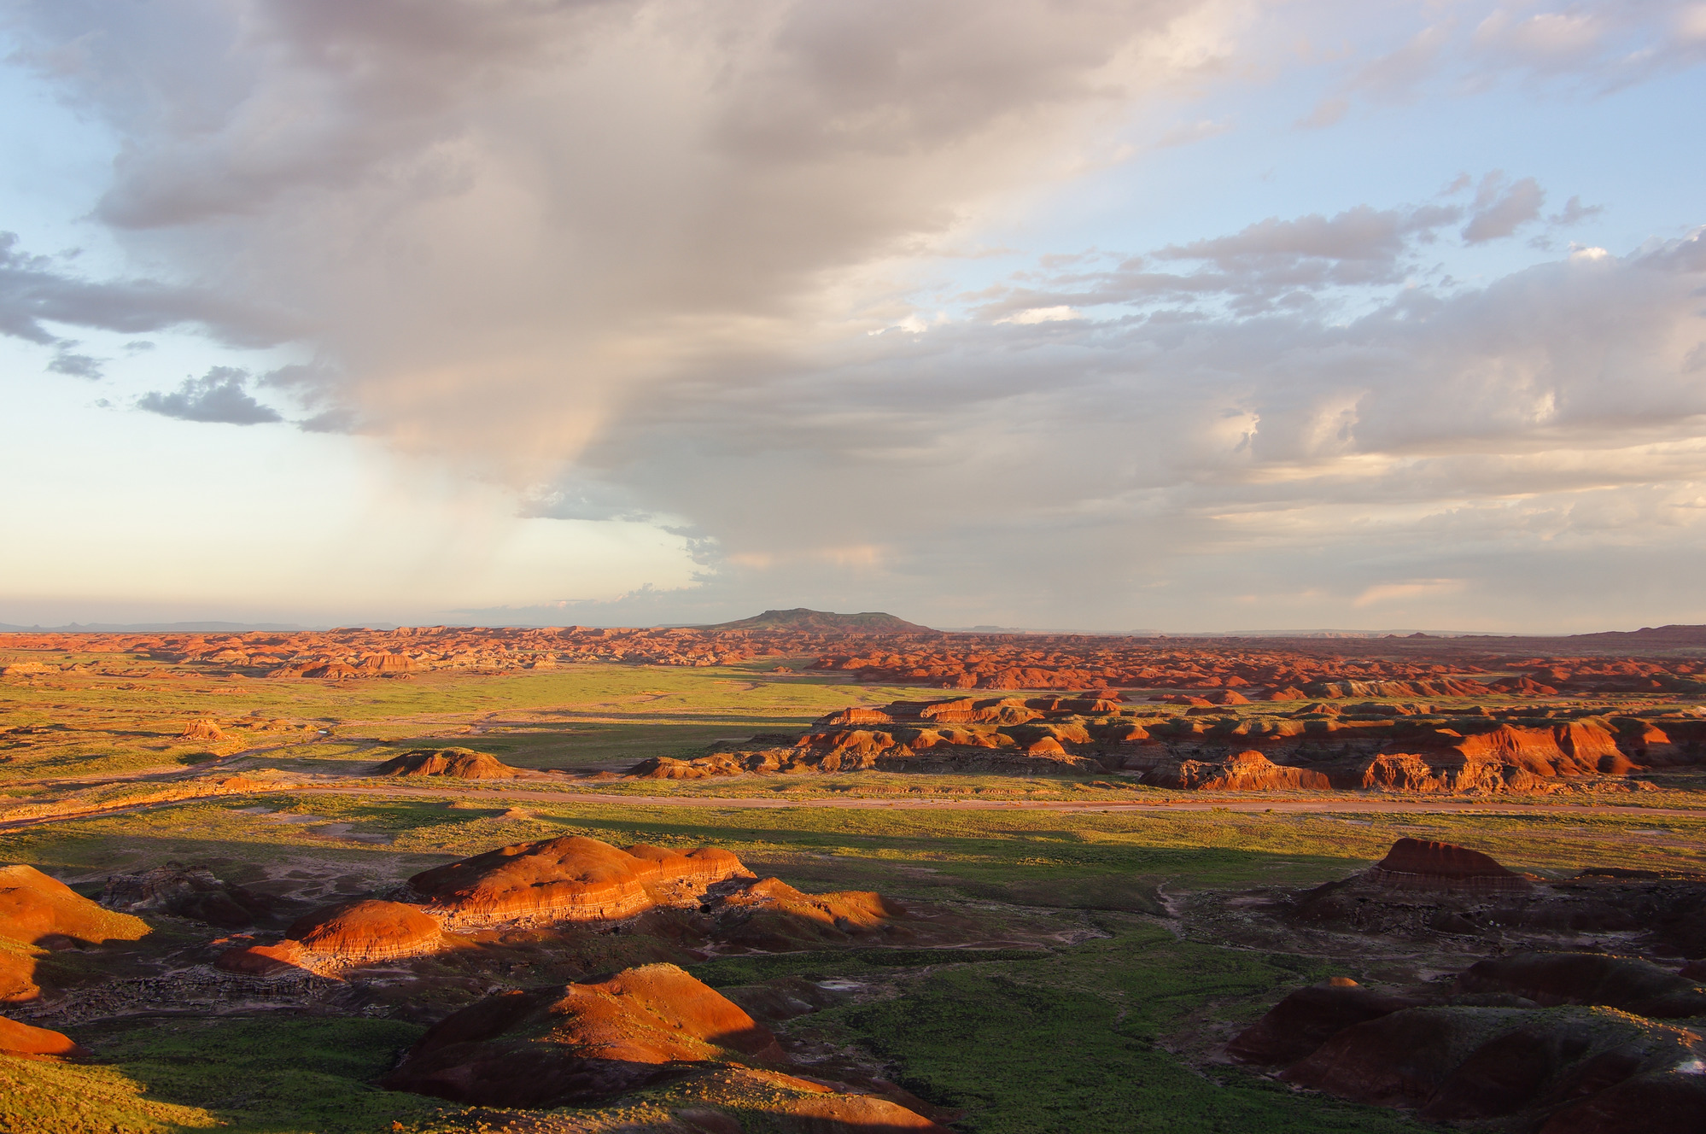
Arizona’s Important Landmarks – Painted Desert
The Painted Desert, located in northern Arizona, is an area of badlands with colorful buttes, flattop mesas, and hardened sand dunes, many of which seem to be "painted" with red and gray stripes from years of wind erosion. Many towns within the Painted Desert are often covered in red dust blown in from the surrounding desert.
Painted Desert

Slide 18
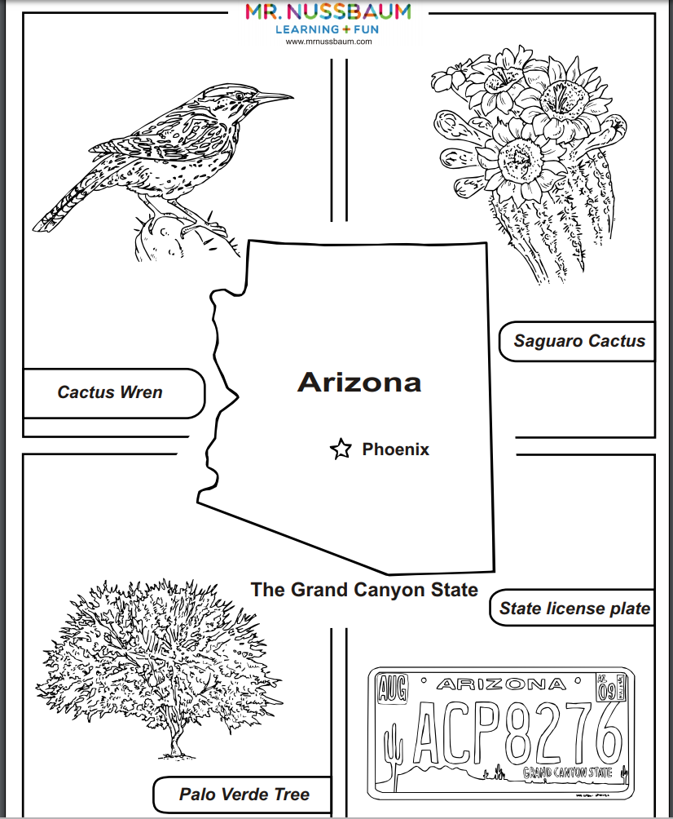
Follow-up Activities
Learn About America has dozens of Arizona-themed activities.
Search for Arizona, or, visit the geography section and click on “Arizona.”

