Slide 1
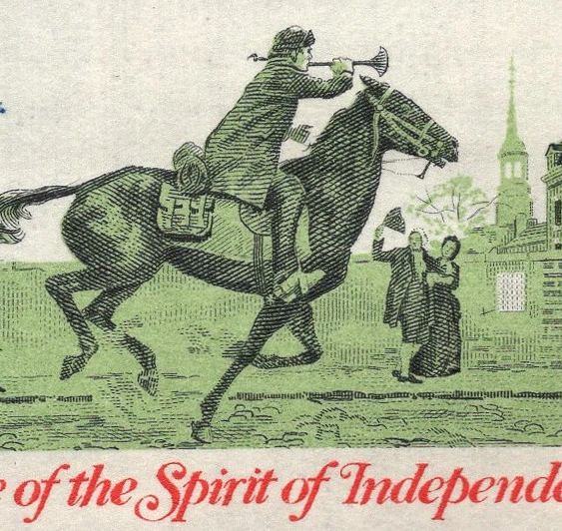
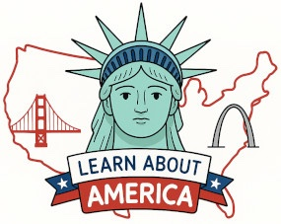
Paul Revere and His Midnight Ride

Slide 2
LearnAboutAmerica.com
*For our presentations, lesson plans, articles, printables, interactives, stories, and games related to Paul Revere, please visit:
https://learnaboutamerica.com/american-history/revolutionary-war/people-of-the-revolutionary-war/paul-revere
* For the greatest American History website for teachers, parents, and students, visit:
https://learnaboutamerica.com

Slide 3
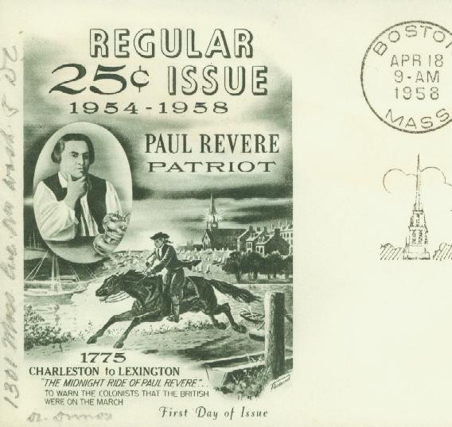
Early Life
Born January 1, 1735
Boston, Massachusetts
Prosperous silversmith and engraver

Slide 4
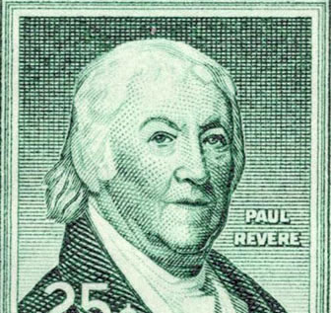
Paul Revere the Patriot
Active American Patriot
Member of the Sons of Liberty

Slide 5
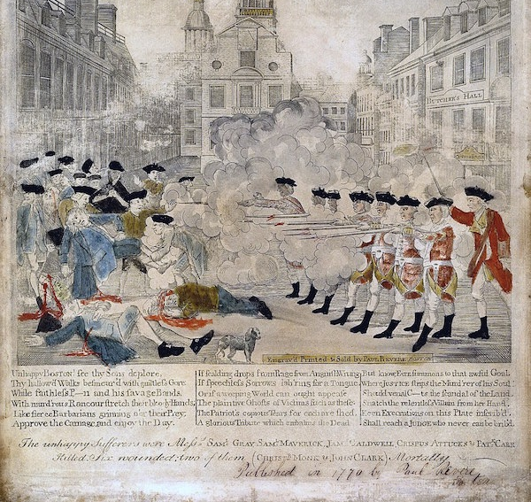
Boston Massacre Propaganda
Engraved iconic propaganda after the 1770 Boston Massacre

Slide 6
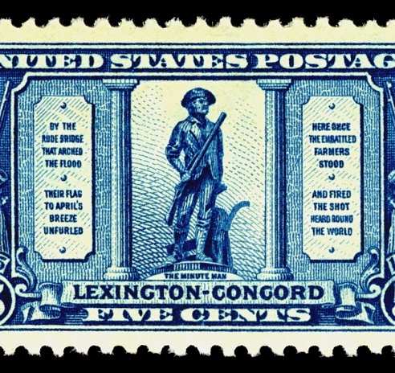
Revere’s Warning – April 7, 1775
British troops moved toward Concord
Joseph Warren sent Revere to warn the Provincial Congress
Supplies were moved to safety

Slide 7
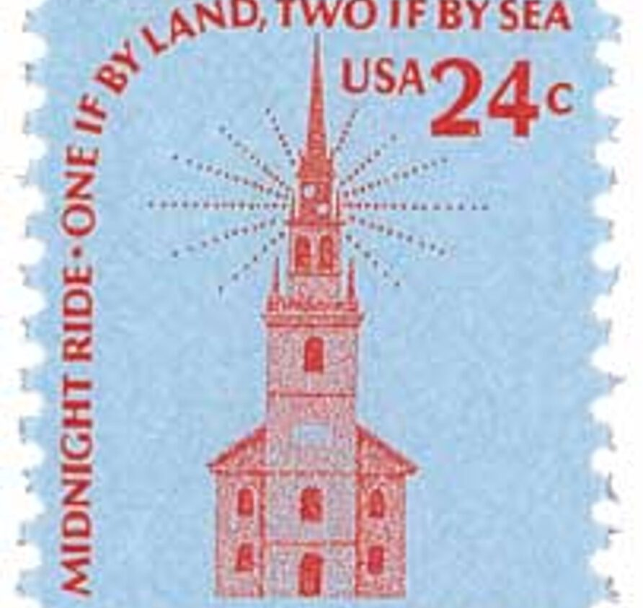
The Midnight Ride – April 18, 1775
Warned of British plans to capture Hancock and Adams
Warned militia along the way

Slide 8
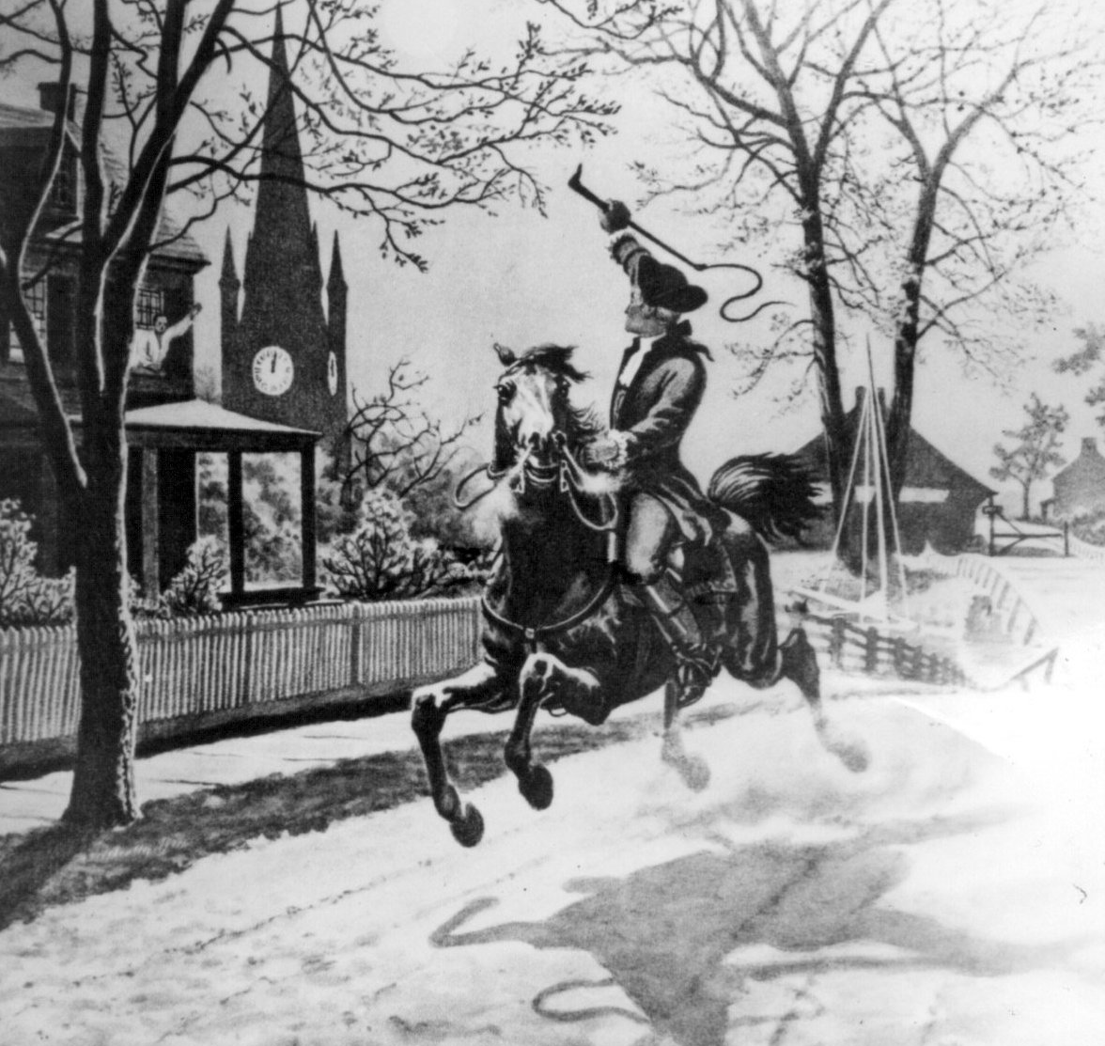
What Did Revere Really Say?
Did not shout 'The British are coming'
Likely said 'The Regulars are coming out'

Slide 9
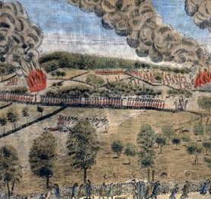
Capture and Release
Revere was captured by British troops
British retreated after learning of Patriot defenses

Slide 10
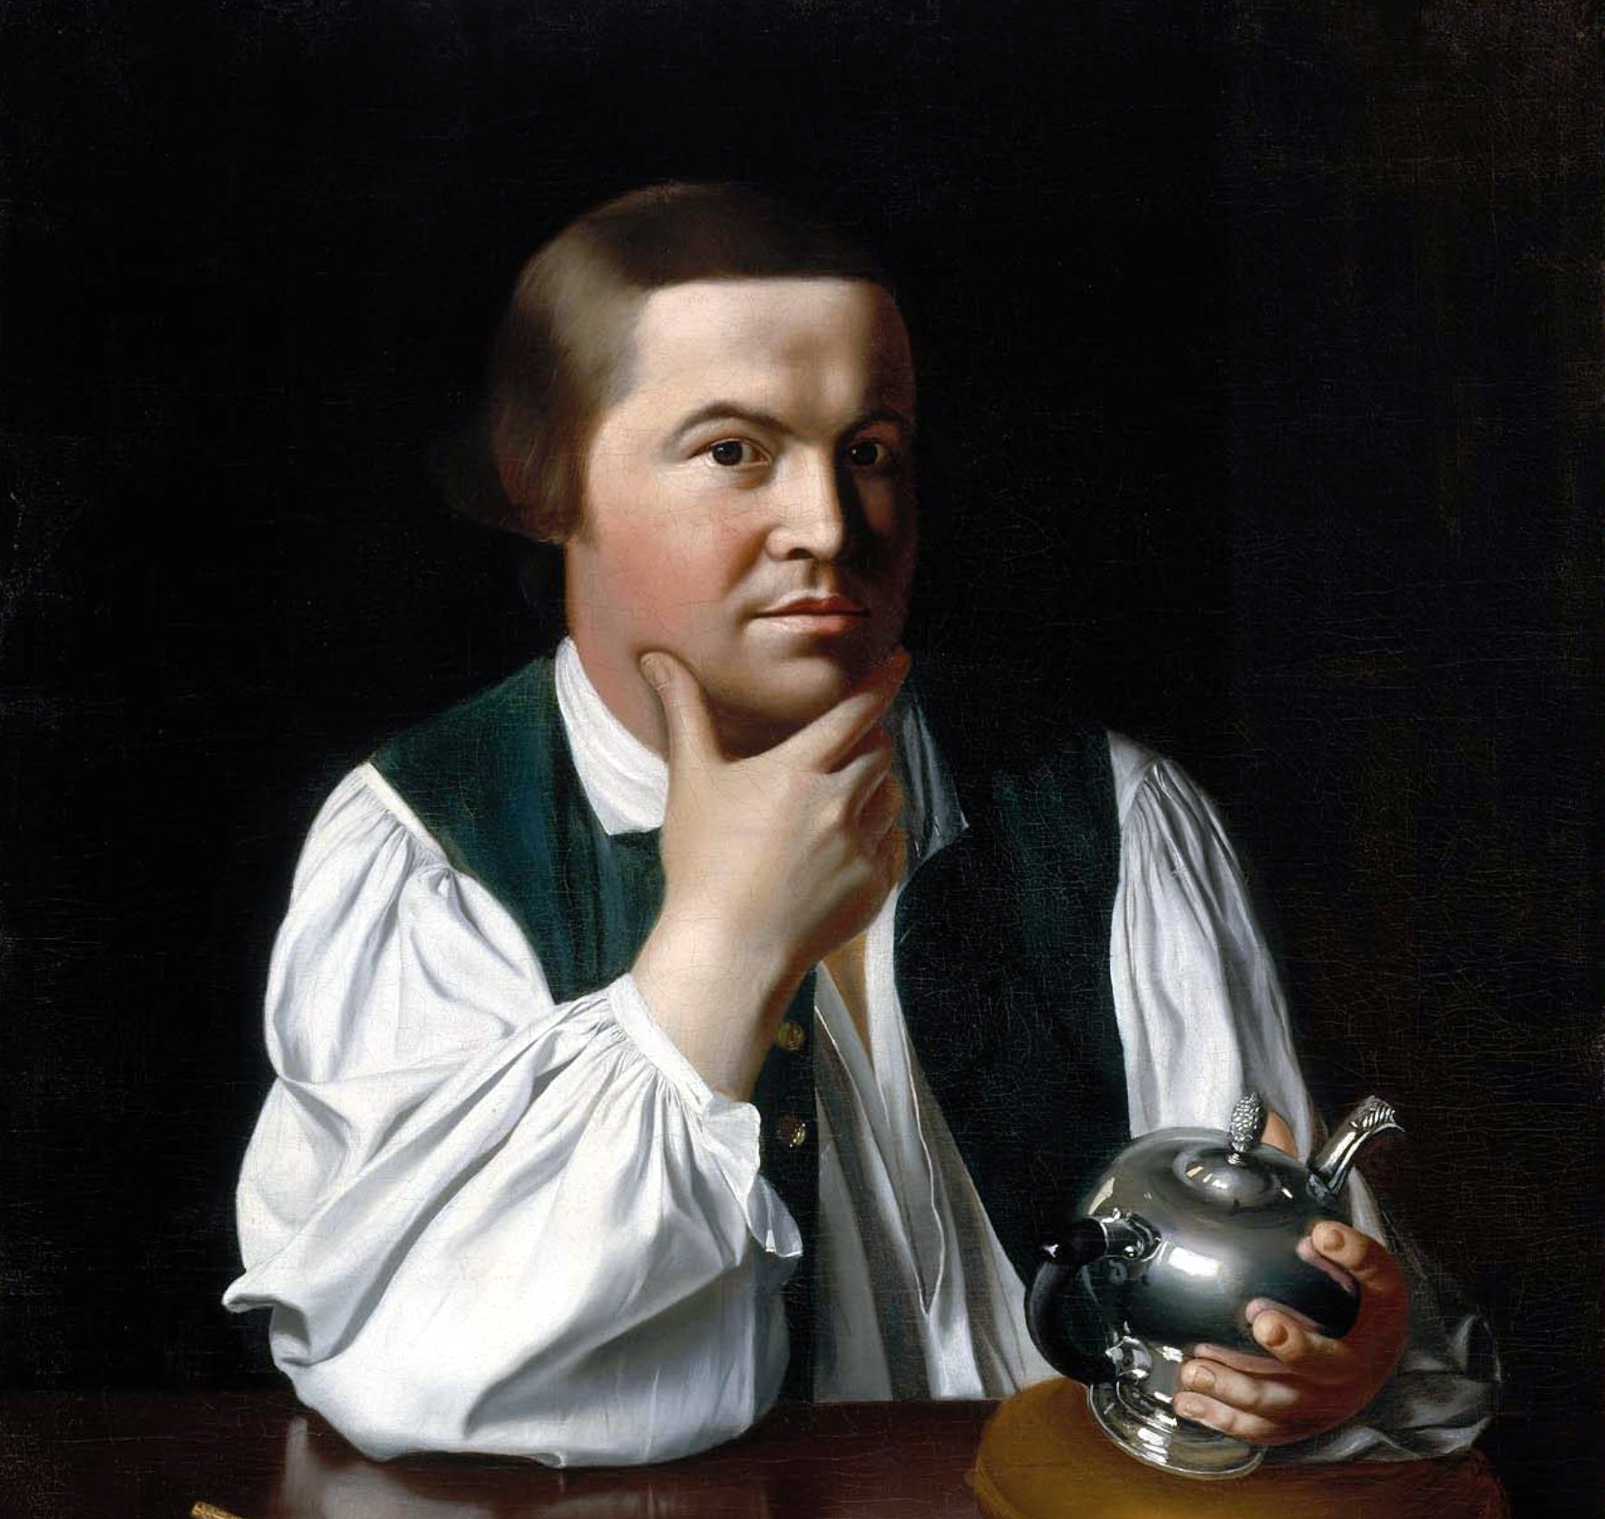
Life After the Revolution
Returned to silversmithing
Died May 8, 1818 at age 83

Slide 11
Key Vocabulary
Patriot
Provincial Congress
Militia
Sons of Liberty
Regulars

Slide 12
Discussion Questions
Why was Revere’s warning important?
How did his ride affect Lexington and Concord?

