Slide 1
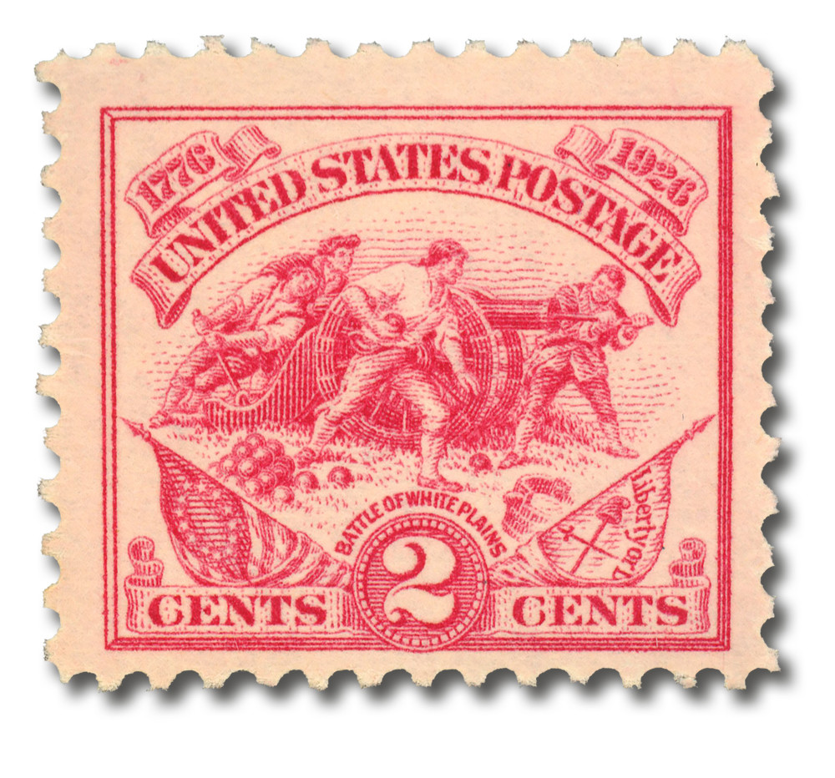
Battles of New York (1776)
https://learnaboutamerica.com
Notes:
Introduce the importance of New York in the Revolutionary War and explain that Britain hoped a major victory here would end the rebellion.

Slide 2

LearnAboutAmerica.com
*For our presentations, lesson plans, articles, printables, interactives, stories, and games related to these battles, please visit:
https://learnaboutamerica.com/american-history/revolutionary-war/battles-of-the-revolutionary-war/battles-of-new-york
* For the greatest American History website for teachers, parents, and students, visit:
https://learnaboutamerica.com

Slide 3
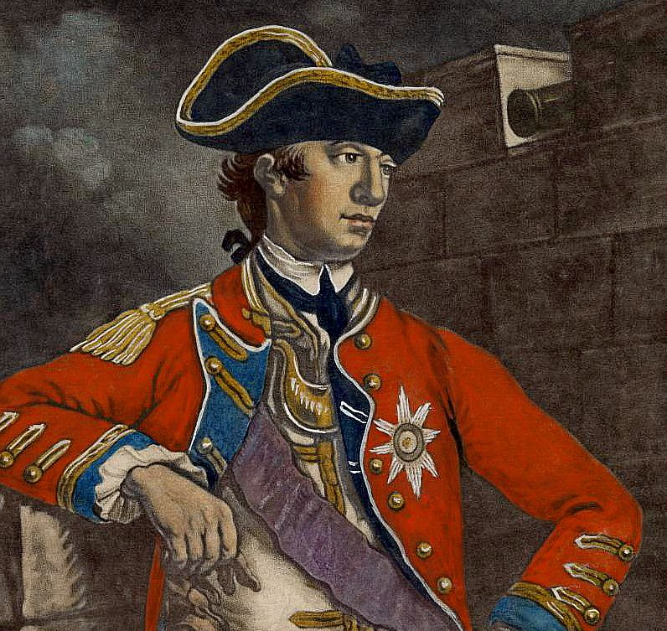
After Bunker Hill
British victory was costly (Pyrrhic)
General William Howe sought a decisive blow
New York City chosen as the target
Notes:
Explain what a Pyrrhic victory is and why Bunker Hill convinced Howe that a larger, more organized attack was necessary.

Slide 4
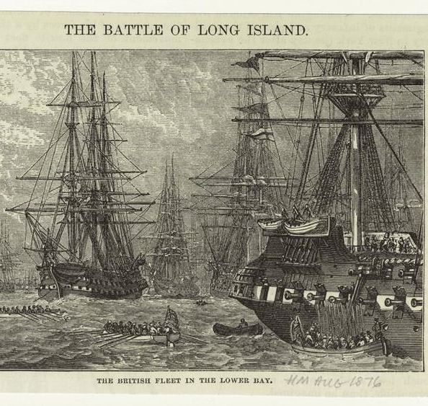
British Strategy
Massive invasion planned
Tens of thousands of British and German troops
Fleet mobilized in Halifax, Nova Scotia
Notes:
Describe how the British planned one of the largest military operations of the war.

Slide 5
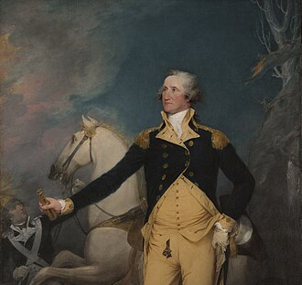
American Preparations
George Washington led American forces
General Charles Lee ordered to defend New York
Continental Army spread thin
Notes:
Explain the difficulties Washington faced trying to defend a city surrounded by water.

Slide 6
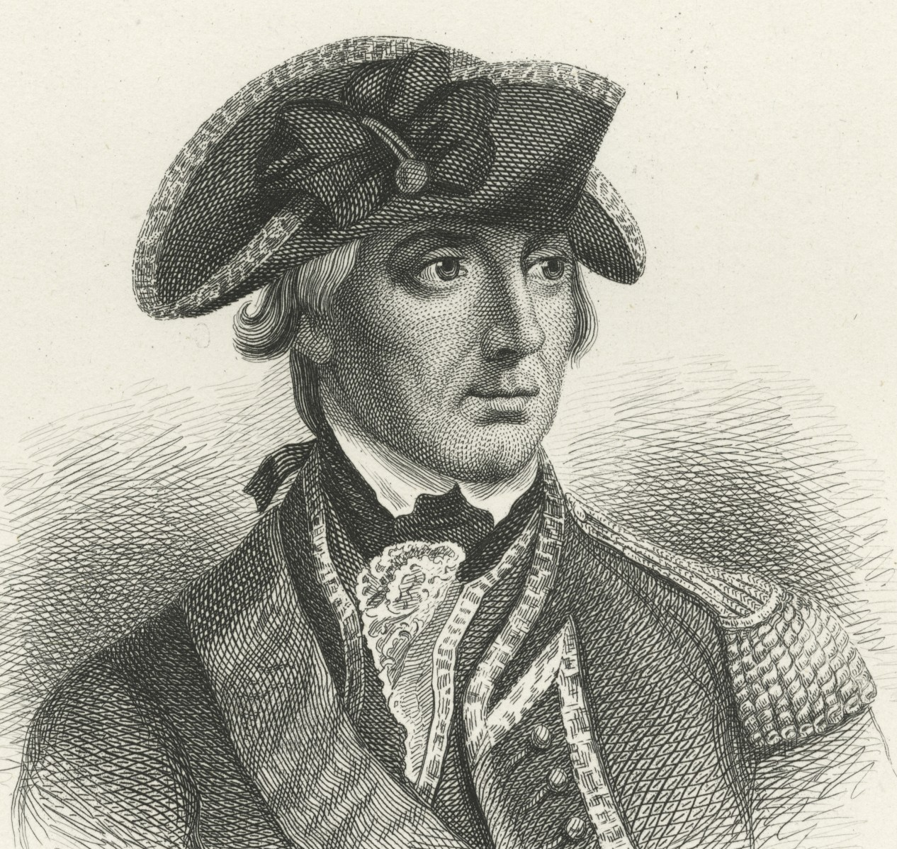
British Arrival
Howe sailed with 9,000 troops
British landed on Staten Island
More reinforcements followed
Notes:
Emphasize the overwhelming size and strength of the British forces.

Slide 7
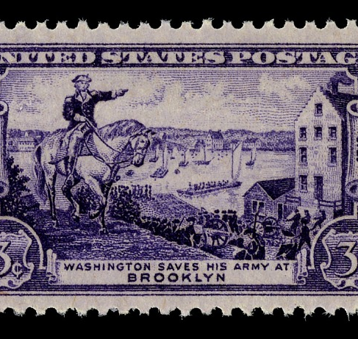
Battle of Brooklyn Heights
August 27, 1776
Also called the Battle of Long Island
British outflanked the Americans
Notes:
Explain how British maneuvering nearly trapped Washington’s army.

Slide 8
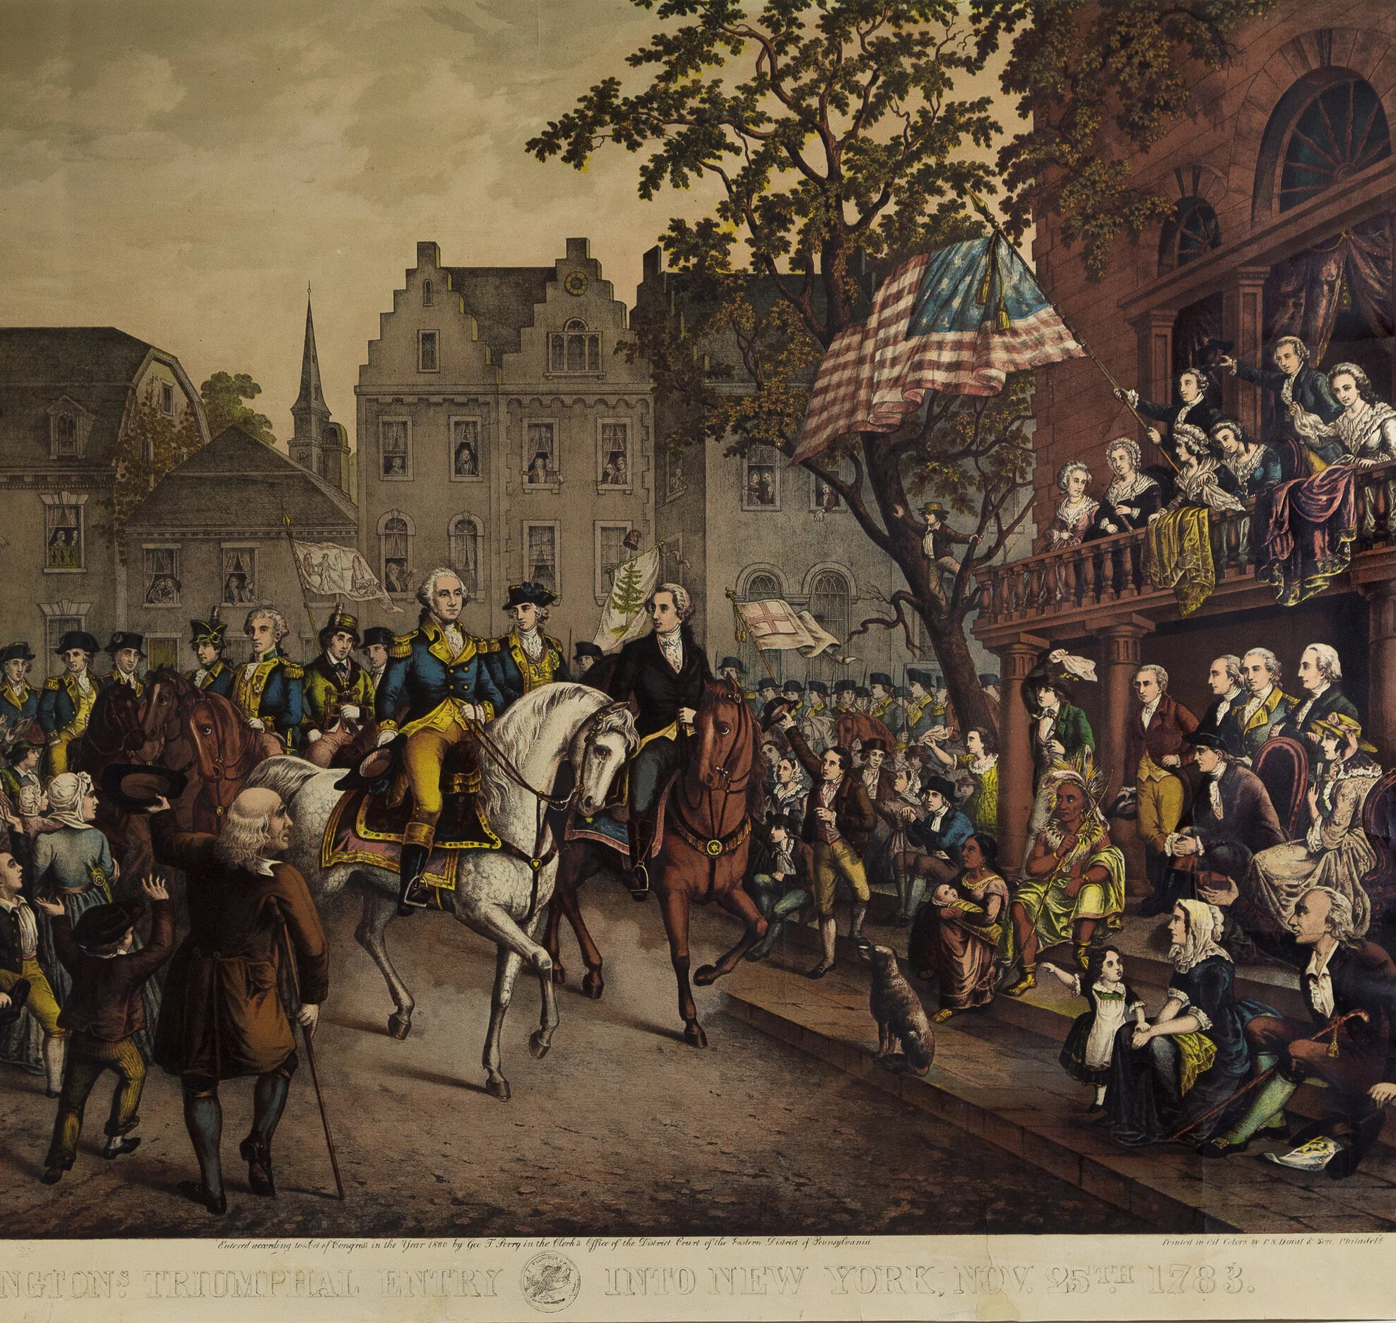
American Retreat
Patriots withdrew under cover of darkness
Evaded a British siege
Retreated to Manhattan
Notes:
Highlight Washington’s skillful nighttime evacuation that saved the army.

Slide 9
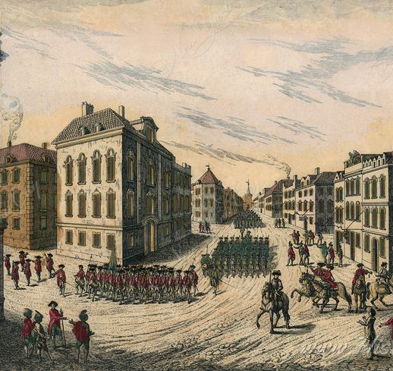
British Take Manhattan
Peace talks failed
12,000 British troops captured Lower Manhattan
Americans retreated north
Notes:
Explain how quickly the British gained control of the city.

Slide 10
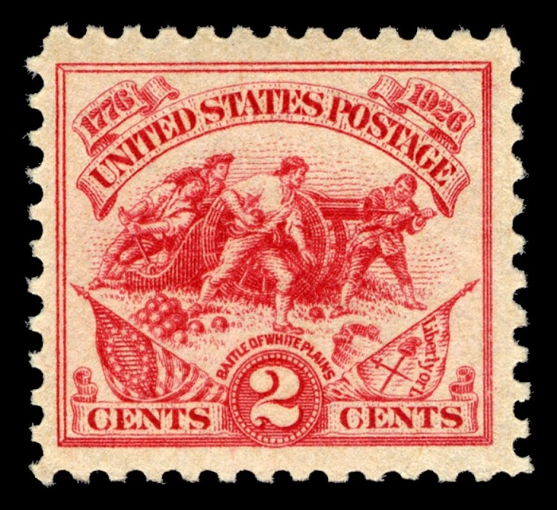
Harlem Heights and White Plains
Continental Army regrouped north of the city
Some success at Harlem Heights
Eventually forced back to White Plains
Notes:
Describe how Washington attempted to slow the British advance.

Slide 11
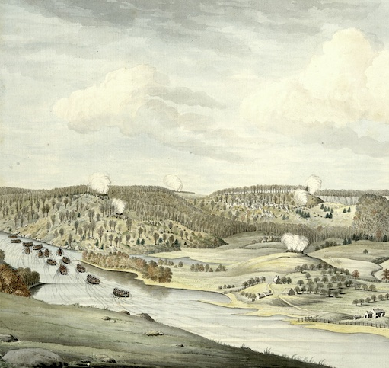
Fort Washington
Last American stronghold in Manhattan
British launched a three-pronged attack
Nearly 3,000 Americans captured
Notes:
Explain why holding Fort Washington was a major mistake.

Slide 12
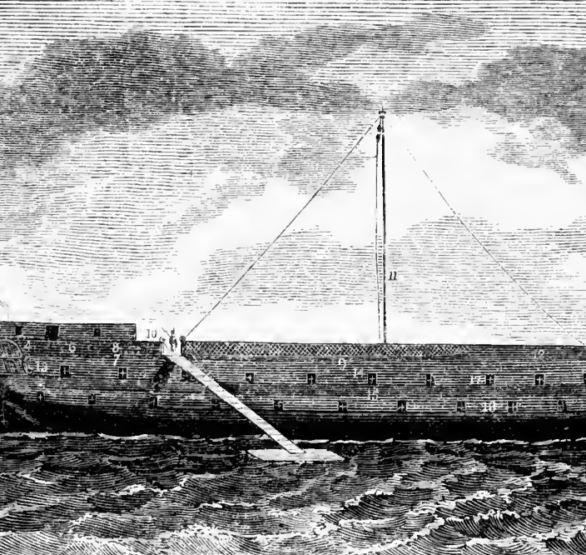
Prison Ships
American prisoners taken to British ships
Disease and starvation common
Most prisoners did not survive
Notes:
Emphasize the human cost of the defeat.

Slide 13
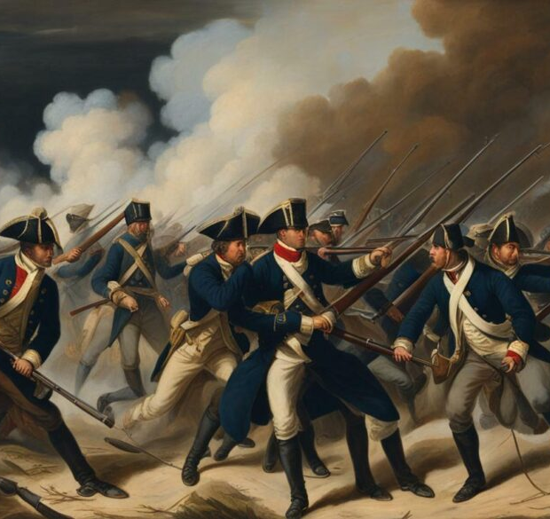
Fort Lee and Retreat
Washington watched Fort Washington fall
Ordered evacuation of Fort Lee
Army retreated across New Jersey
Notes:
Explain Washington’s decision to preserve his army at all costs.

Slide 14
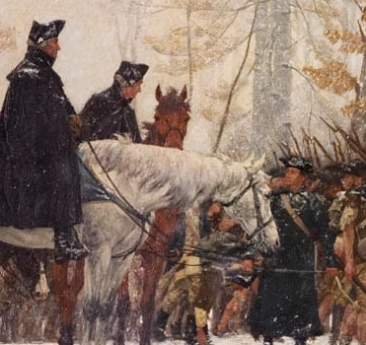
Across the Delaware
Continental Army crossed into Pennsylvania
British controlled New York
Patriot position weakened
Notes:
Explain how dire the situation became for the Americans.

Slide 15
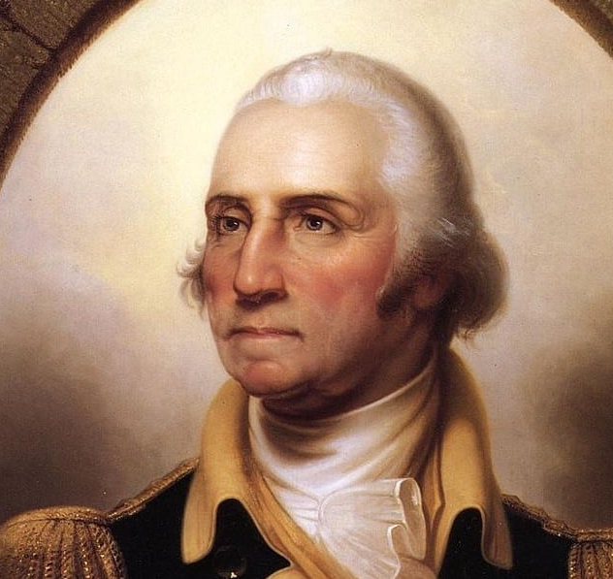
Bleak Outlook
Low morale and desertions
Enlistments ending
Washington doubted success
Notes:
Describe how close the Patriot cause came to collapse.

Slide 16
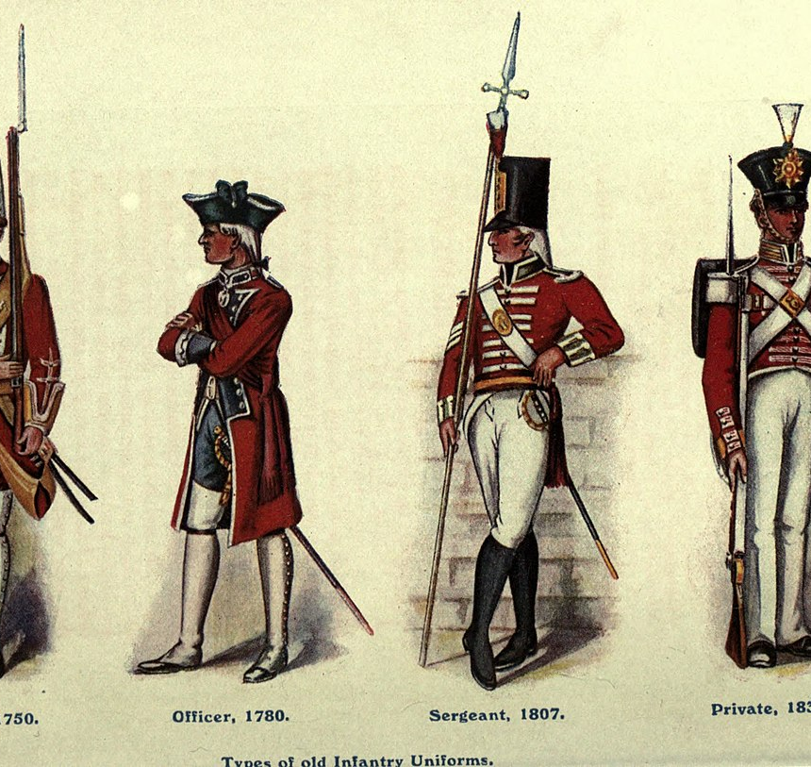
British Winter Quarters
Howe halted the campaign
British settled into winter quarters
Outposts stretched into New Jersey
Notes:
Foreshadow how this decision would later allow Washington to strike back.

