Slide 1
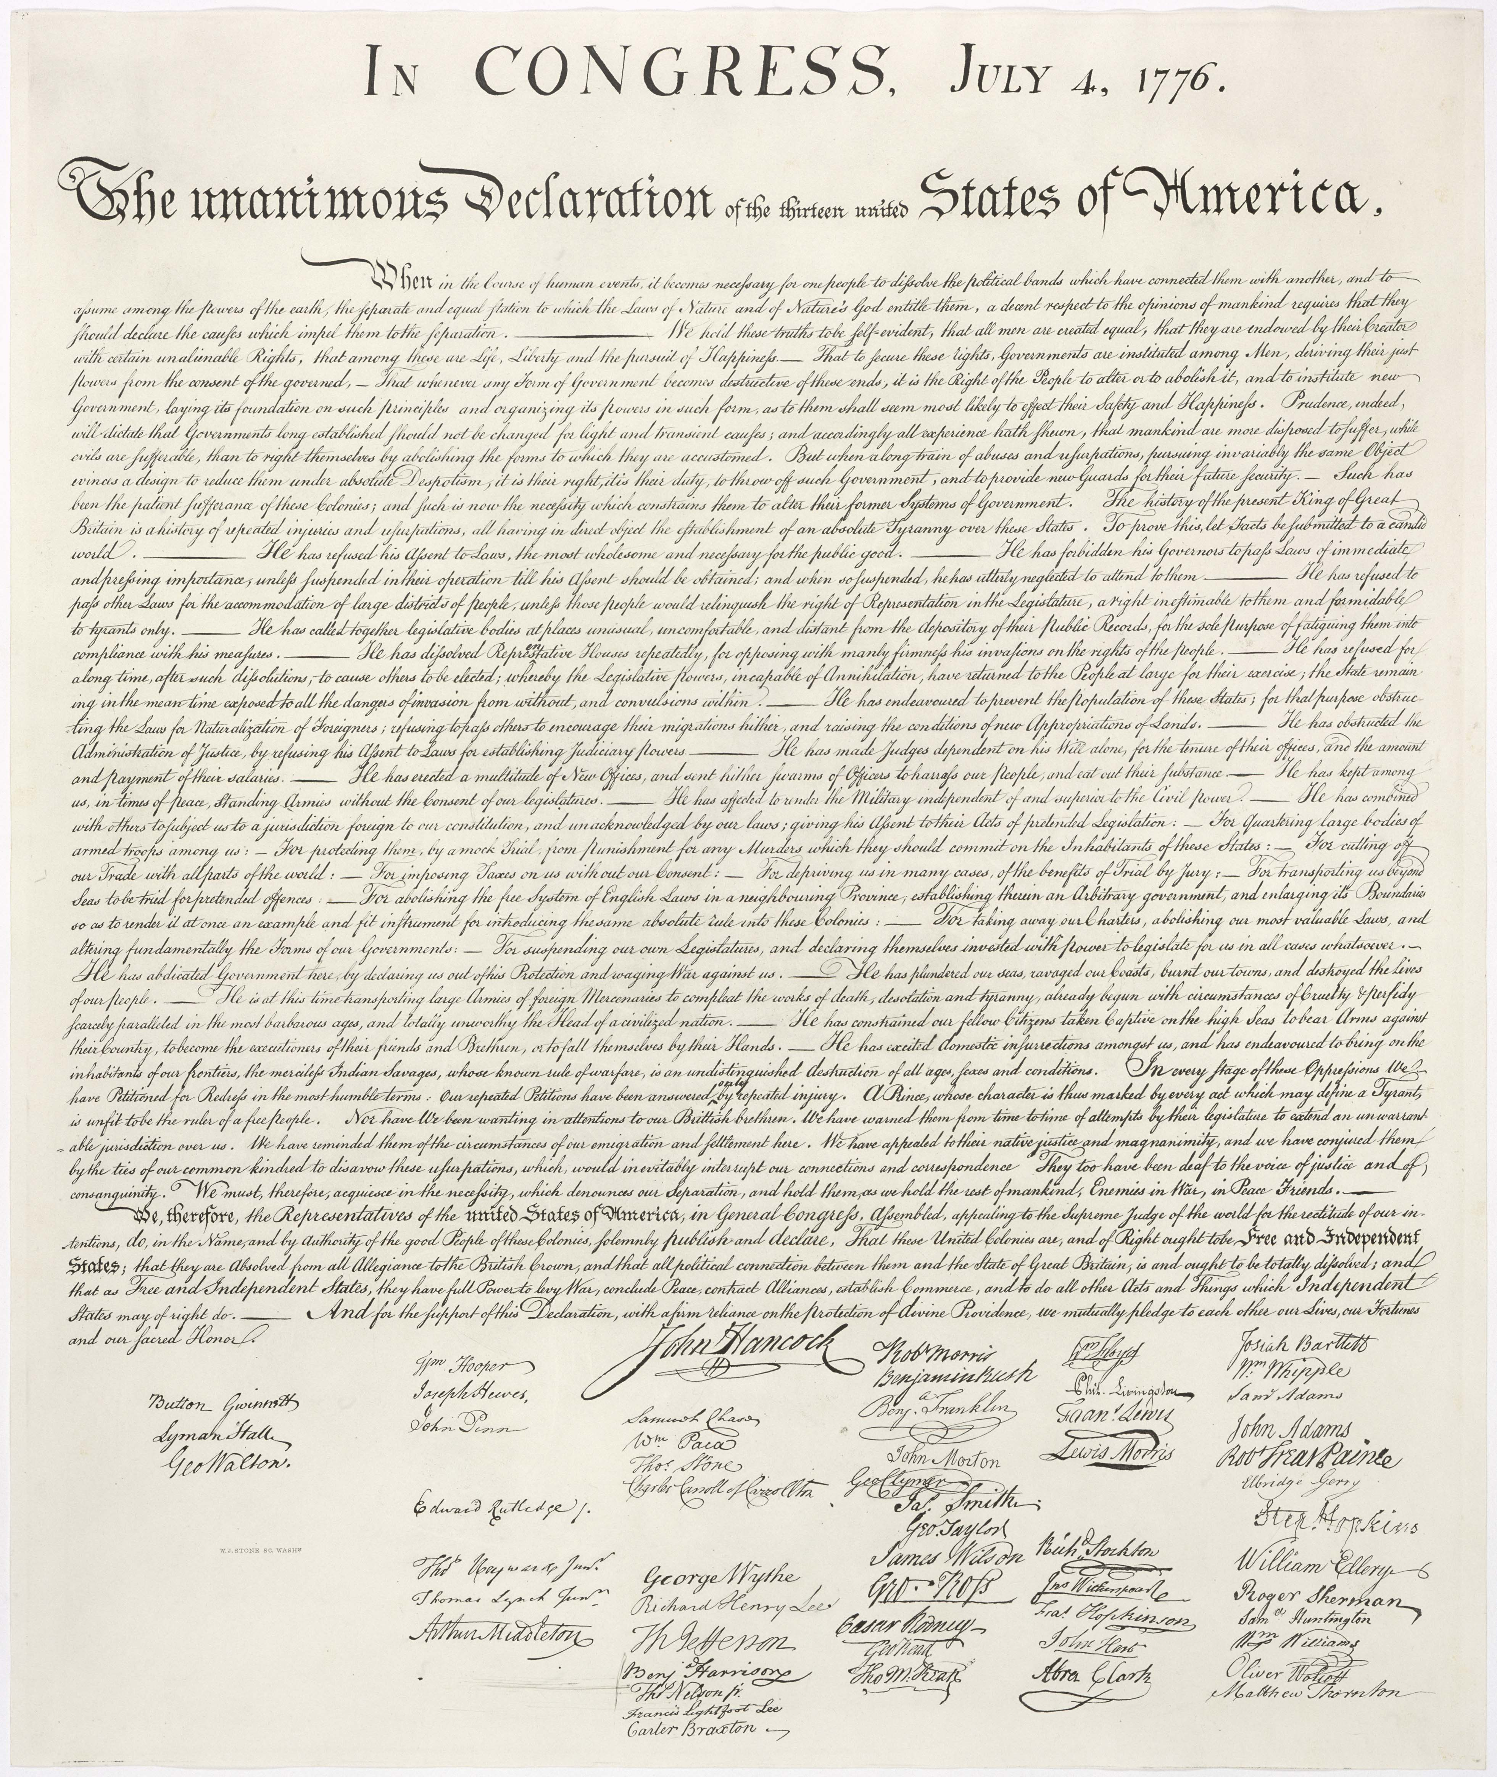
The Declaration of Independence
https://learnaboutamerica.com

Slide 2

LearnAboutAmerica.com
*For our presentations, lesson plans, articles, printables, interactives, stories, and games related to the Declaration of Independence, please visit:
https://learnaboutamerica.com/american-history/revolutionary-war/causes-of-the-revolutionary-war/declaration-of-independence
* For the greatest American History website for teachers, parents, and students, visit:
https://learnaboutamerica.com

Slide 3
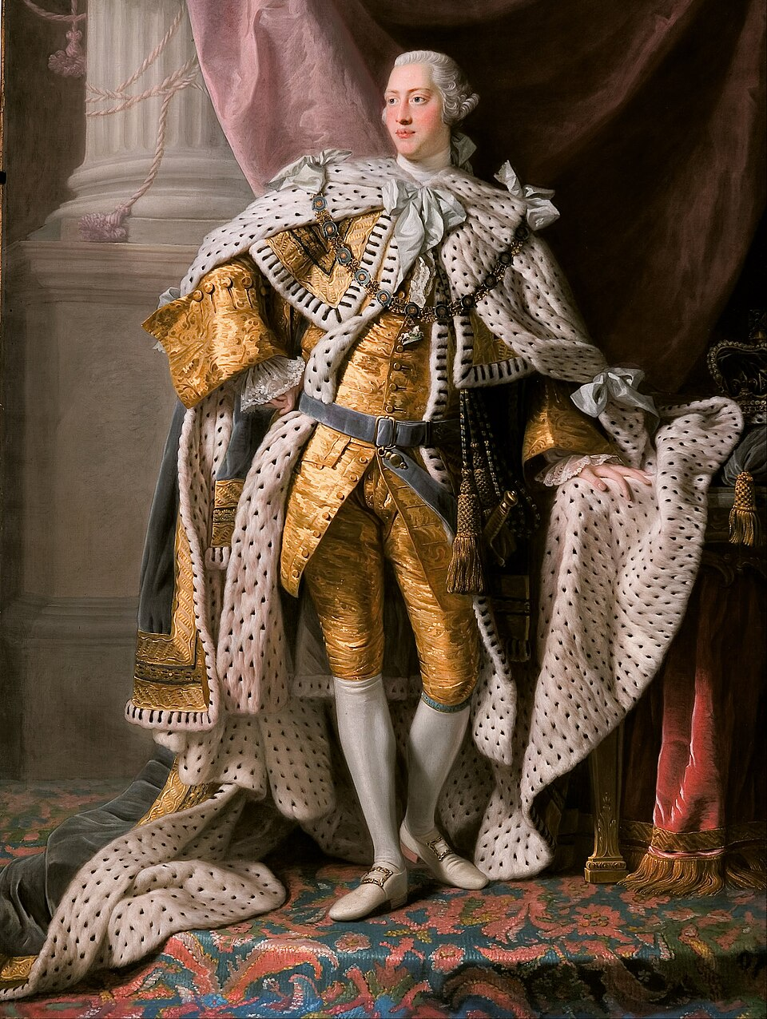
Colonial America Before 1776
Colonists were divided over their relationship with Great Britain
Patriots believed British rule was unfair and oppressive
Loyalists believed loyalty provided stability and protection
Disagreements affected families and communities

Slide 4
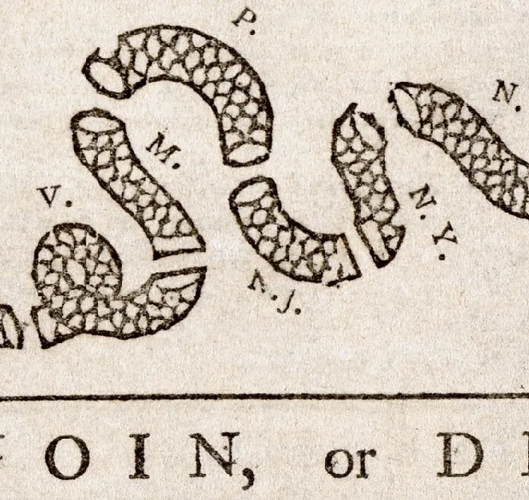
Patriots vs. Loyalists
Patriots believed:
- Taxes without representation were unjust
- Rights were being violated
- Self-government was necessary
Loyalists believed:
- Britain provided order and security
- Rebellion would lead to chaos
- Loyalty to the king was a duty

Slide 5
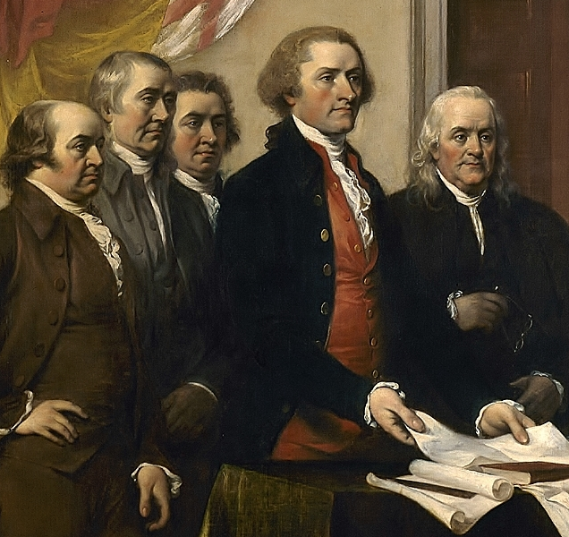
Why the Declaration Was Written
Colonists wanted to explain why they were breaking away
The Declaration justified independence to Britain, the colonies, and foreign nations
It was meant to persuade, not just announce

Slide 6
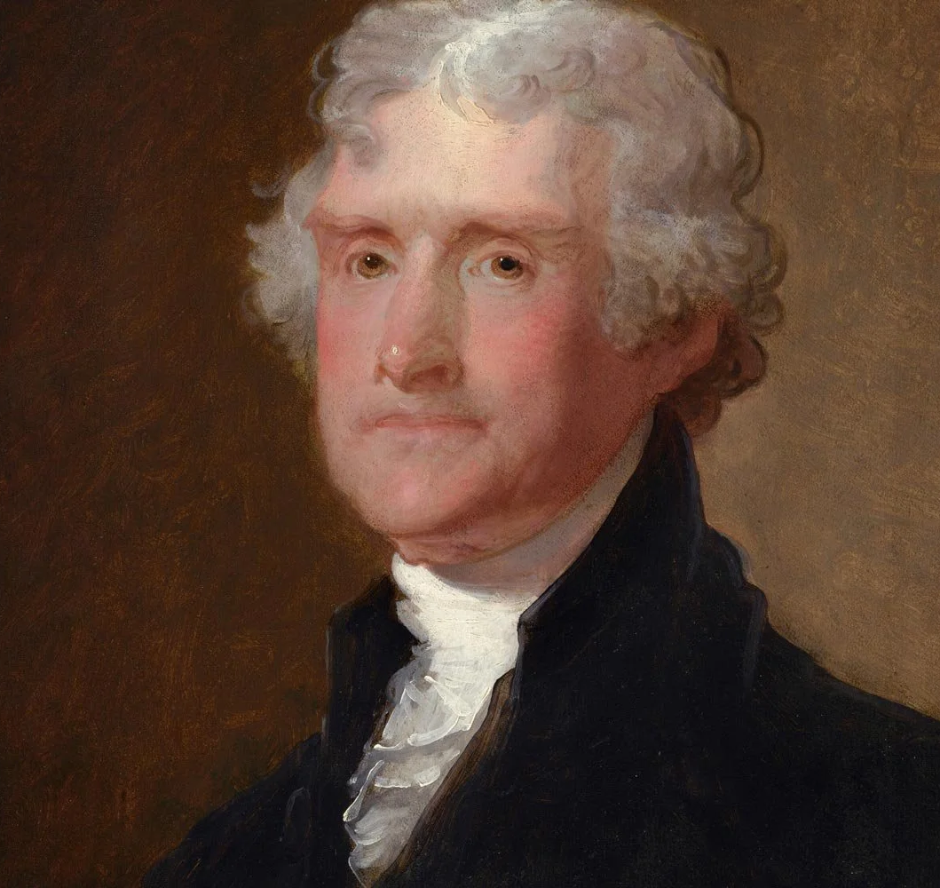
Who Wrote the Declaration
Written mainly by Thomas Jefferson
Edited and approved by the Continental Congress
Influenced by Enlightenment ideas like natural rights

Slide 7
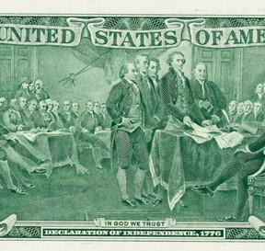
Core Idea: Natural Rights
All people are born with natural rights
Life, Liberty, and the pursuit of happiness
Governments exist to protect these rights
People may change governments that fail

Slide 8
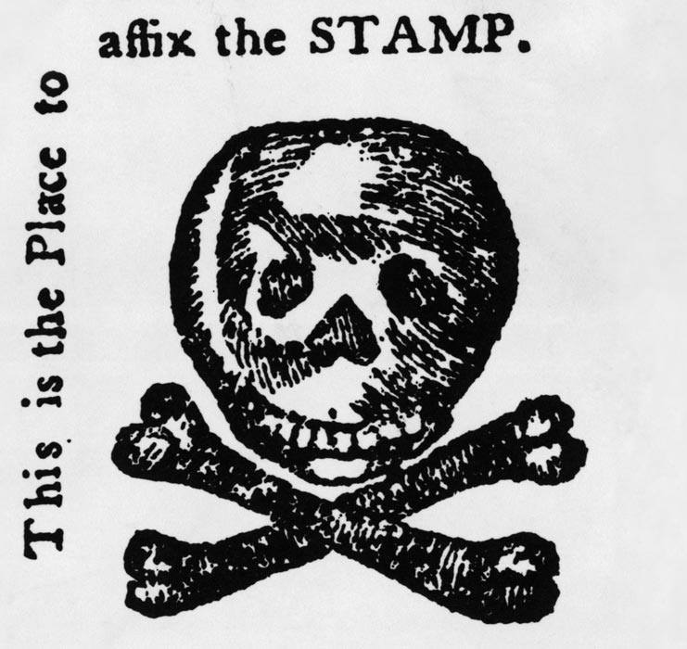
Complaints Against the King
Taxation without representation
British soldiers in colonial cities
Laws passed without colonial consent
Interference with self-government

Slide 9
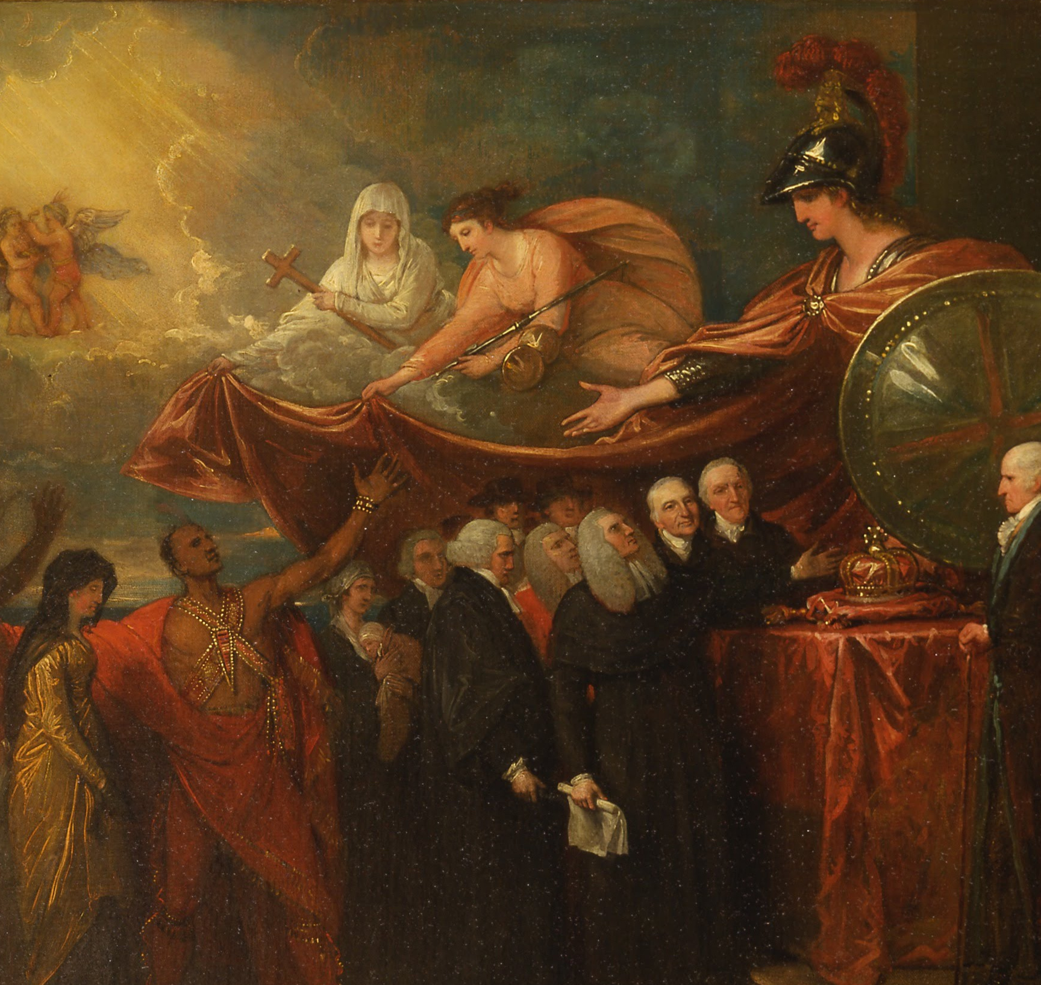
Loyalist Perspective
Believed problems could be solved peacefully
Feared war and instability
Thought rebellion was dangerous

Slide 10
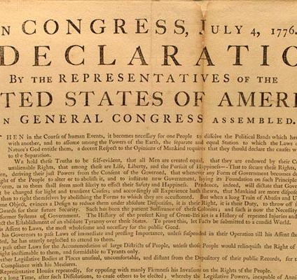
What the Declaration Did
Announced independence from Britain
United the colonies
Encouraged foreign support

Slide 11
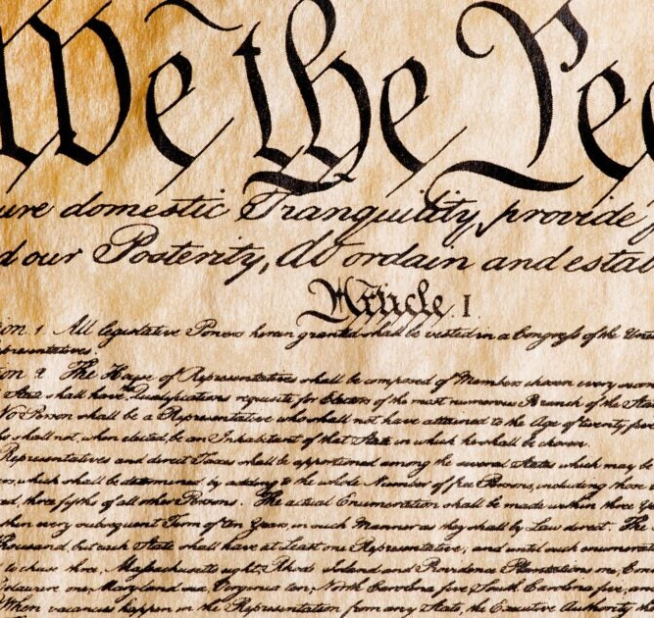
Long-Term Importance
Inspired democratic movements worldwide
Influenced the Constitution and Bill of Rights
Remains a symbol of freedom

Slide 12
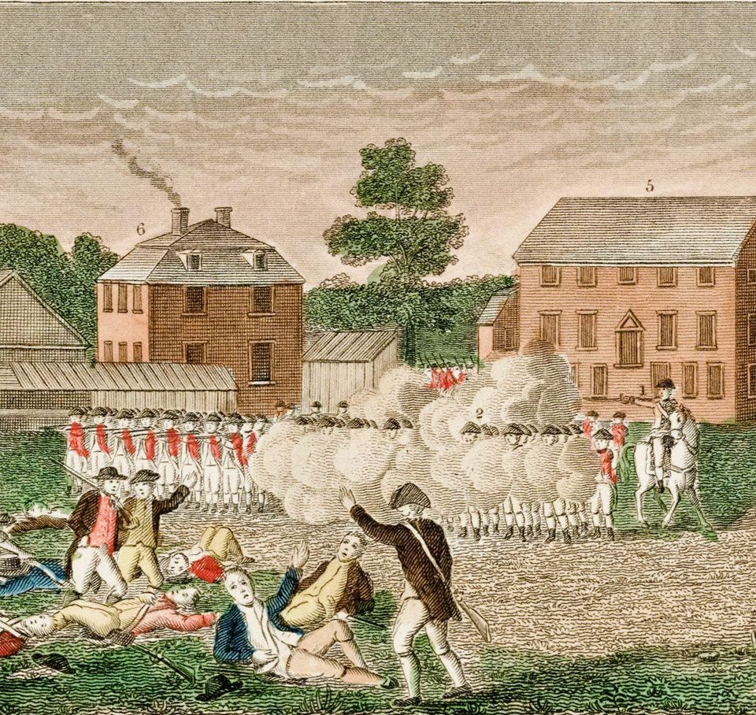
A Divided Society
Not all colonists supported independence
Loyalists faced punishment or exile
The Revolution was also a civil conflict

Slide 13
From Words to a Nation
The Declaration explained why independence was necessary
Ideas and arguments fueled the Revolution
Its impact continues today

