Slide 1
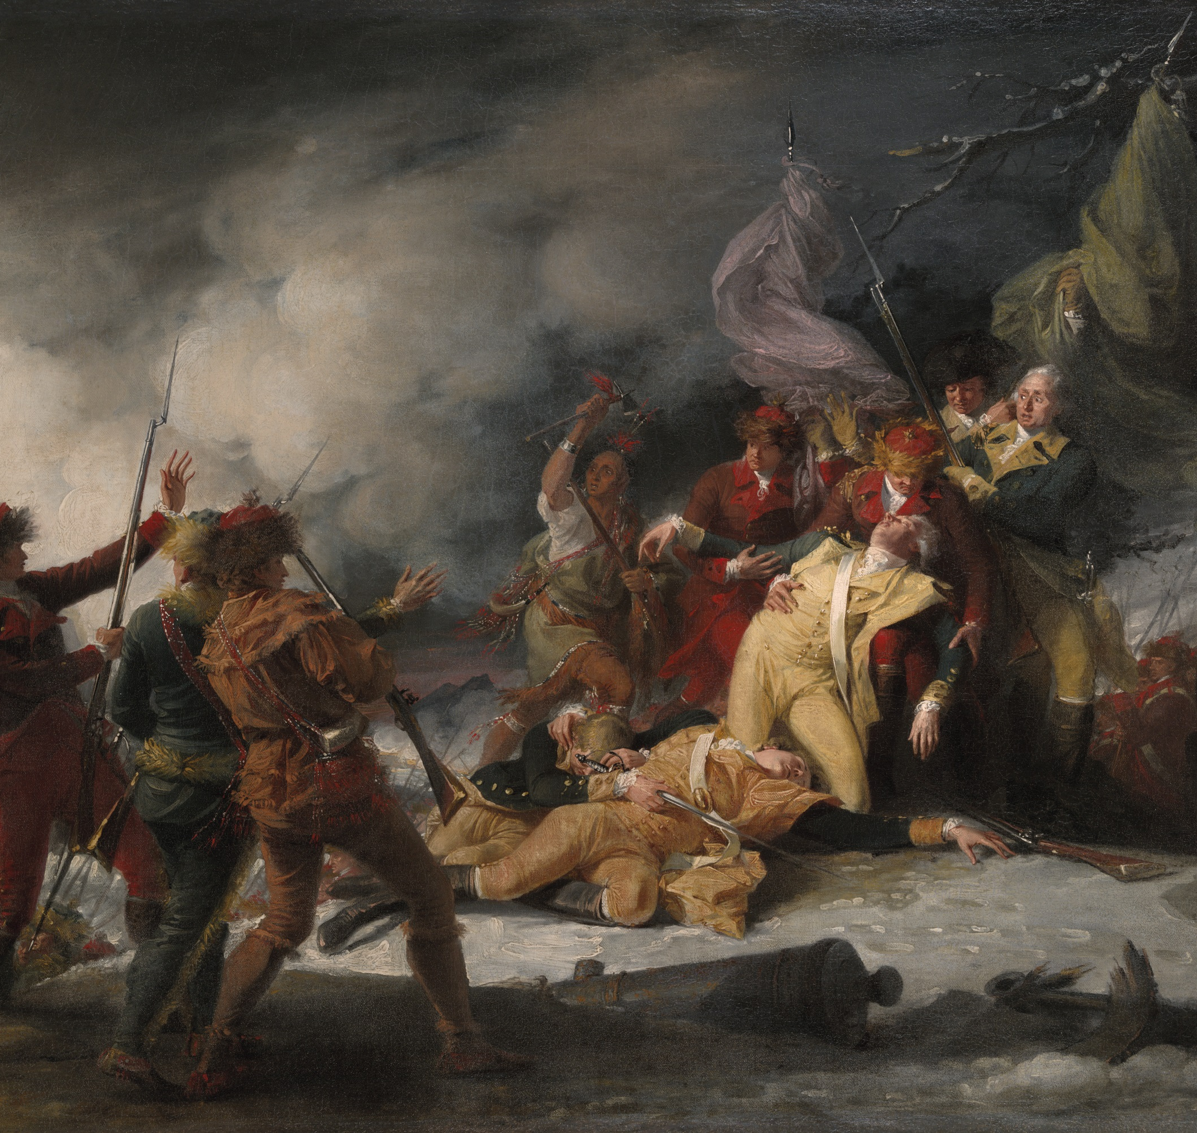
Benedict Arnold and the Near Conquest of Canada
A Revolutionary War Sub-Plot

Slide 2
What Is a Sub-Plot?
A sub-plot is a smaller story within a larger conflict
It runs alongside the main events of a war
Arnold’s invasion of Canada was one such sub-plot

Slide 3
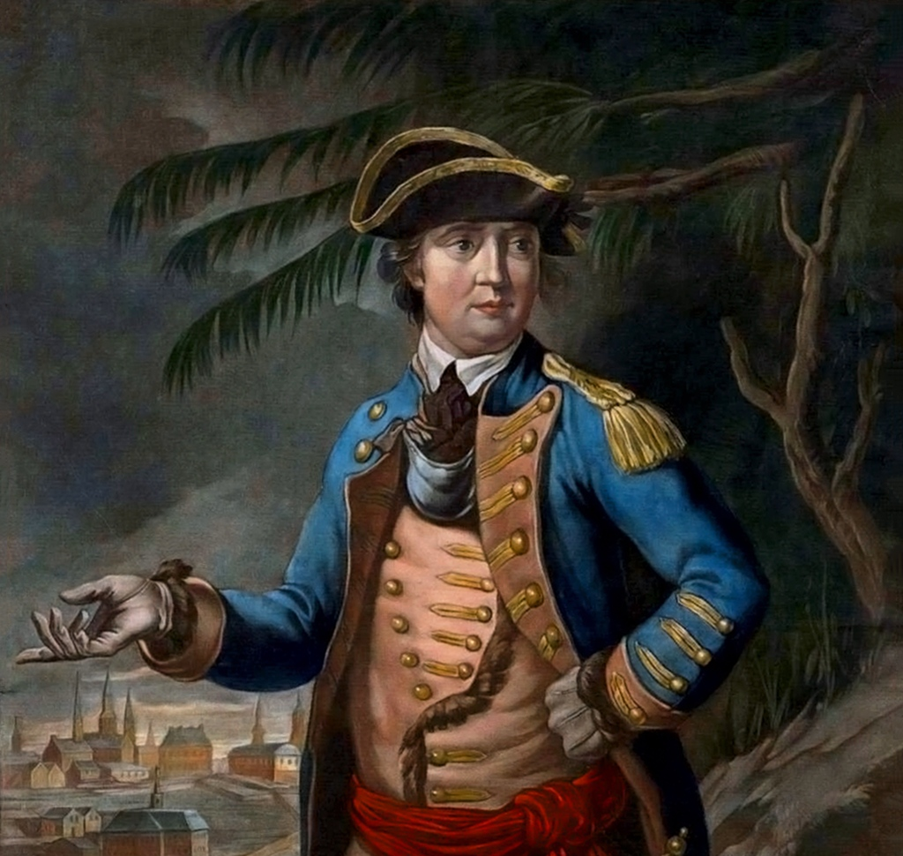
Benedict Arnold Before Betrayal
Best known today for later betraying the American cause
Earlier served as a bold Patriot officer
Led dangerous missions for the Continental Army

Slide 4
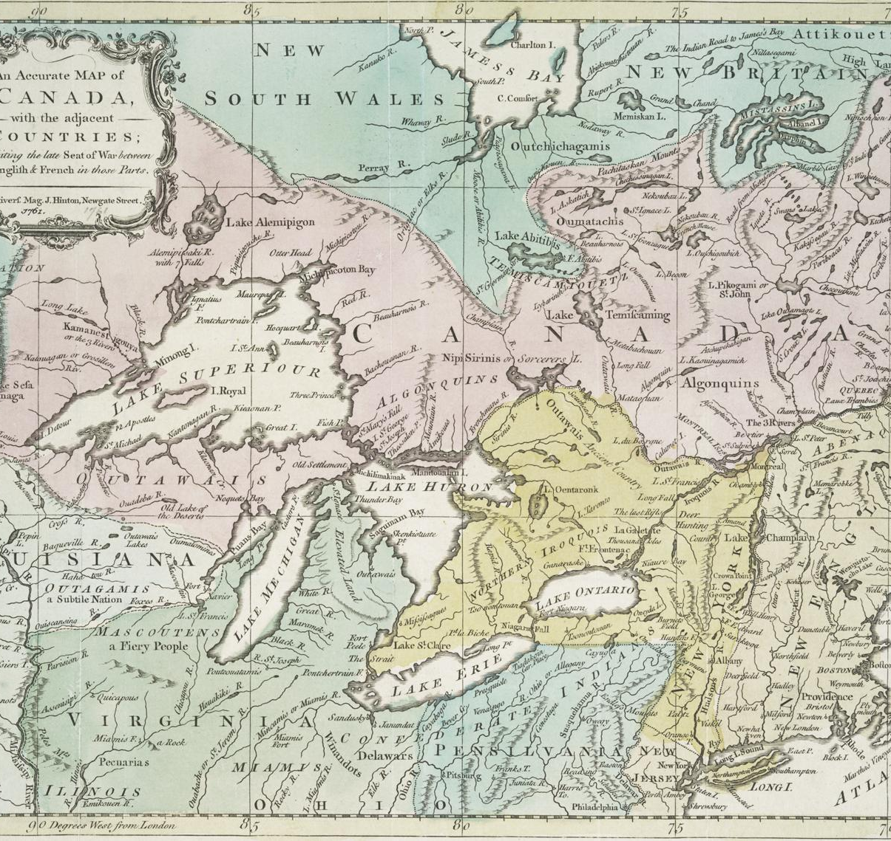
Why Invade Canada?
Canada was controlled by the British
British could attack the colonies from the north
Arnold hoped French Canadians would support independence

Slide 5
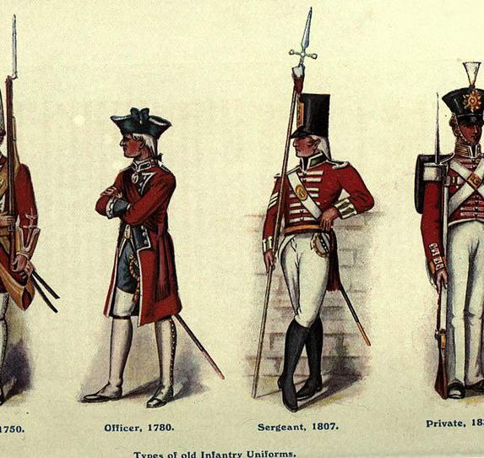
Weak British Defenses
Only about 775 British troops in all of Canada
Fewer than 300 stationed in Quebec
Invasion seemed possible

Slide 6
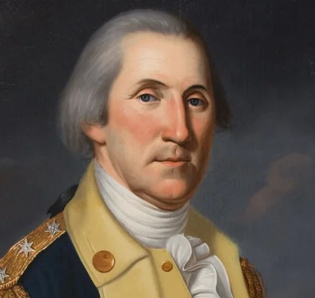
Washington Approves the Mission
Arnold requested permission in 1775
George Washington approved the plan
Two American forces were sent north

Slide 7
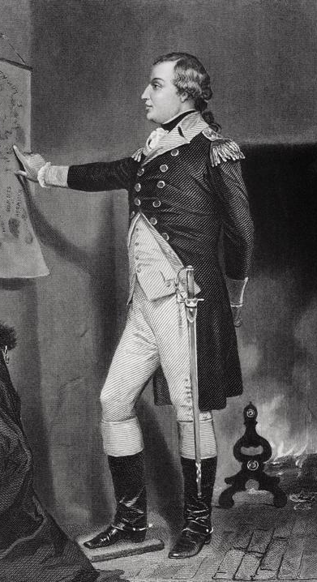
The Two-Pronged Attack
Richard Montgomery led troops to Montreal
Arnold led 1,050 men through Maine
Goal was to capture Quebec City

Slide 8
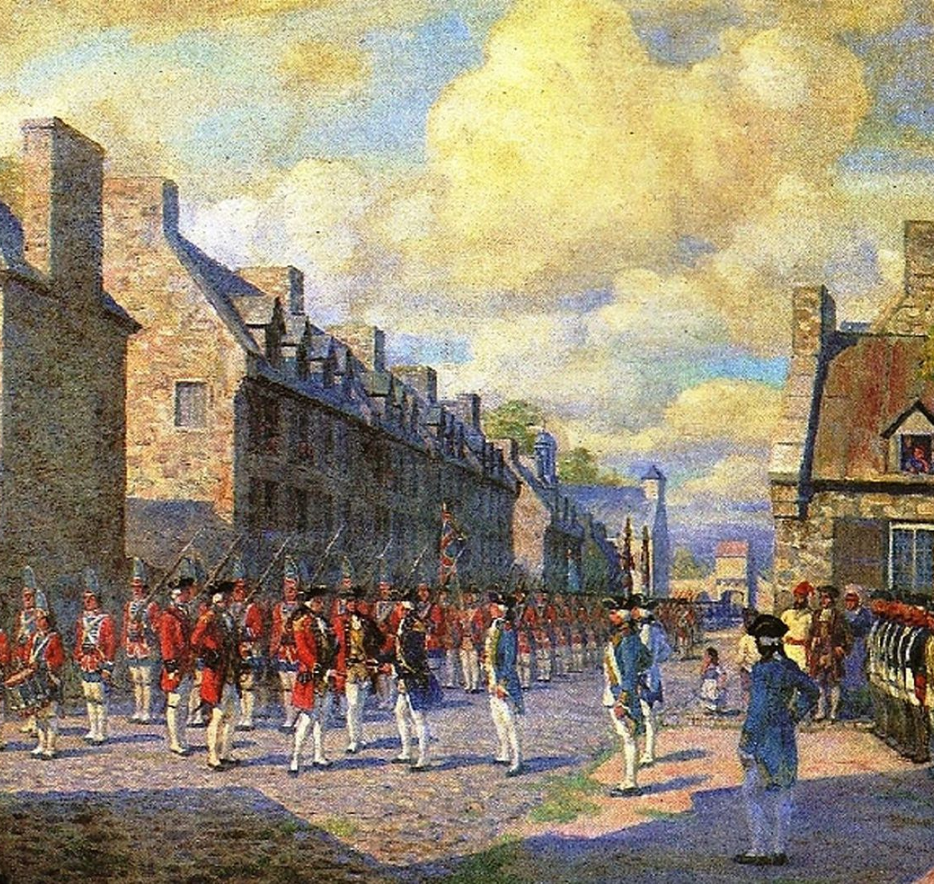
Early Success
Montgomery successfully captured Montreal
Arnold continued toward Quebec
Canada could have joined the American cause

Slide 9

Major Logistical Problems
Departure delayed due to pay problems
Maps were inaccurate
Journey took much longer than expected

Slide 10
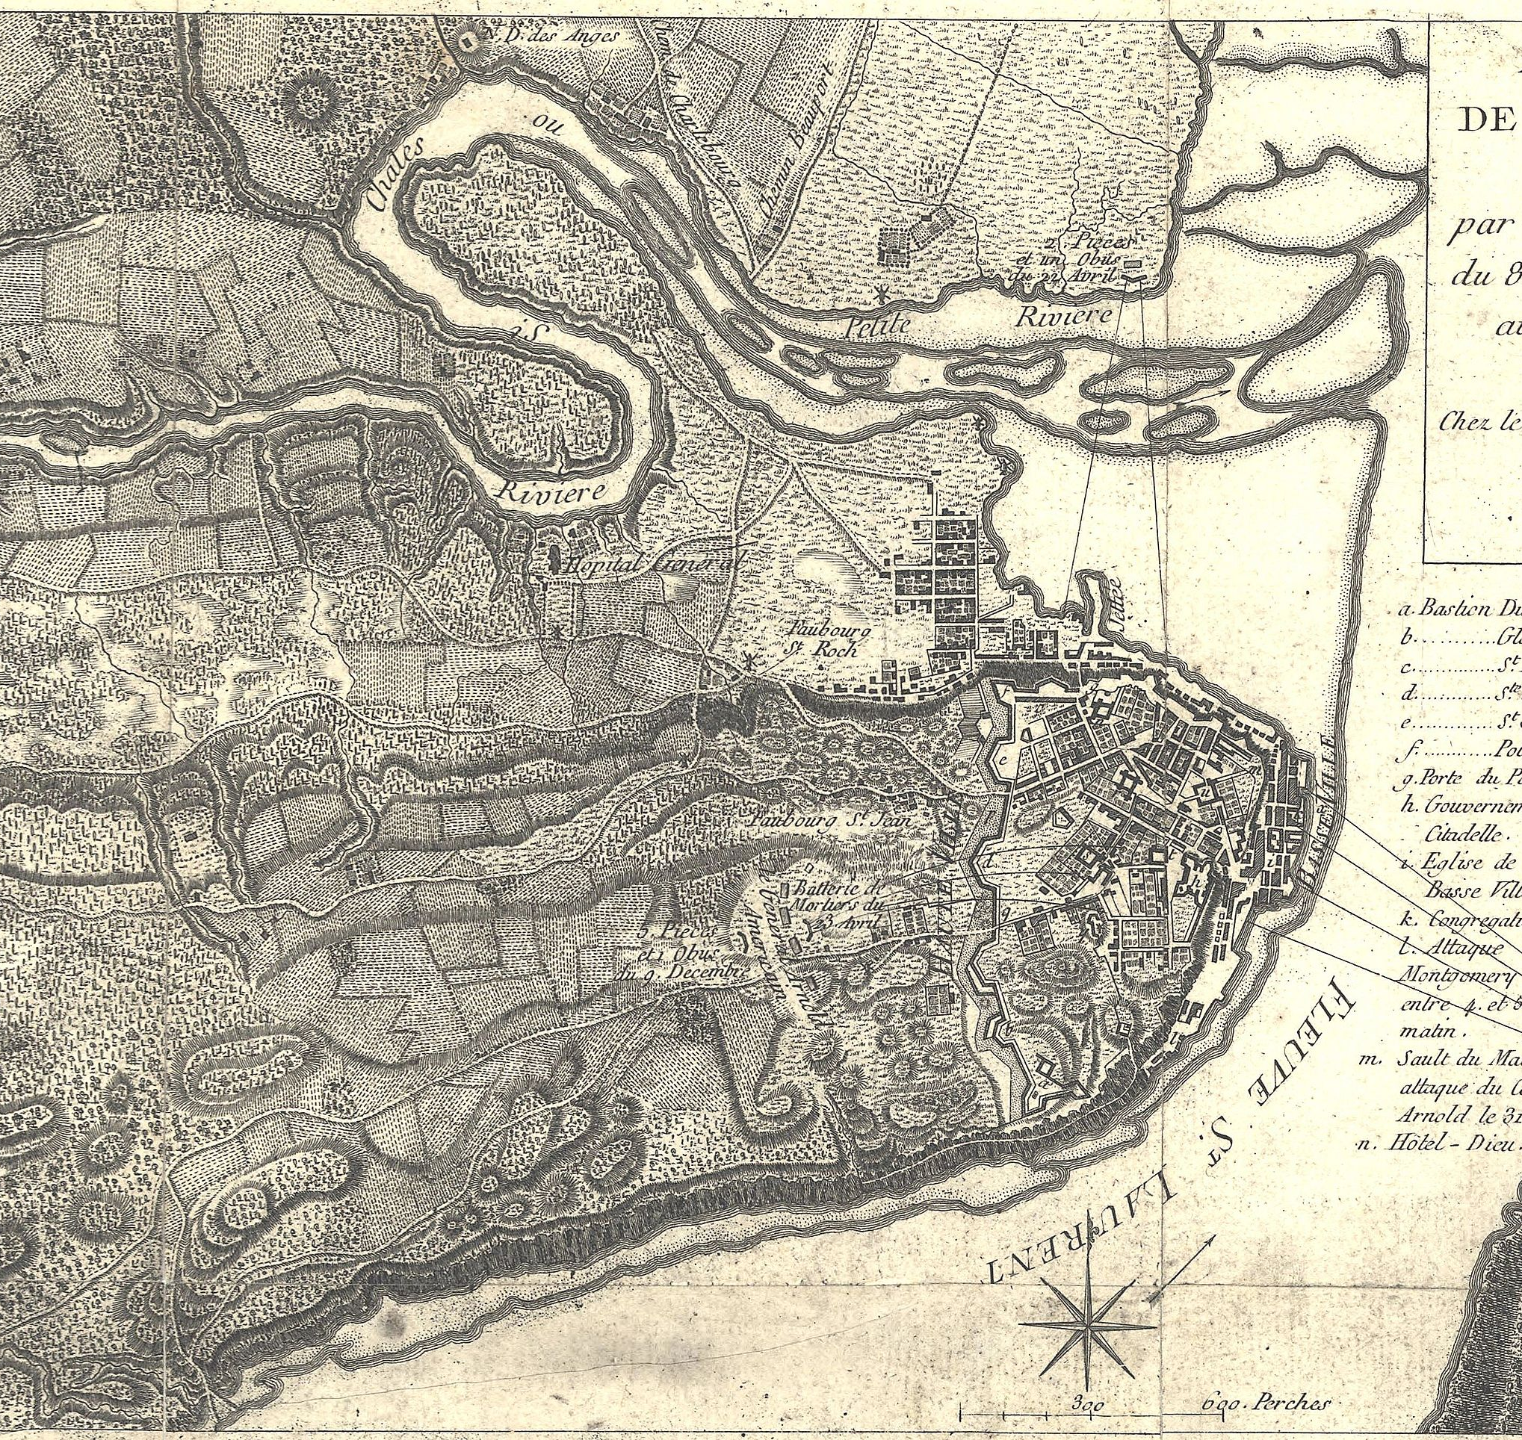
Sabotage and Disaster
Shipbuilder was a British sympathizer
Boats were sabotaged
Supplies sank in icy rivers

Slide 11
More Hardships
A hurricane destroyed remaining supplies
Soldiers deserted
Many suffered from dysentery

Slide 12
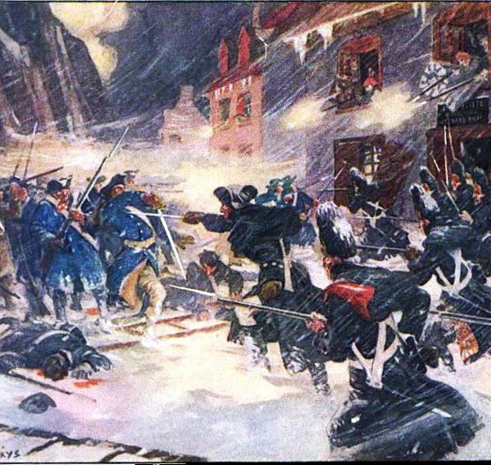
Reaching Canada
Arnold arrived in November 1775
Only 675 starving soldiers remained
Little food or equipment

Slide 13
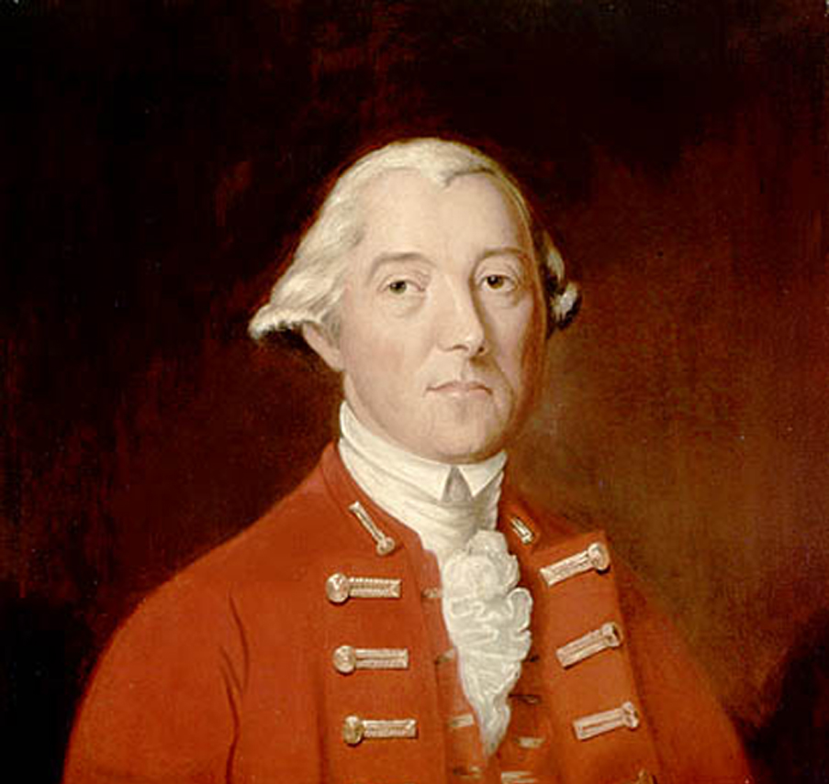
British Prepared
Sir Guy Carleton knew of the invasion
British reinforcements arrived in Quebec
City was well defended

Slide 14
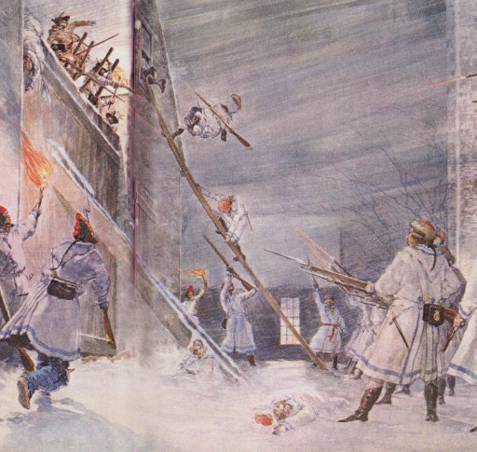
Attack on Quebec
Arnold waited for reinforcements
Attacked on New Year’s Eve, 1775
Attempted to seize the city

Slide 15
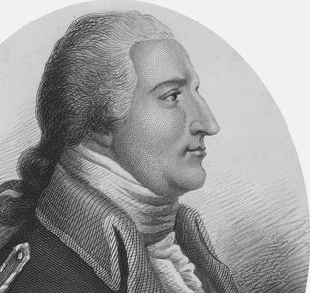
Disaster at Quebec
Fewer than 100 of 300 soldiers escaped
Arnold was shot in the leg
Had to be carried from the battlefield

Slide 16
Holding On
Arnold continued commanding despite injury
Used one cannon to appear stronger
Maintained pressure on Quebec

Slide 17
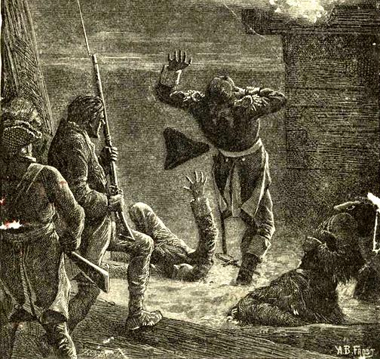
A Failed Siege
Reinforcements arrived in spring 1776
Americans blockaded the city
British fleet arrived in May

Slide 18

Retreat from Canada
British naval power forced retreat
American invasion failed
Forces withdrew

Slide 19
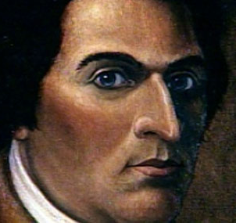
Growing Disenchantment
Arnold passed over for promotion
Felt underappreciated
Resentment increased

Slide 20
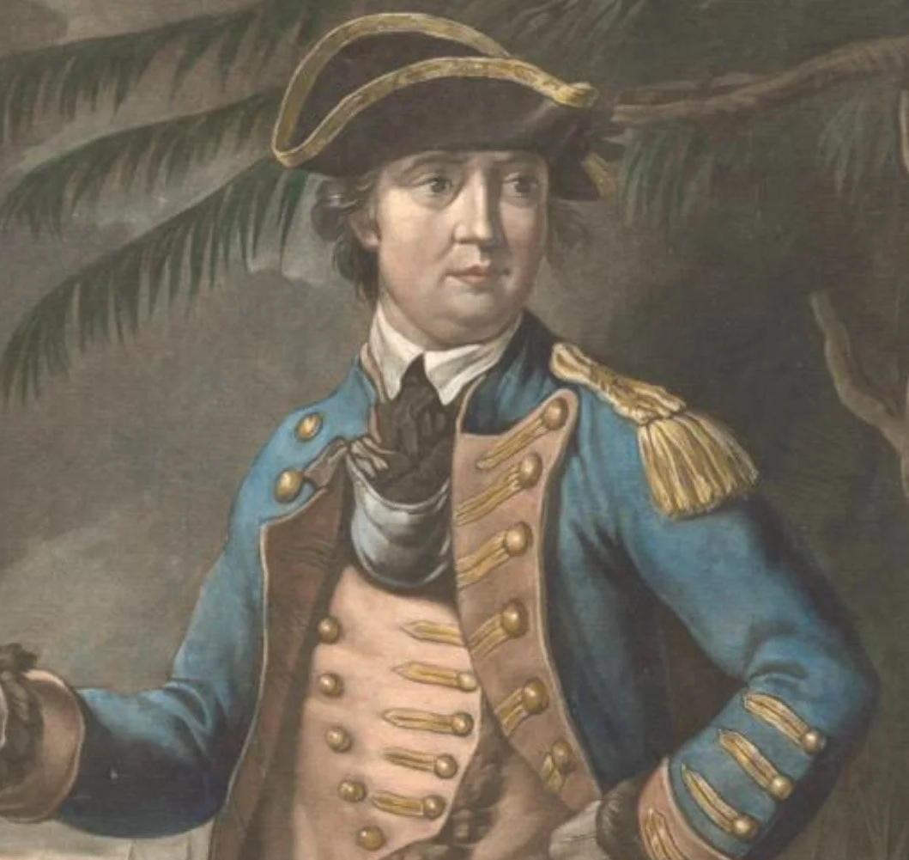
Why This Sub-Plot Matters
Nearly changed the course of the war
Showed limits of American power
Helped lead to Arnold’s later betrayal

