Slide 1
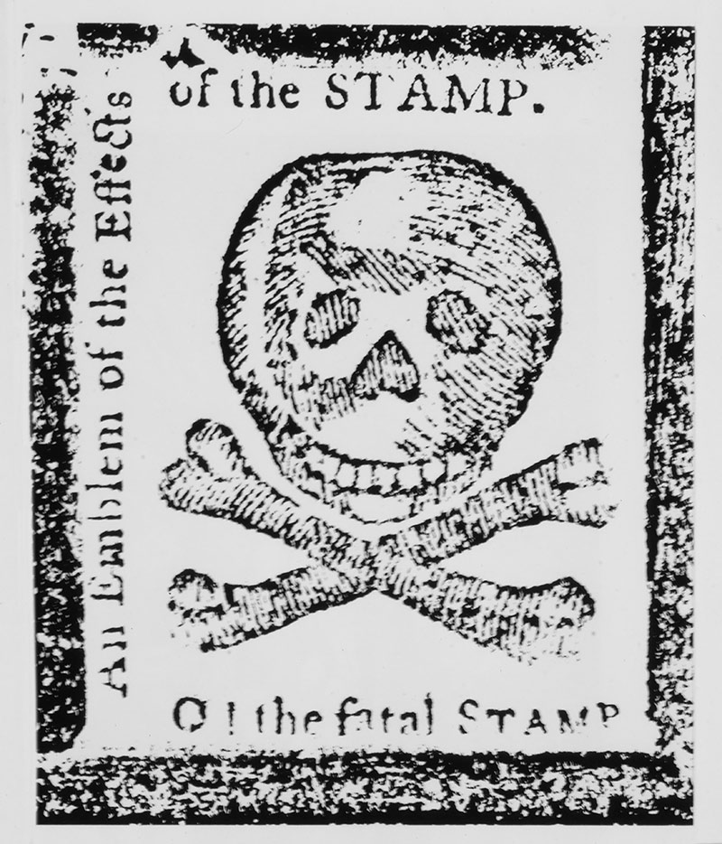

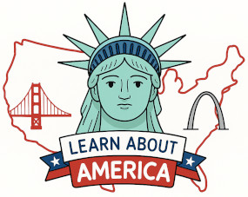
The American Revolution Series
Causes:
The Stamp Act and No Taxation without Representation

Slide 2

LearnAboutAmerica.com
*For our presentations, lesson plans, articles, printables, interactives, stories, and games related to the Stamp Act, please visit:
https://learnaboutamerica.com/american-history/revolutionary-war/causes-of-the-revolutionary-war/stamp-act
* For the greatest American History website for teachers, parents, and students, visit:
https://learnaboutamerica.com

Slide 3
What is a revolution?
The process in which a government is overthrown and a new government takes over.

Slide 4
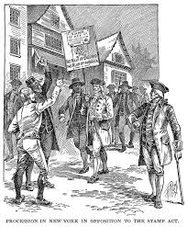
What is the American Revolution?
The process in which America became a free country by breaking away from Great Britain

Slide 5
When did the American Revolution happen?
It started in 1775 and was completed in 1783 after the Revolutionary War.
1775 - 1783

Slide 6
Why did the American Revolution happen?
There were several major causes of the revolution. A cause is a reason something happens. We’ll start in 1763.

Slide 7
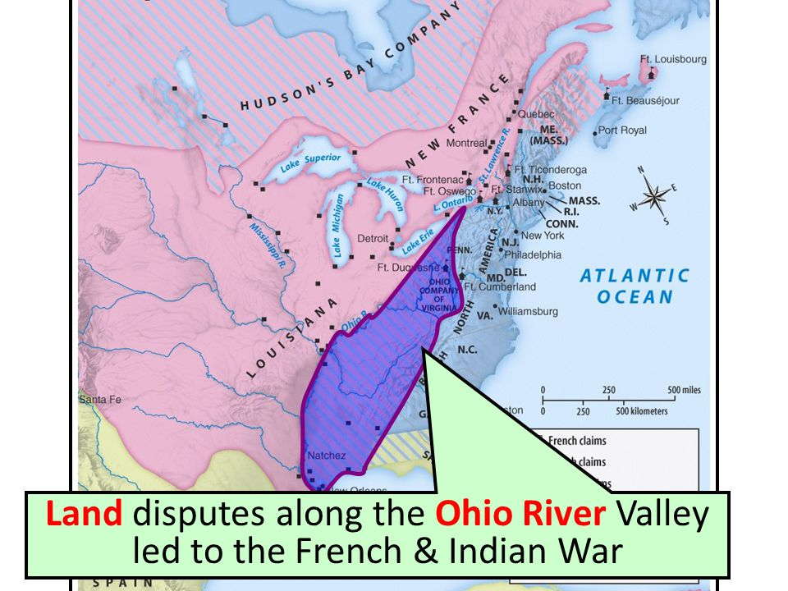
1763 – French and Indian War
This war was fought between the English and French over control of the Ohio River Valley in America.
The English won the war and control over the
Ohio River Valley.

Slide 8
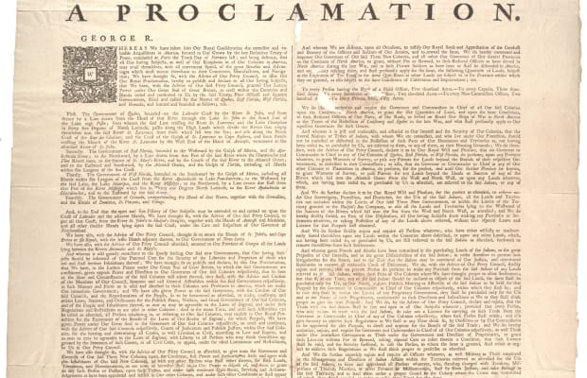
1763 – Proclamation of 1763
Surprisingly, Parliament (the English government) refused to let Americans settle the Ohio River Valley.
This led to conflict and the Americans largely
ignored the Proclamation of 1763.
That said, in the minds of the Americans,
England was taking steps to try to control them.

Slide 9
The French and Indian War was expensive for Parliament!
How do you think it tried to recover the money it spent fighting the war?

Slide 10
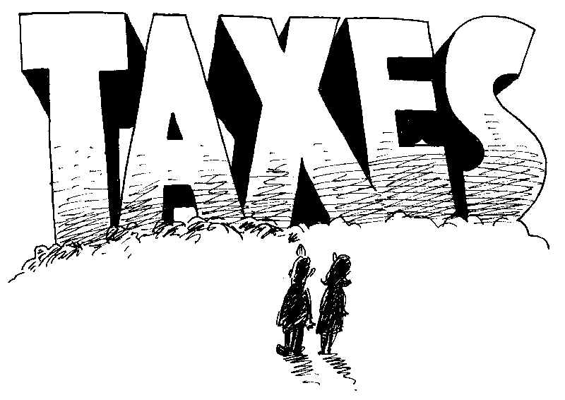

Slide 11

What are taxes?
Taxes are fees paid by individuals or companies to a government for buying a product or for conducting business.

Slide 12
Taxes
Taxes have existed since the start of American history.
Current taxes:
Income tax
Real estate tax
Personal Property tax (in Virginia)
Sales tax
Many others

Slide 13
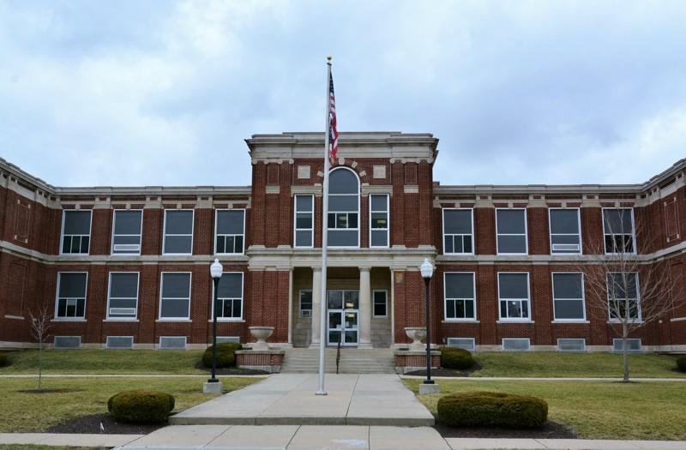
Taxes
Today, the government uses tax money collected from citizens for:
Schools
Maintaining Roads and Highways
For Government Services
Health Care Programs

Slide 14
STAMP ACT - 1765
Parliament began issuing taxes against the Americans.
The most famous was called the STAMP ACT.

Slide 15
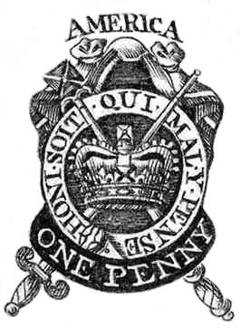
STAMP ACT - 1765
The Stamp Act required Americans to buy a tax “stamp” when they bought printed items such as:
Newspapers
Magazines
Playing Cards
Marriage Licenses

Slide 16
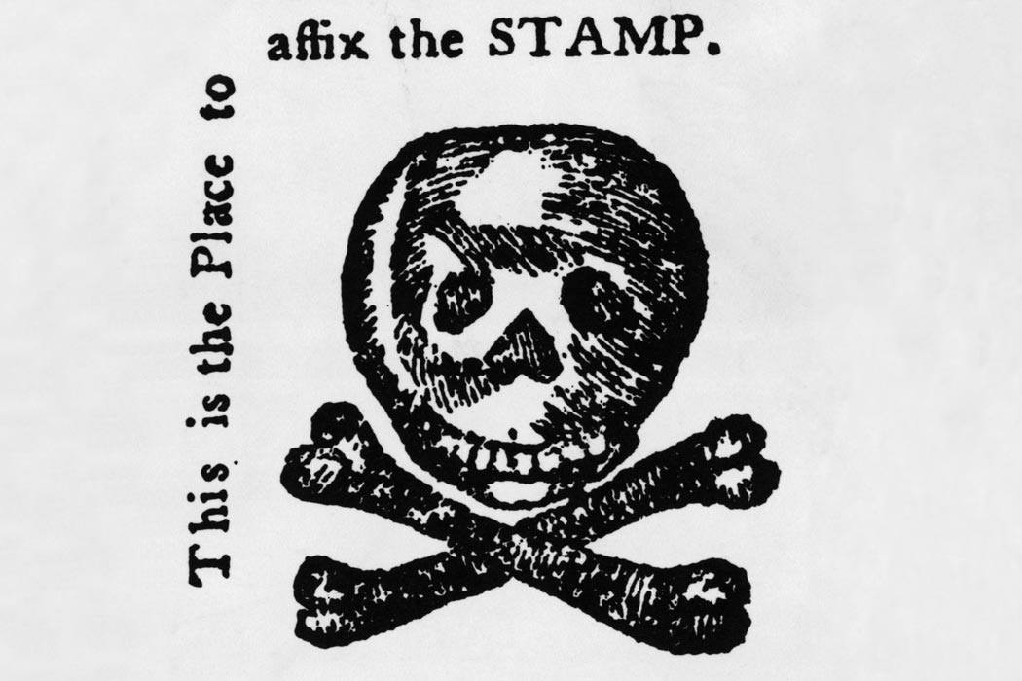
What was the effect of the Stamp Act?
Colonists were enraged
The Sons of Liberty formed
“No Taxation without Representation” became a motto
Tax collectors were intimidated and tortured.

Slide 17
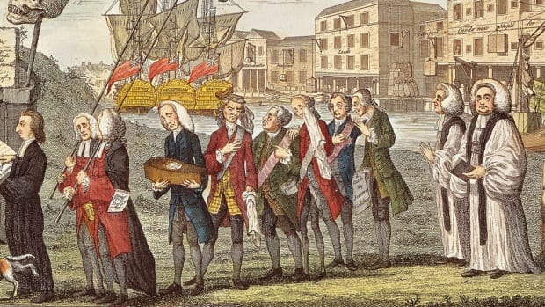
Who were the Sons of Liberty?
The Sons of Liberty were a group of men in Boston and New York who used the threat of intimidation and violence to protect the rights of Americans against the laws and taxes issued by Parliament.

Slide 18
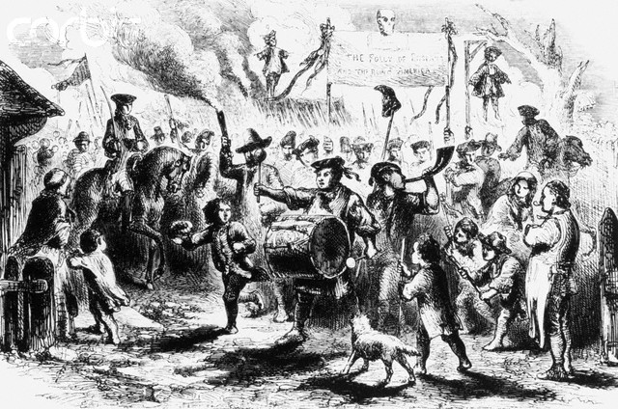
What was NO Taxation Without Representation?
Because Americans were NOT represented in Parliament, the stamp tax was forced upon them without their consent. Without representation in Parliament, many refused to pay the tax because it wasn’t fair.

Slide 19
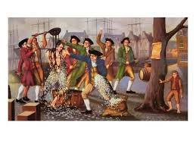
Tarring and Feathering
In Boston, the Sons of Liberty used violence to intimidate British tax collectors. Some were tarred and feathered, which wasn’t deadly, but extremely painful and embarrassing.

Slide 20
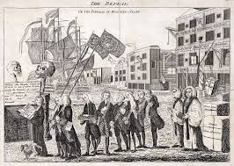
What did Parliament do?
Boston was in chaos. Parliament failed to foresee such problems. As a result, it repealed (took away) the Stamp Act and issued the Declaratory Act, which reaffirmed its right to issue any law or tax in America.

Slide 21
Follow-up
The above icon is known as the Emblem of the Effect of the Stamp. It was a symbol meant to represent American feelings toward the Stamp Act. It basically says “you can put the stamp on our dead bodies!” Design a “Stamp” that you can use to protest too much homework or not enough recess.
https://www.mrnussbaum.com/protesting-the-stamp-act-printable/

