Slide 1


The American Revolution
Documents and Publications

Slide 2
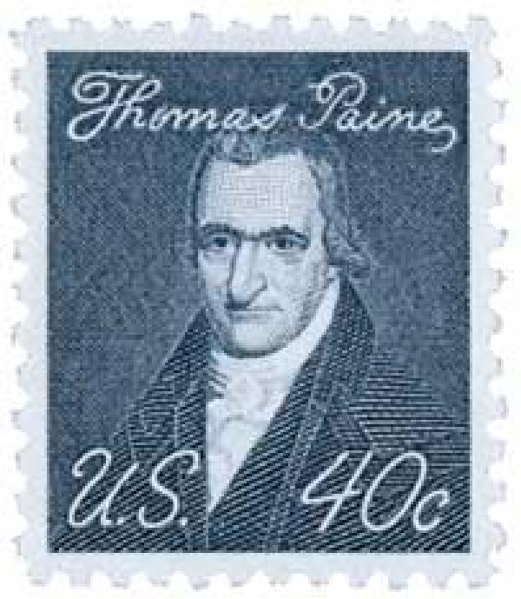
January 10, 1776
Thomas Paine published Common Sense, a pamphlet that outlined the reasons (both political and moral) that the American public should support the quest for independence. The powerfully written pamphlet was very influential.

Slide 3
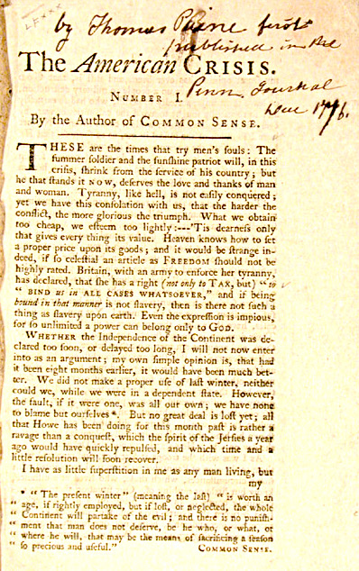
1776 - 1783
Thomas Paine published the Crisis, a series of 16 pamphlets meant to inspire the quest for independence. Below is a timeless quote from one of the pamphlets:
“These are the times that try men's souls: The summer soldier and the sunshine patriot will, in this crisis, shrink from the service of his country; but he that stands it now, deserves the love and thanks of man and woman.”

Slide 4
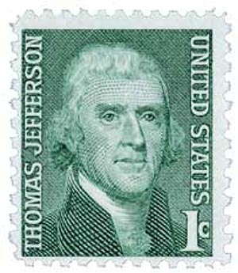
June 7, 1776
On June 7, 1776, the Second Continental Congress authorized the drafting of a document detailing its reasons for seeking independence from England.
Thomas Jefferson was chosen to write the document with help from four others. Together they were referred to as “The Committee of Five.”

Slide 5
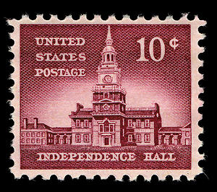
The Committee of Five
Thomas Jefferson
Benjamin Franklin
John Adams
Roger Sherman
Robert Livingston
Independence Hall in Philadelphia was the
site of adoption of the Declaration of Independence

Slide 6
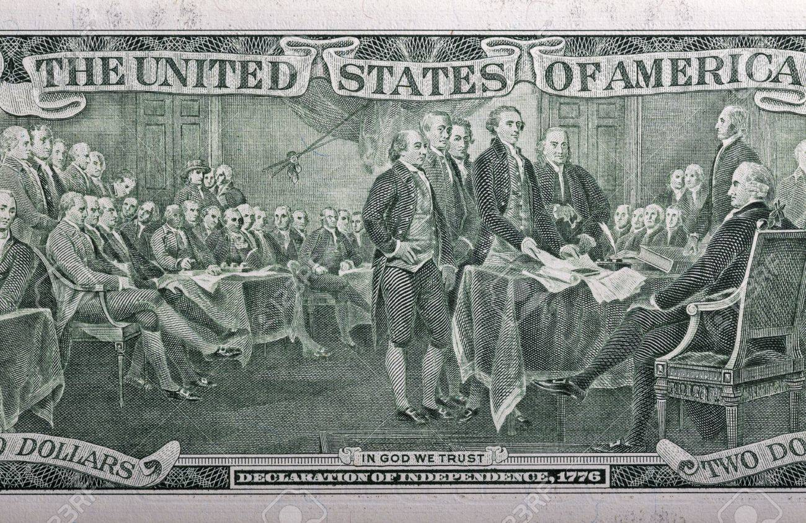
Declaration of Independence
Thomas Jefferson was the primary author and drafted the declaration in a single day.
Congress accepted the draft and made many changes.
It officially adopted the actual declaration on July 4th, 1776
A declaration is a statement or announcement

Slide 7
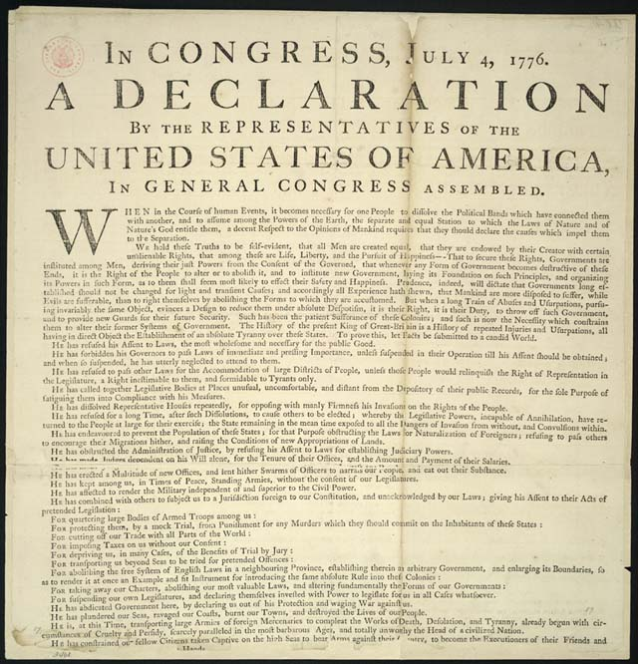
Declaration of Independence
Its primary purpose was to explain to the nations of the world reasons why America was seeking independence from England.
It Remains perhaps the most important document in American history. During World War II, it was hidden away at Fort Knox!

Slide 8
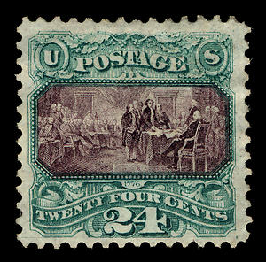
What did it say?
People have the DUTY to change government if that government tries to rule without having permission of the people (consent).
People have certain unalienable rights such as life, liberty, and the pursuit of happiness.
Unalienable rights are those that cannot be
taken away

Slide 9
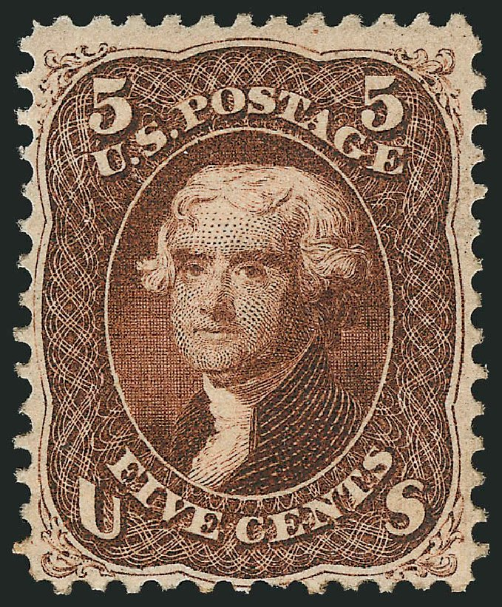
Hypocrisy?
Slaves, however, were denied “unalienable rights.” How is that possible when the Declaration of Independence claims all people are entitled to these?
Slavery supporters considered slaves PROPERTY before they considered them humans.
Thomas Jefferson owned up to 200 slaves.
Unalienable rights are those that cannot be
taken away

Slide 10
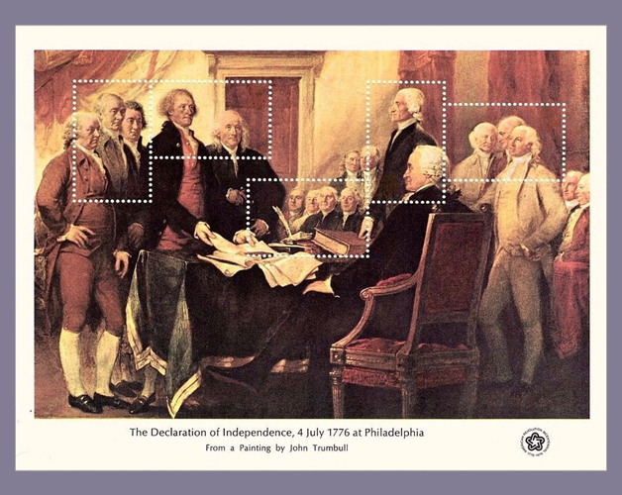
Facts about the Declaration of Independence
56 delegates from the Second Continental Congress signed it.
John Hancock, president of the convention, signed first. His iconic signature was by far the largest. He said he wanted the King to see it without his “spectacles.”
Eight signers were born in England.
An original copy was discovered behind in old picture in a frame in a Pennsylvania flea market in 1989. It cost $4 at the time, but was sold for $8.1 million!

Slide 11
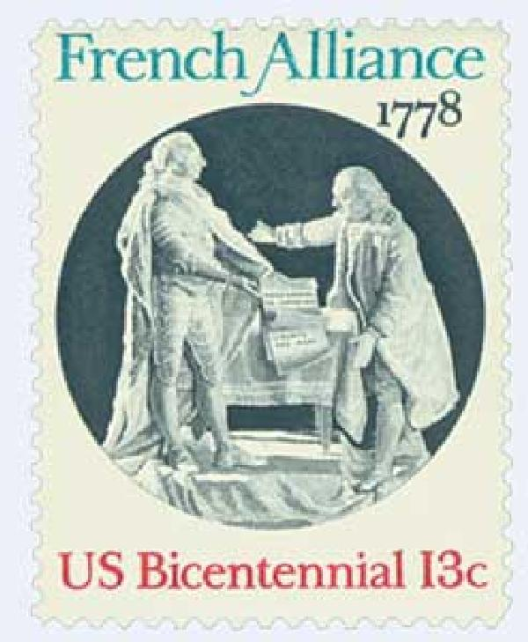
Treaty of Alliance - 1778
In 1778, France and America signed the Treaty of Alliance after France recognized America as an independent nation. It joined the war effort against England and sent money, supplies, weapons, soldiers, and military officers.
France wanted revenge for its defeat in the French and Indian War and its subsequent loss of land in North America.
Originally, the treaty was supposed to bond France and America indefinitely (there was no end).

Slide 12
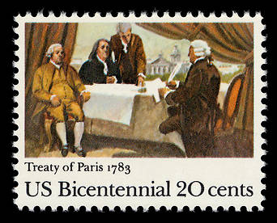
Treaty of Paris - 1783
On September 3, 1783, England and the United States signed the Treaty of Paris, effectively ending the Revolutionary War, and acknowledging the United States as an independent nation.
The treaty also set the boundaries of the United States and the English empire in North America. It also stipulated that all prisoners of war were to be released (among other things)
The treaty was negotiated by Benjamin Franklin, John Adams and others. It was signed in Paris, France.

Slide 13
Follow up Activity 1
In the Declaration of Independence, Thomas Jefferson asserts that all men have the right to life, liberty, and the pursuit of happiness. He called these “unalienable” rights – meaning they cannot be taken away. Recently, there has been debate over whether or not teachers should be able to take recess away from students for various reasons. Do you think recess is an “unalienable” right of students in elementary school? Why or why not? Give specific reasons.
https://www.mrnussbaum.com/is-recess-an-unalienable-right/

Slide 14
Follow up Activity 2
John Hancock’s signature on the Declaration of Independence is perhaps the most iconic signature in American history. What if you had one chance to make your signature known to the world. Design your signature and make it as “iconic” as possible.
https://www.mrnussbaum.com/john-hancocks-signature/

