Slide 1
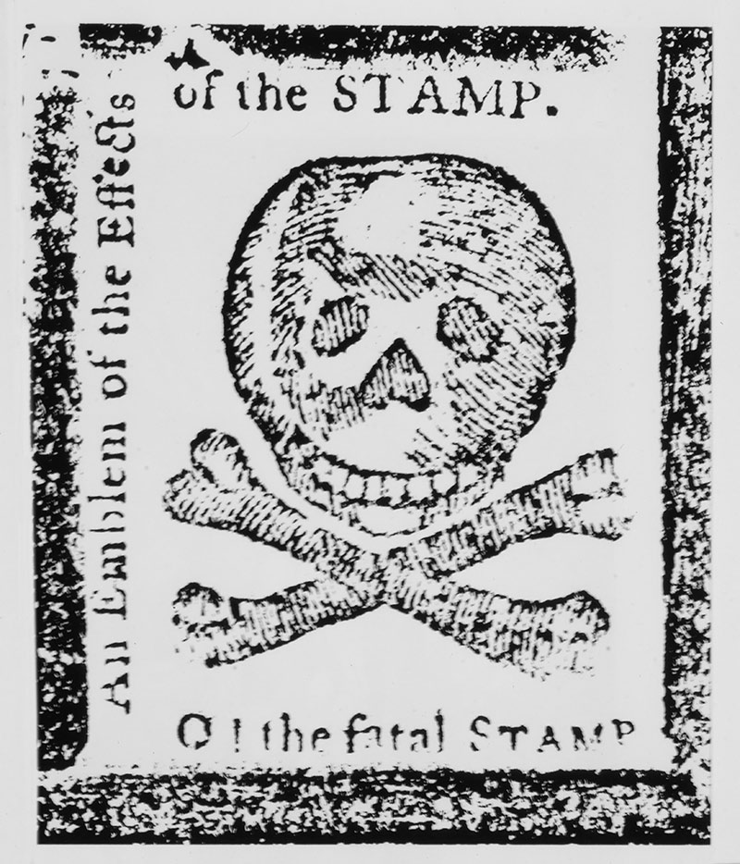


The American Revolution Series
Causes:
Boston Tea Party and the Intolerable Acts

Slide 2
LearnAboutAmerica.com
*For our presentations, lesson plans, articles, printables, interactives, stories, and games related to the Boston Tea Party, please visit:
https://learnaboutamerica.com/american-history/revolutionary-war/causes-of-the-revolutionary-war/boston-tea-party
* For the greatest American History website for teachers, parents, and students, visit:
https://learnaboutamerica.com

Slide 3
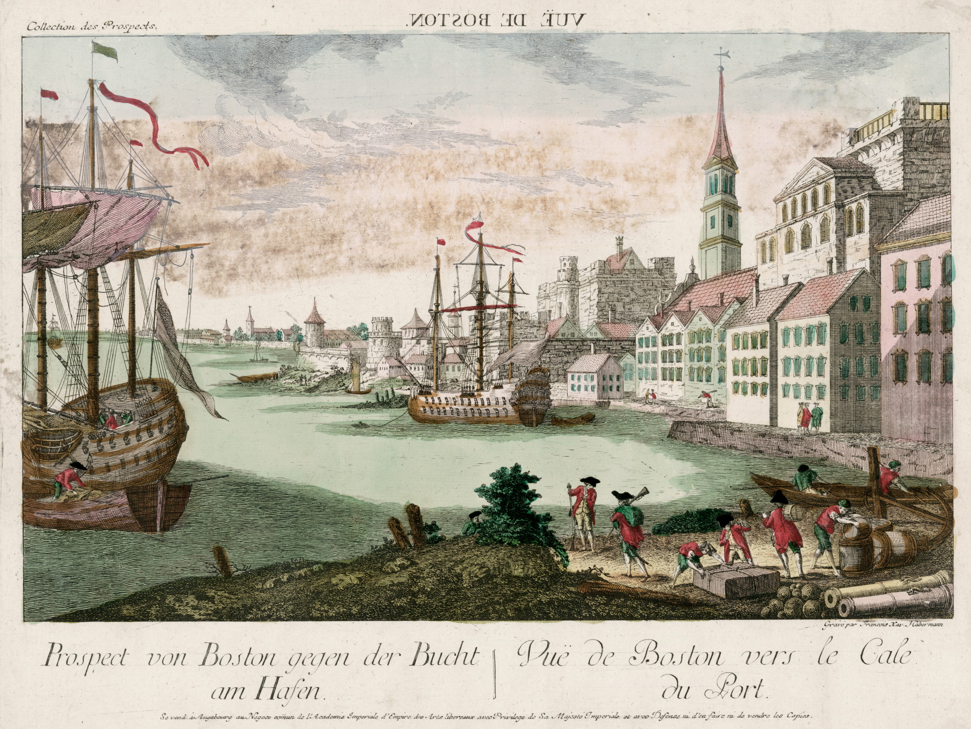
1773
Peace had reigned in Boston since the Boston Massacre in 1770. In 1773, however…

Slide 4
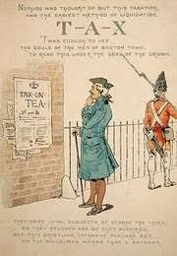
1773
Parliament issued the Tea Act.
The Tea Act granted the East
India Company (an English
company) a monopoly over the American tea trade.

Slide 5
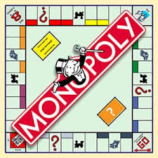
1773
What is a monopoly?
A situation in which a single company controls the entire supply of a product or products.

Slide 6
1773
Why is a monopoly bad?
Provides only a single option for consumers
A lack of competition discourages innovation
Prices can become too high and supply too low

Slide 7

1773
Why did the East India Company Get a Monopoly?
Parliament wanted to help the struggling company survive
Parliament wanted to make the price of tea low enough to stop illegal smugglers who brought Dutch tea to America.
Smuggling – Illegally bringing goods into or out of a country

Slide 8
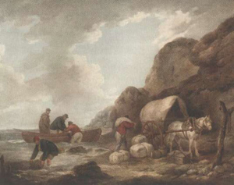
1773
What did the Americans think?
Opposition was “universal”
Parliament was purposefully interfering in American business.
Americans were angry as their own tea merchants were put out of business, as were smugglers.
Smuggling – Illegally bringing goods into or out of a country

Slide 9
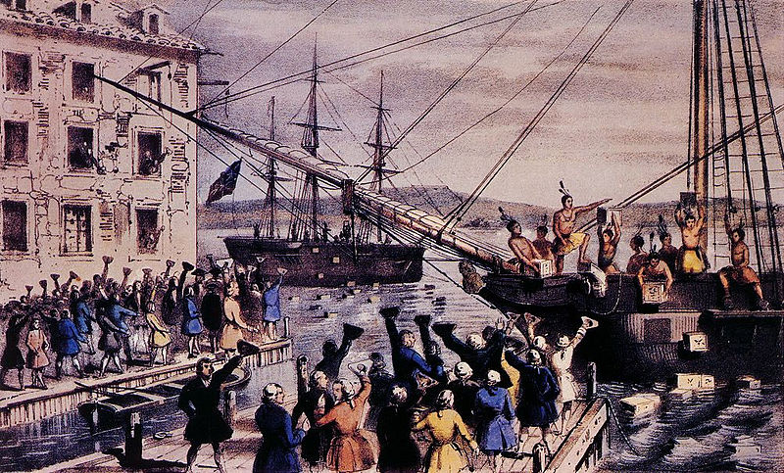
Boston Tea Party - 1773
What did the Americans do?
- To show opposition to the Tea Act, the Sons of Liberty staged an event called “the Destruction of the Tea,” now called the Boston Tea Party.
- December 16, 1773
More than 100 men, dressed as Mohawk Indians, boarded the British tea ship Dartmouth and threw its entire load of tea, 342 chests (92,000 pounds) into Boston Harbor. It was worth an estimated $2 million in today’s dollars.

Slide 10
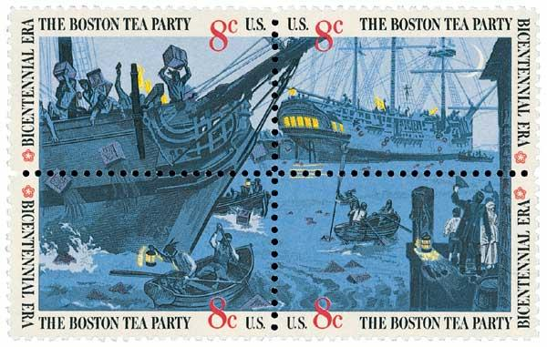
Boston Tea Party - 1773
Interesting Facts
- The event was carefully planned
- There were no injuries
- Other than the tea, the only reported damage was to a single padlock, which was replaced by the Sons of Liberty
- Participants in the “tea party” were prohibited from damaging any private property by the Sons of Liberty. After the tea party, the decks of the ship were swept clean.

Slide 11
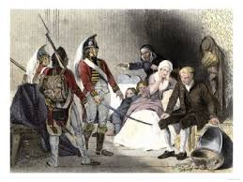
Boston Tea Party - 1773
The British Response
- Parliament was furious.
- Issued a set of five “acts” known as the Intolerable Acts, or, the Coercive Acts.
- The Intolerable Acts were issued to punish Americans.

Slide 12
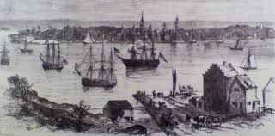
Intolerable Acts
Boston Harbor Bill – Closed Boston Harbor until the tea was paid for.
Quartering Act – A new version of the 1765 act that required Americans to provide housing and food to British soldiers.
Quebec Act – Extended the border of British Quebec into the Ohio River Valley. This eliminated land claims made by various colonies.
Administration of Justice Act – Provided trials in England for royal officials charged with capital crimes in America.
Massachusetts Government Act – Made all legislators in America subject to royal approval.

Slide 13
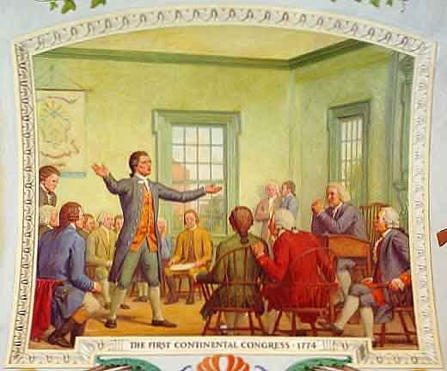
First Continental Congress
The Intolerable Acts were viewed throughout the colonies as an attack on the people of Massachusetts.
Hatred toward England grew
Representatives from 12 of the 13 colonies met in Philadelphia in what would become known as the first Continental Congress. Their purpose was to craft a united response to the acts of Parliament.

Slide 14
Follow-up
What if your school issued unfair acts against its students? In the linked printout below. Write a details of a fictional “recess act” and “homework act.” Then, make up your own act!
https://www.mrnussbaum.com/fun-with-acts-and-taxes/

