Slide 1
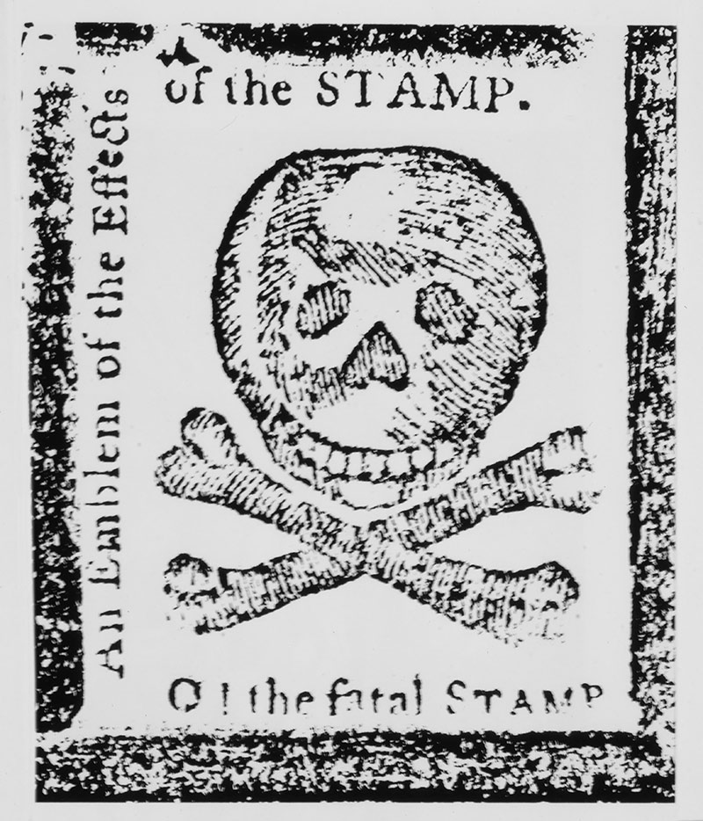


The American Revolution Series
Causes:
The Boston Massacre

Slide 2
LearnAboutAmerica.com
*For our presentations, lesson plans, articles, printables, interactives, stories, and games related to the Boston Massacre, please visit:
https://learnaboutamerica.com/american-history/revolutionary-war/causes-of-the-revolutionary-war/boston-massacre
* For the greatest American History website for teachers, parents, and students, visit:
https://learnaboutamerica.com

Slide 3
Why did the American Revolution happen?
There were several major causes of the revolution. We’ve learned about the French and Indian War, Proclamation of 1763, and the Stamp Act. Today, we’ll learn about an event called the Boston Massacre.

Slide 4
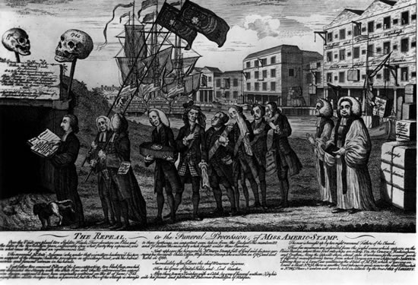
1768 Townshend Act
In 1768, Parliament issued the Townshend Act. It required Americans to pay taxes on:
Paint
Glass
Lead
Paper
Tea
The Townshend Act was named after Charles Townshend – the head of the royal treasury. It was meant as a
Replacement for the failed Stamp Act.

Slide 5
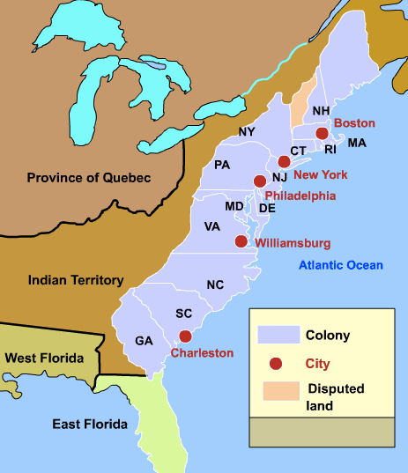
BOSTON
- Americans were once again enraged! A new set of taxes!
- The situation in Boston became so tense that English soldiers, known as Redcoats, began patrolling the streets.
- The people in Boston believed the Redcoats were there to take away their freedom.
- Many merchants staged a boycott of British goods.

Slide 6
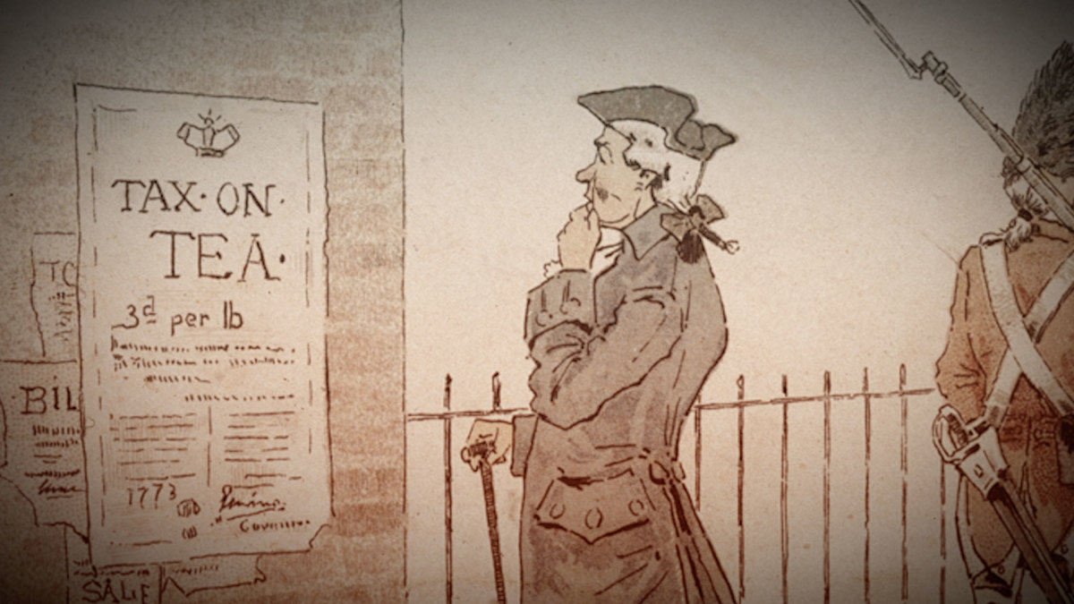
Boycott
- A boycott is form of protest in which a group of people stops purchasing items or services from an organization it believes is unjust.
- Can you think of other times in American history where a boycott has been used as a means to protest?

Slide 7
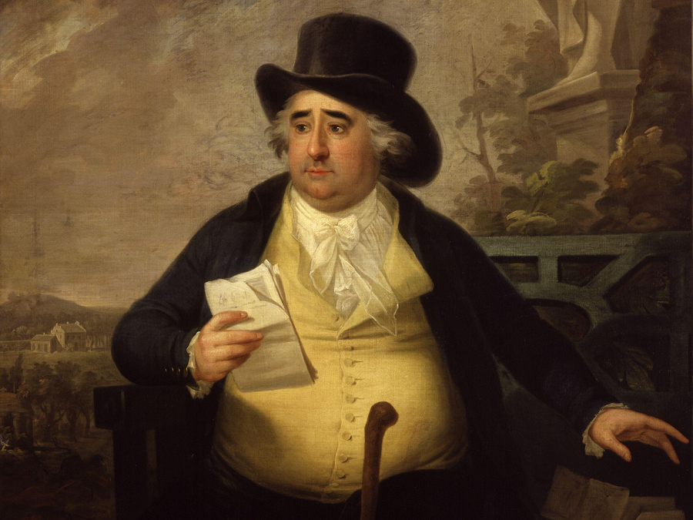
1770
By 1770, British soldiers were still
patrolling the streets of Boston.
On March 5th, Lord North, the British
Prime minister decided to repeal parts
of the Townshend Acts. But…

Slide 8

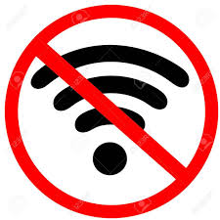
March 5, 1770
Communication was slow at the time. It could take weeks or months for news in England to make its way to America.

Slide 9
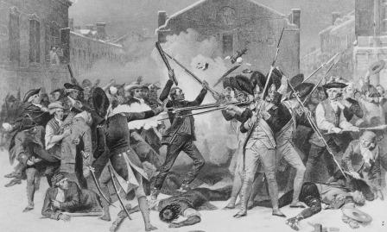
Boston Massacre
- On the night of March 5th, a fight broke out
between an American and a Redcoat.
- Soon, dozens of townspeople, many of
whom were drunk, formed a mob around
several Redcoats.
- Before long, the mob grew to several hundred
People.
- They started throwing ice and shouting
threats to the cornered soldiers.
A massacre can be defined as a deliberate attempt
to kill a large number of people.

Slide 10
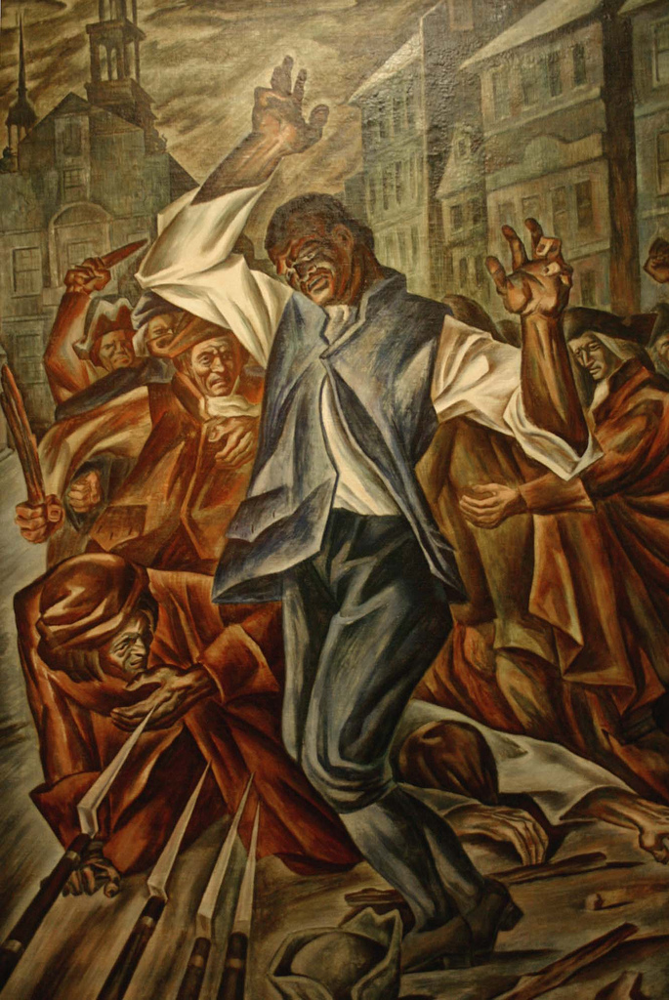
Boston Massacre
The situation was growing desperate for the
Redcoats.
Despite their pleas, the mob refused to
disperse.
Finally, someone in the mob threw a club,
which hit a Redcoat named Hugh Montgomery.
Montgomery fired his musket into the
surging mob. Others fired as well. Chaos
ensued, but finally the mob shrank away.

Slide 11
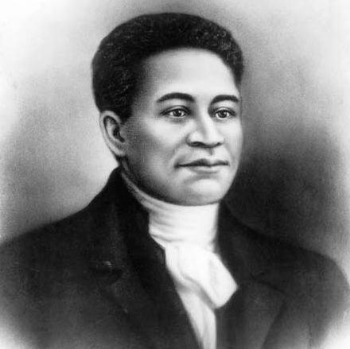
Boston Massacre
When the mob retreated, it was revealed that five Bostonians were dead and three were injured.
The soldiers who fired were charged with murder.
One of the dead was named Crispus Attucks. He
was the first African-American casualty of the
Revolutionary era.

Slide 12
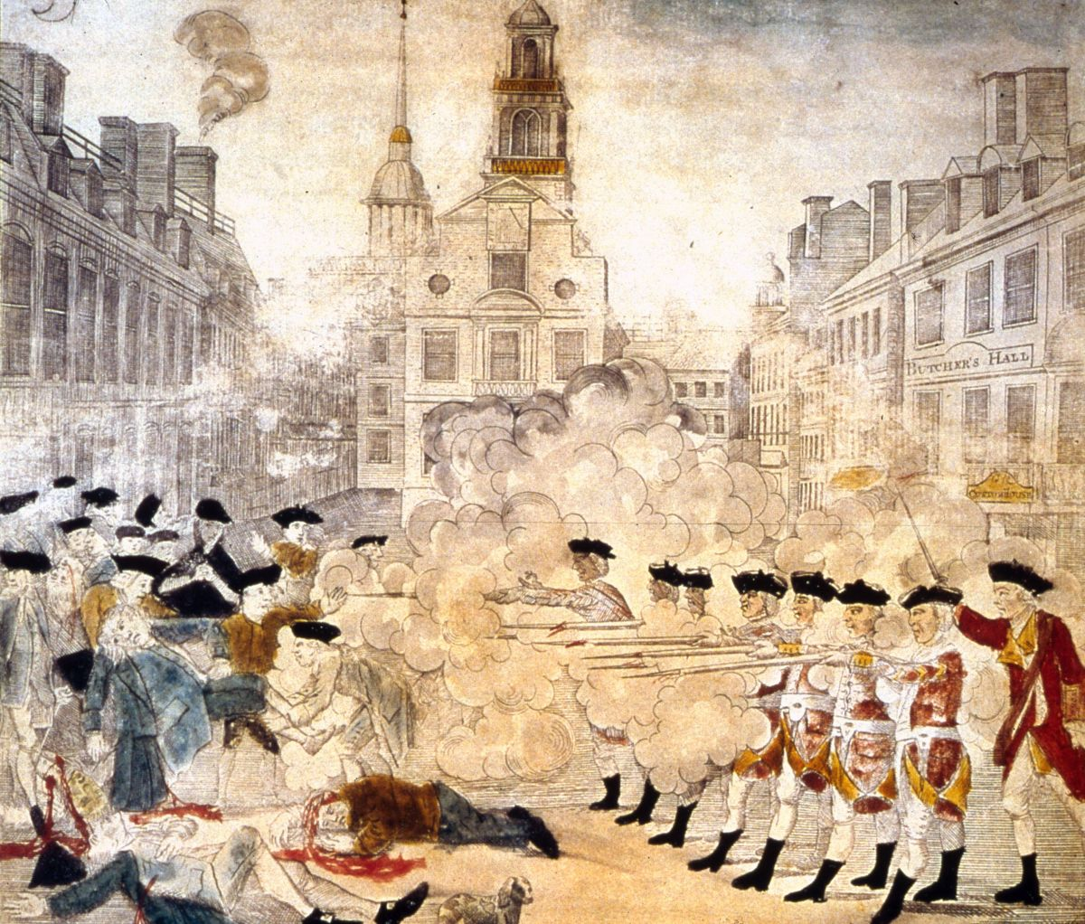
Boston Massacre
- The people of Boston were angry.
- Propaganda, such as the depiction to the
left made by Paul Revere, fueled their
anger.
- How is Revere’s image different from
what really happened?

Slide 13
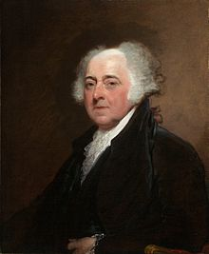
The Trial
- Future president and founding father John Adams
was assigned the task of defending the soldiers.
- He claimed they only fired in self-defense.
- Six of the eight British soldiers were judged
not-guilty. Two were convicted of manslaughter,
which is a less severe version of murder in the eyes
of the law.
The soldiers convicted of manslaughter were punished by being branded on their thumbs. They did not go to jail.

Slide 14
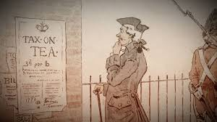
The Aftermath
- Following the trial, the tension eased in Boston,
although many were left unsatisfied by the
result.
Parliament repealed most of the taxes, but the tax
on tea remained.
Americans ended their boycotts of English goods.
A tenuous peace came upon the relationship
between America and England that lasted more
than three years.
- Calls for independence seemed to soften.

Slide 15
Follow-up
View the depiction of the Boston Massacre as rendered by Paul Revere. How did it compare with the reality of what really happened? Why?
https://www.mrnussbaum.com/propaganda/

