Slide 1
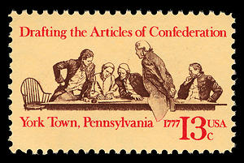
Articles of
Confederation

Slide 2
What was the Articles of Confederation?
The Articles of Confederation was the first constitution that bound the 13 original states together. It was approved during the meeting of the Second Continental Congress on November 15, 1777. All 13 states ratified the wartime constitution by 1781.

Slide 3
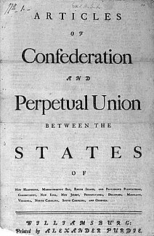
Why did America need the Articles of Confederation?
The leaders of the Continental Congress believed that along with a Declaration of Independence, it needed to establish diplomatic and economic relations with other countries, as well as a set of laws binding the former colonies as a nation. With these three factors established, America would more likely gain foreign recognition as an independent nation, rather than a rebellious group of colonies. The Articles of Confederation were the set of laws.
.

Slide 4
Articles of Confederation
The Articles of Confederation contained a preamble, 13 articles, and a conclusion.
The Articles of Confederation allowed for Canada to join the Union if it accepted the terms.
It was within the Articles of Confederation in which the terms “United States of America” was written for the first time.
"The stile of this confederacy shall be 'The United States of America.'"

Slide 5
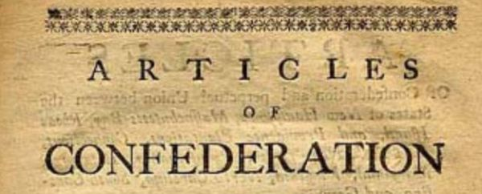
Major Problems
Following the Revolutionary War, the Articles of Confederation proved inadequate for governing a nation. There were governing, economic, and military problems which doomed the Articles as a permanent solution.
“

Slide 6
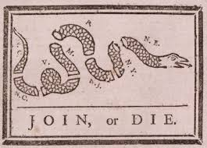
Governing Problems
The Articles made for a very weak central government. The states retained most of the power.
Changes to the Articles of Confederation required a unanimous vote from all 13 states.
Conflict within and between the states threatened to destroy the new nation.

Slide 7
Economic Problems
Congress was not able to tax the states to raise money. It essentially had to rely on contributions from the states.
Congress did not have the power to regulate business between states or business between a state and foreign nations.

Slide 8
Military Problems
Congress was able to declare war, but was unable to draft soldiers from the states.

Slide 9

Did anything good come from the Articles of Confederation?
The Land Ordinance of 1785 – This law divided land in the unchartered west into townships that could be purchased by settlers and farmers. Land sales provided Congress with money since it could not demand it from the states.
The Ordinance of 1787 – This law created the Northwest Territory. It would eventually allow for the division of this land into states such as Ohio, Kentucky, Indiana, and others.

Slide 10
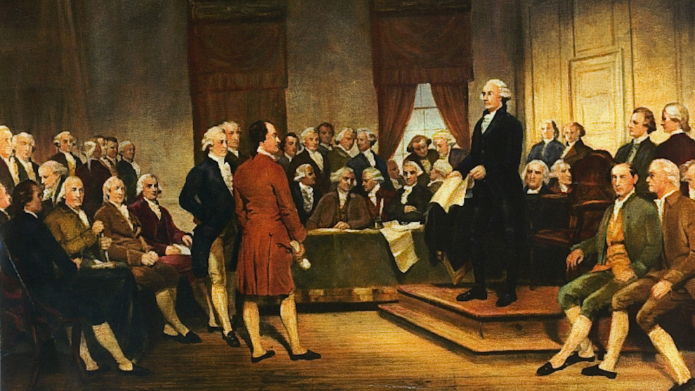
Ultimately…
The decision was made first to revise the Articles of Confederation during the Constitutional Convention of 1787, and then, to scrap them completely.

Slide 11
Follow-up Activities
A constitution is a set of laws governing a country or state. The Articles of Confederation was America’s first constitution. It worked great during the Revolutionary War, but its limitations threatened to destroy the new nation after the war.
Among other things it:
gave the states too much power.
was difficult to change unless all 13 states agreed.
perpetuated conflict within states and between states.
required Congress to request (rather than demand) money from states.
could not regulate business between states or between states and other nations.
was authorized to declare war on other nations, but not to draft soldiers from the states.
Based on the information above and what you know about the Articles of Confederation, what do you think was its most GLARING or serious weakness. Give details explaining your answer.
https://www.mrn365.com/activity/2959

