Slide 1
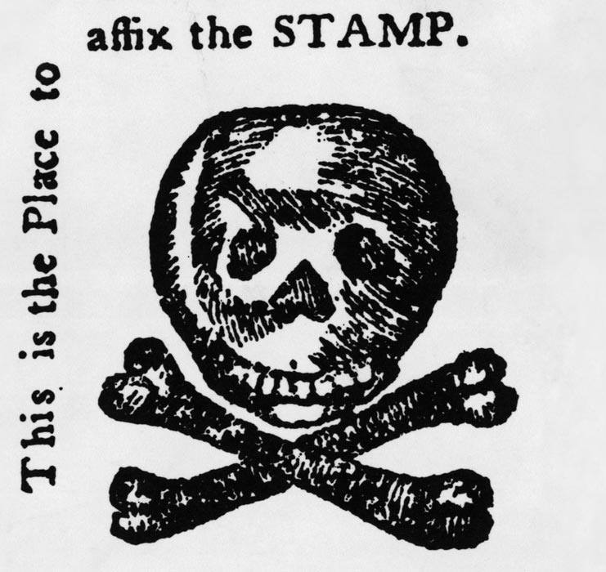
Effects of the French and Indian War

Slide 2

LearnAboutAmerica.com
*For our presentations, lesson plans, articles, printables, interactives, stories, and games related to the effects of the French and Indian War, please visit:
https://learnaboutamerica.com/american-history/french-and-indian-war/causes-and-effects
* For the greatest American History website for teachers, parents, and students, visit:
https://learnaboutamerica.com

Slide 3
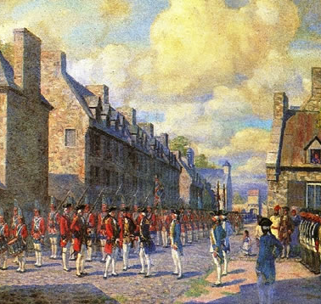
Britain Gains New Territory
France lost most of its North American land
Britain gained Canada and land east of the Mississippi River
Spain gained Louisiana from France
Britain became the dominant power in North America

Slide 4
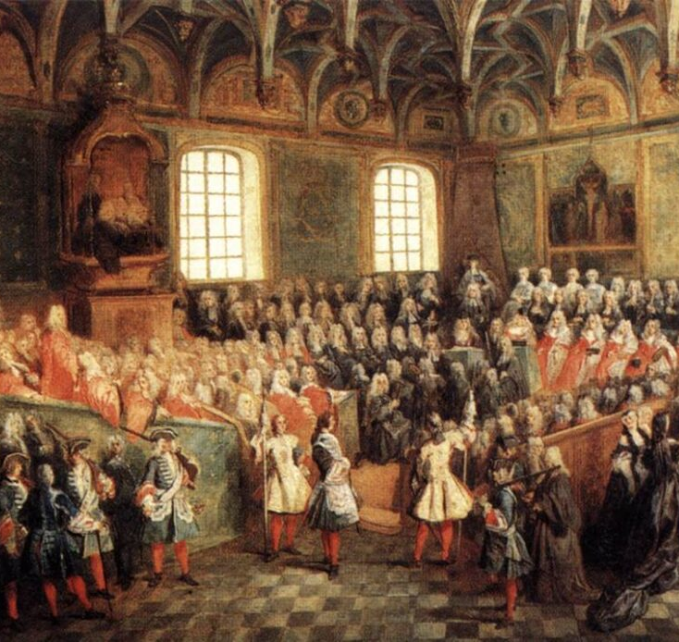
Debt and Financial Problems
The war was expensive for Britain
Britain owed a large amount of money
British leaders believed colonists should help pay
This led to new taxes on the colonies

Slide 5
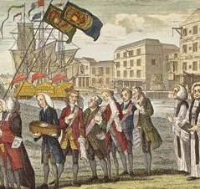
New Taxes on the Colonies
Britain passed new laws to raise money
Colonists were taxed to pay war debt
Many colonists felt the taxes were unfair
This caused anger and protests

Slide 6
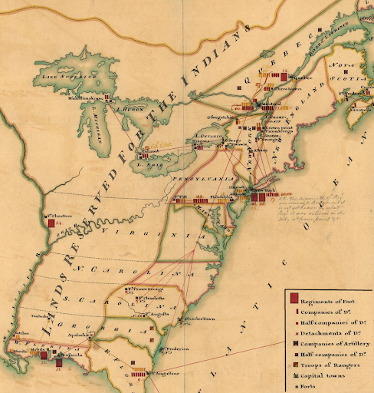
The Royal Proclamation of 1763
Issued by King George III
Banned colonial settlement west of the Appalachian Mountains
Created a boundary line to reduce conflict
Angered colonists who wanted western land

Slide 7
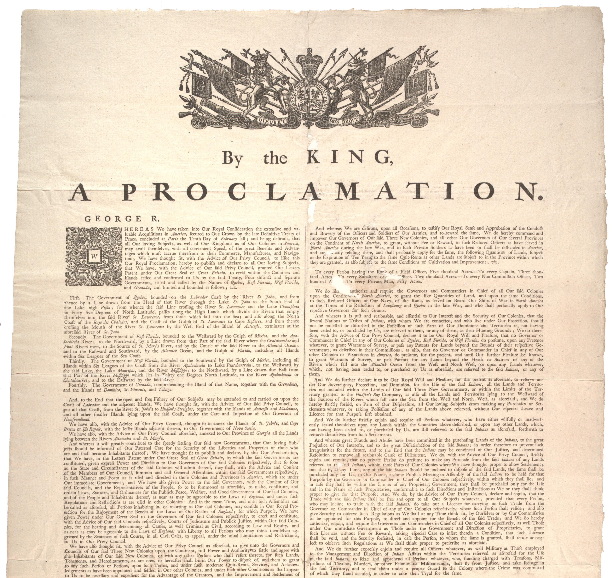
Why Britain Issued the Proclamation
To avoid more wars with Native Americans
To control colonial expansion
To protect British forts and troops
To reduce military costs

Slide 8
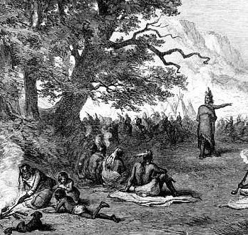
Pontiac’s Rebellion
Native American uprising after the war
Led by Pontiac, an Ottawa leader
Native Americans attacked British forts
Showed Native anger toward British policies

Slide 9
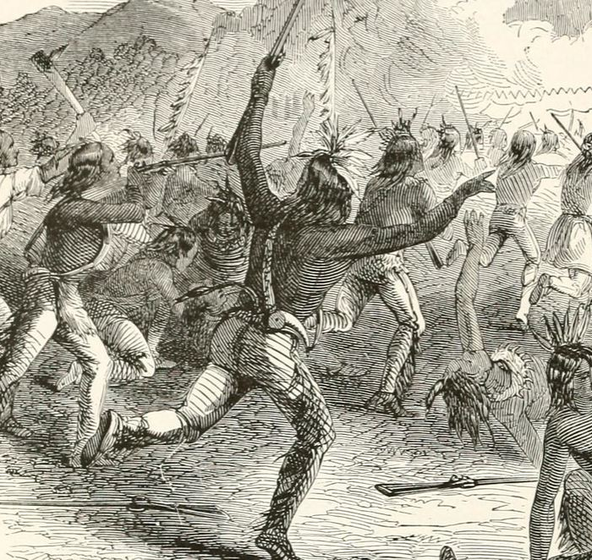
Impact of Pontiac’s Rebellion
British settlers were attacked on the frontier
Britain realized Native resistance was strong
Led directly to the Royal Proclamation of 1763
Increased tensions between groups

Slide 10
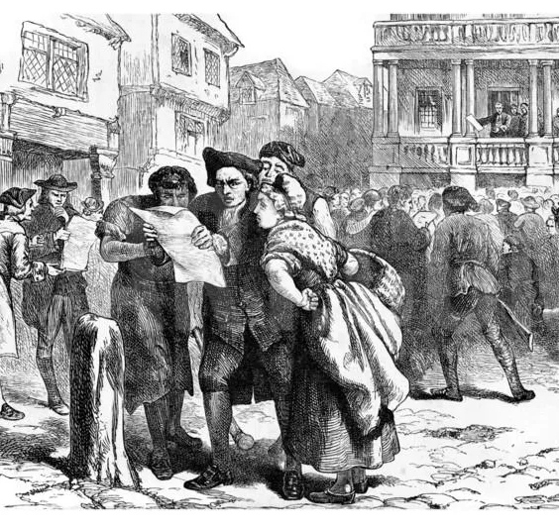
Colonial Reactions
Colonists felt betrayed by Britain
Many ignored the Proclamation line
Tensions grew between Britain and colonies
Trust between groups weakened

Slide 11
Why the War’s Effects Matter
Changed Britain’s relationship with the colonies
Increased conflict over land and money
Native Americans lost power and land
Helped lead to the American Revolution

