Slide 1
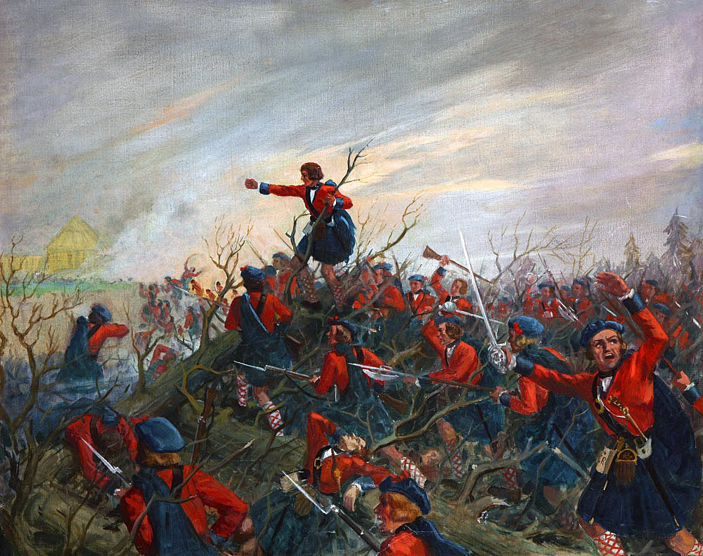
Causes of the French and Indian War https://learnaboutamerica.com

Slide 2

LearnAboutAmerica.com
*For our presentations, lesson plans, articles, printables, interactives, stories, and games related to the causes of the French and Indian War, please visit:
https://learnaboutamerica.com/american-history/french-and-indian-war/causes-and-effects
* For the greatest American History website for teachers, parents, and students, visit:
https://learnaboutamerica.com

Slide 3
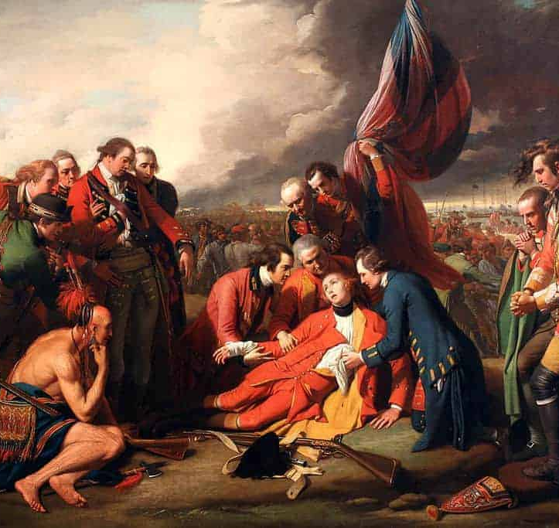
Colonial Rivalry in North America
Britain and France competed for territory
Both wanted control of trade and resources
Colonies continued to expand westward
Tensions increased as borders overlapped

Slide 4
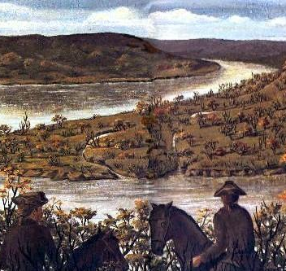
The Importance of the Ohio River Valley
Rich land for farming and fur trading
Both France and Britain claimed the region
Key transportation routes along rivers
Native American tribes also lived on the land

Slide 5
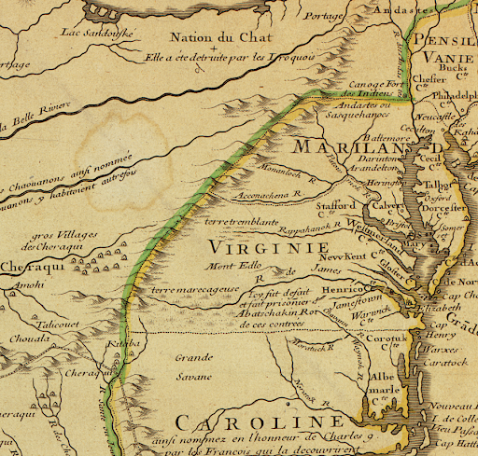
French and British Claims to Land
France claimed land from Canada to Louisiana
Britain claimed land along the Atlantic coast
Colonial charters often overlapped
No clear boundaries existed

Slide 6
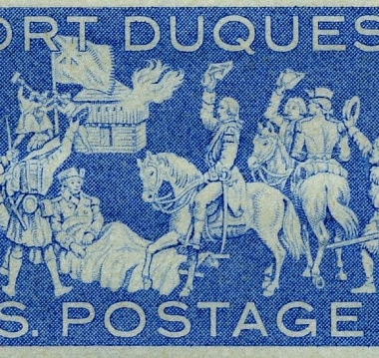
French Forts in the Ohio Valley
France built forts to protect its claims
Fort Duquesne was especially important
Forts blocked British colonial expansion
British colonists felt threatened

Slide 7
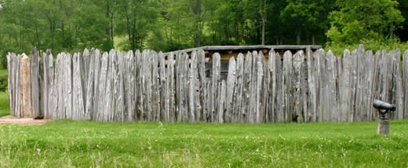
British Colonial Expansion
British colonists moved west of the Appalachians
Land was needed for farms and settlements
Colonists ignored French warnings
Conflicts with Native Americans increased

Slide 8
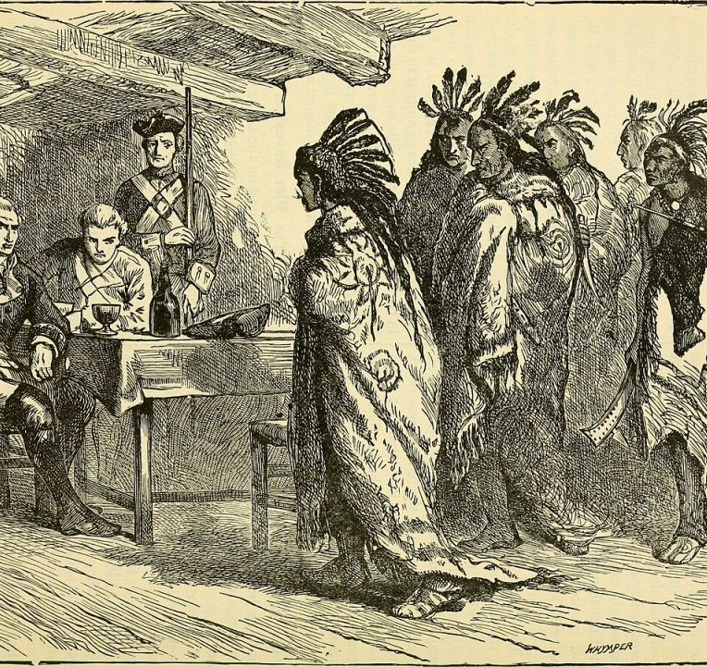
Native American Alliances
Tribes chose sides based on self-interest
Many tribes allied with the French
French traded fairly and had fewer settlers
Native Americans wanted to protect their land

Slide 9
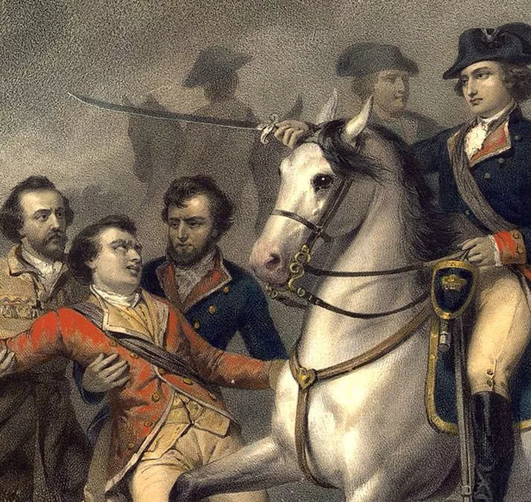
Early Fighting and George Washington
Young George Washington sent to the Ohio Valley
Clash at Fort Necessity in 1754
Marked the beginning of armed conflict
War soon spread beyond the colonies

Slide 10
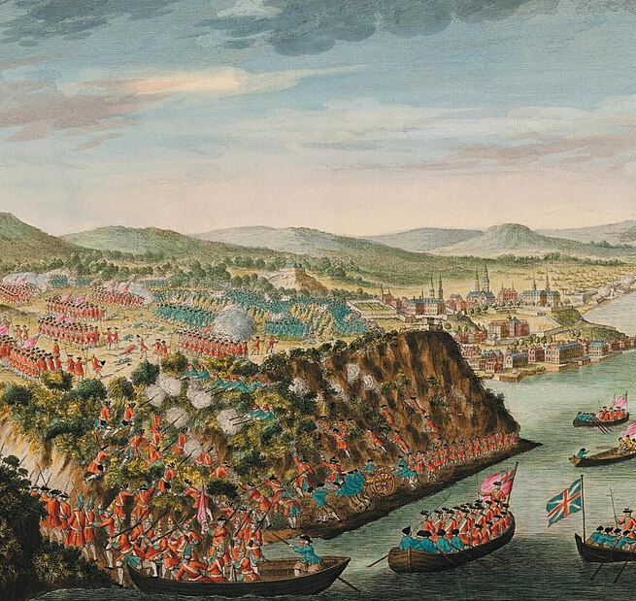
Global Conflict: The Seven Years’ War
French and Indian War was part of a global war
Known as the Seven Years’ War in Europe
Fighting spread to Europe and overseas colonies
Britain and France battled worldwide

Slide 11
Why War Was Inevitable
Competing land claims could not be resolved
Economic and political rivalries grew
Native American concerns were ignored
Violence became unavoidable

