Slide 1
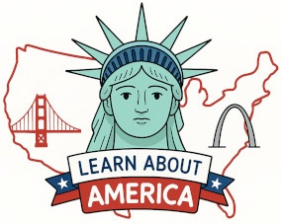
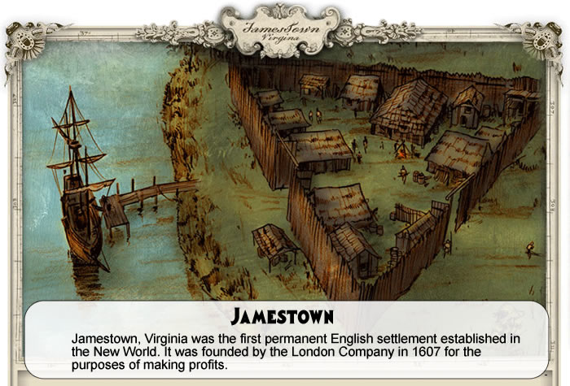
Jamestown https://learnaboutamerica.com

Slide 2
LearnAboutAmerica.com
*For our presentations, lesson plans, articles, printables, interactives, stories, and games related to Jamestown, please visit:
https://learnaboutamerica.com/american-history/13-colonies/colonies-and-cities/virginia-colony
* For the greatest American History website for teachers, parents, and students, visit:
https://learnaboutamerica.com

Slide 3
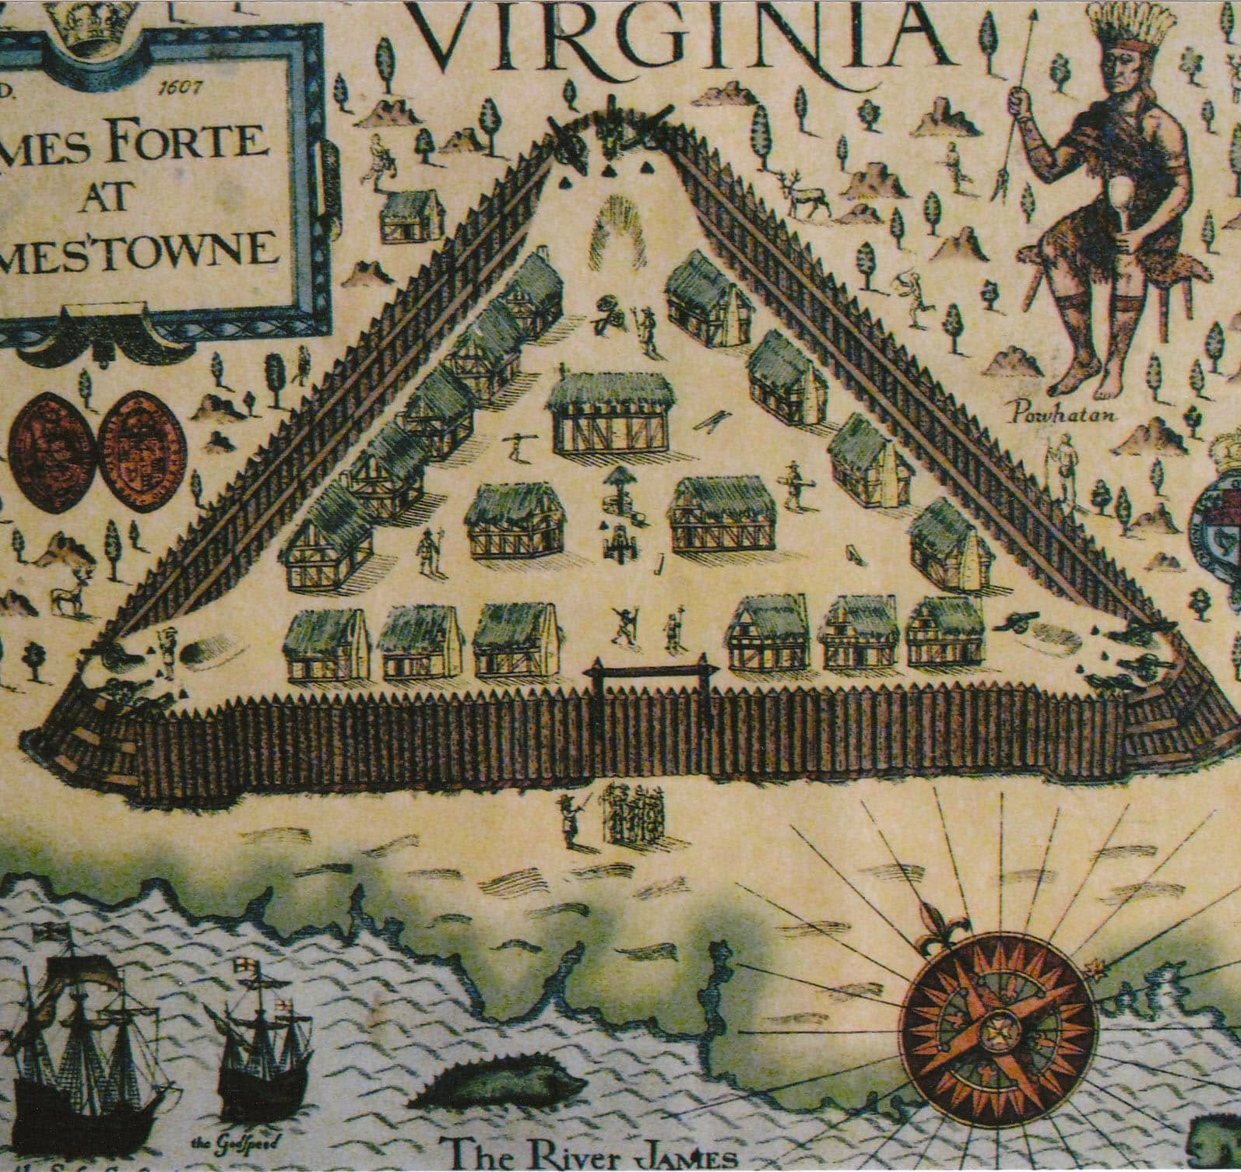
First Permanent English Settlement
  King James I sought a permanent colony after Roanoke failed.
  The London Company, led by Christopher Newport, founded Jamestown in Virginia.
  Location chosen for defense but swampy and unhealthy.

Slide 4
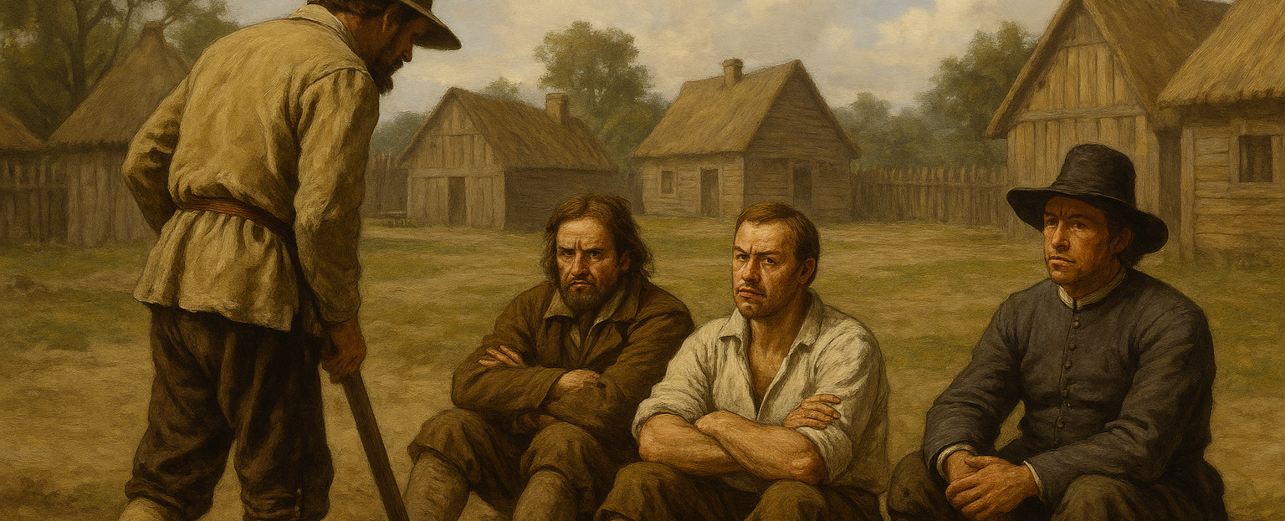
Unfit for Life in the Wilderness
  Swampy climate caused diseases like dysentery and malaria.
  Colonists refused to work; poor leadership hindered progress.
  Few valuable resources were found for England.

Slide 5
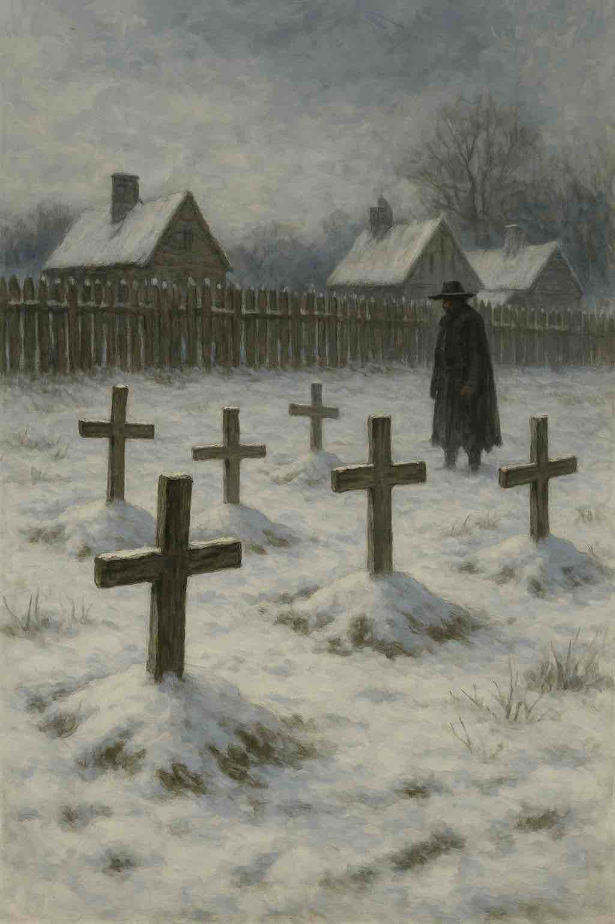
Crisis in Early Jamestown
  Jamestown was on Algonkin hunting grounds, creating tension.
  By winter 1607, only 38 of 104 settlers survived.
  Food shortages pushed Jamestown toward collapse.

Slide 6
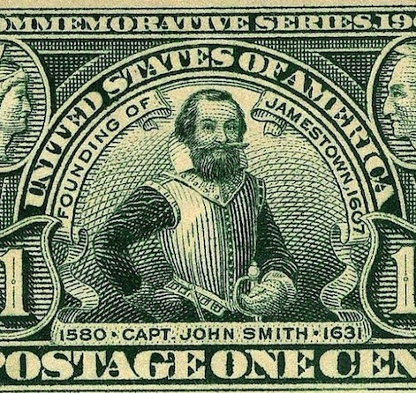
John Smith's Leadership
  John Smith traded with Indians for corn and beans.
  Captured by Powhatan but persuaded him the English were peaceful.
  Returned with new influence among colonists.

Slide 7
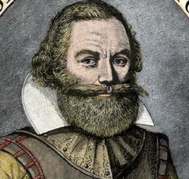
Smith as President of the Council
  Winter 1608: starvation and leadership issues worsened.
  John Smith became council president despite opposition.
  He understood survival needs and took control.

Slide 8
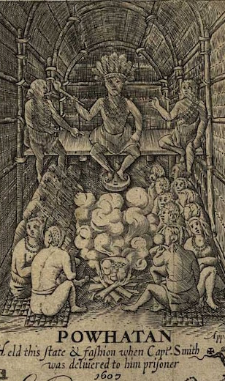
Smith Saves Jamestown
  Forced colonists to work and imposed discipline.
  Traded for food but refused to give guns to Powhatan.
  Pocahontas warned Smith of attacks (maybe); Smith survived many threats.

Slide 9
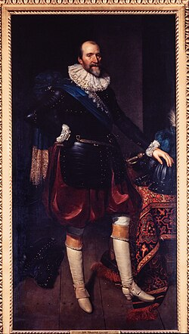
Smith Leaves; New Government
  Virginia Company replaced the president system with a governor.
  After an injury, Smith returned to England permanently.
  Thomas Gates’ shipwreck delayed new leadership’s arrival.

Slide 10
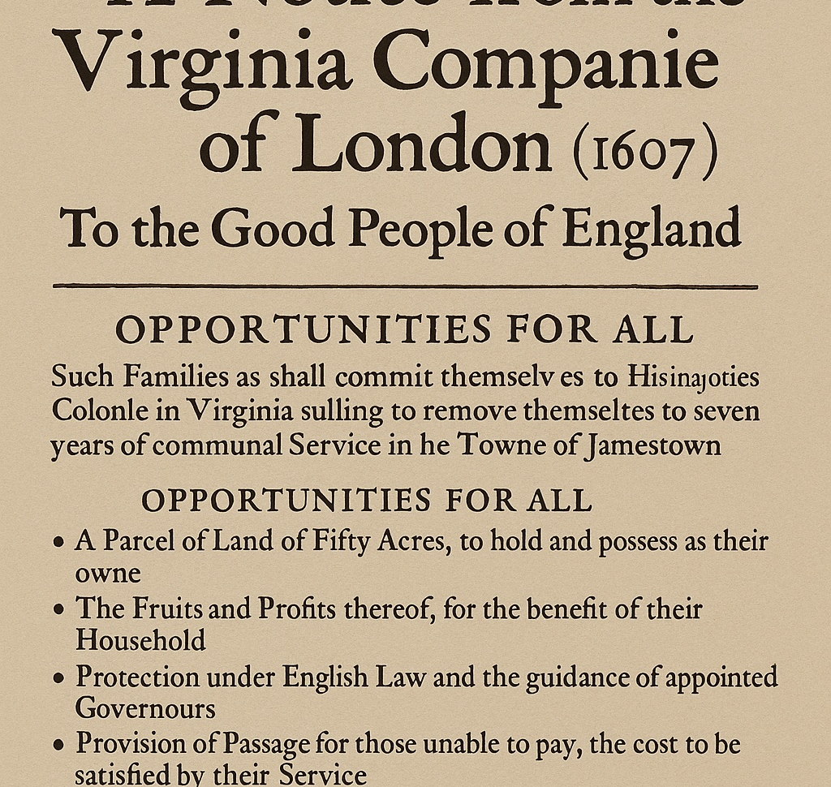
A New Outlook on Profit
  By 1609, profits needed long-term planning.
  Virginia Company sent families, offering land after 7 years of labor.
  Those unable to pay passage became servants.

Slide 11
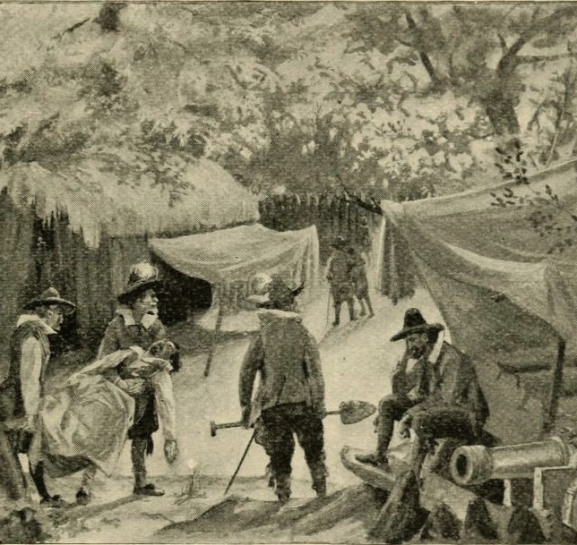
The Starving Time
  Powhatan stopped trading; settlers became complacent again.
  Winter 1609–1610 brought famine, disease, and cannibalism.
  Only 60 of 500 settlers survived; settlement nearly abandoned.

Slide 12
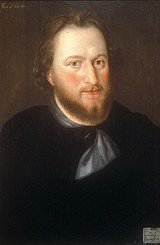
The Return of Discipline
  De La Warre and Gates reinstated strict rules.
  Harsh punishments for rule-breaking were common.
  Violence increased between settlers and Indians.

Slide 13
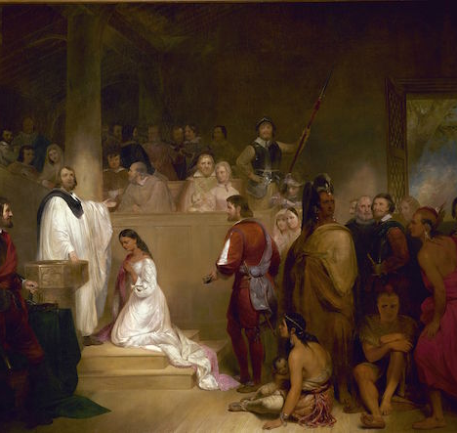
Pocahontas Kidnapped
  Samuel Argall kidnapped Pocahontas in 1612–13.
  She converted to Christianity and married John Rolfe in 1614.
  Marriage brought temporary peace between the groups.

Slide 14
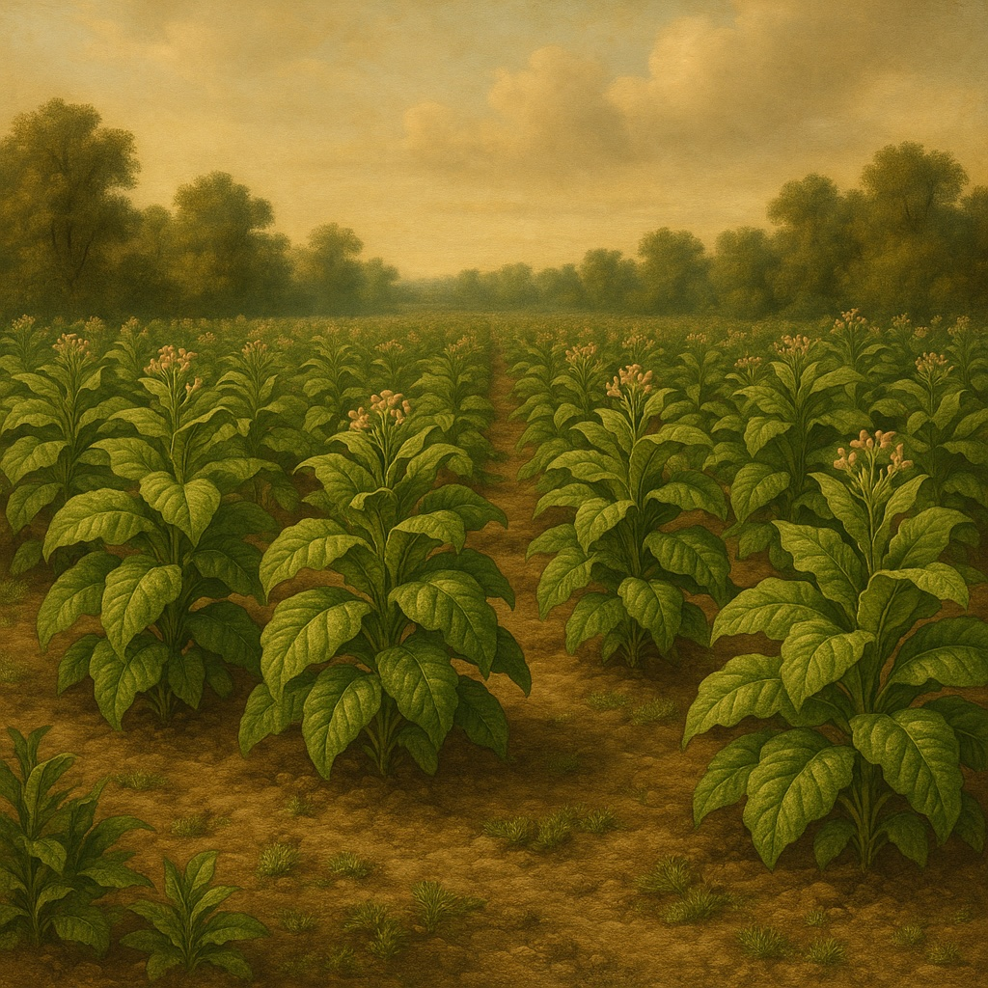
Tobacco & Last Conflicts
  Tobacco became Jamestown’s cash crop under Rolfe.
  The Headright System encouraged migration and farming.
  Opechancanough’s attacks killed 347 settlers, including Rolfe.
  In 1624 Jamestown became a royal colony.

Slide 15
Timeline
1607 – Jamestown founded by the London Company; settlement struggles with disease, poor leadership, and lack of labor.
1607–1608 – John Smith trades for food, builds alliances, and becomes President of the Council.
1609 – Smith returns to England; leadership collapses.
1609–1610 – The Starving Time: only about 60 of 500 colonists survive.
1610 – Gates and De La Warre arrive, restore strict discipline, and rebuild the colony.
1614 – Pocahontas marries John Rolfe, leading to temporary peace.
1614–1616 – Tobacco becomes Jamestown’s cash crop; Headright System encourages migration.
1622 – Opechancanough leads a surprise attack, killing 347 settlers, including John Rolfe.
1624 – King James revokes the Virginia Company charter; Virginia becomes a royal colony.

Slide 16
Discussion Questions
How did the character and goals of the early Jamestown settlers contribute to the colony’s early struggles, especially during the “Starving Time”?
In what ways did John Smith’s leadership style both help and complicate relations between the English settlers and the Powhatan Indians?
Why did the Virginia Company shift from seeking quick profit to promoting long-term settlement through families and the Headright System, and how did this change the future of the colony?
How did the interactions between the English and the Powhatan people—cooperation, conflict, and the kidnapping of Pocahontas—shape the survival and expansion of Jamestown?

Slide 17
Deep Thought
Jamestown struggled because many settlers refused to work or cooperate. Describe a time when you were part of a group or team where everyone had to contribute. What happened when people did or did not do their part, and how does that help you understand the challenges at Jamestown?

