Slide 1
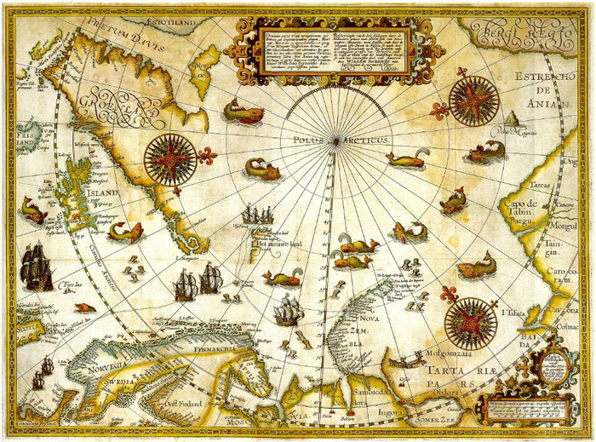
The Age of Exploration
LearnAboutAmerica.com

Slide 2

LearnAboutAmerica.com
* For our entire Age of Exploration curriculum, including all presentations, lesson plans, interactives, printables, games, and much more visit:
https://learnaboutamerica.com/american-history/explorers-and-the-age-of-exploration
* For the greatest American History website for teachers, parents, and students, visit:
https://learnaboutamerica.com

Slide 3
What was the Age of Exploration?
The Age of Exploration was the period of time in history when “The New World,” or the western hemisphere was explored and claimed by European nations.

Slide 4
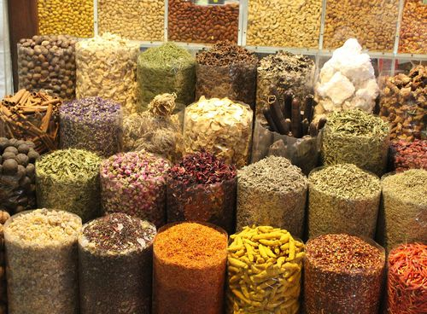
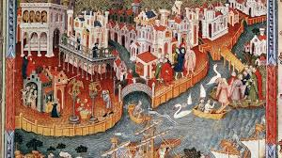
Why did the Age of Exploration occur?
Spices - European rulers wanted
easy access to spices that were
grown in Asia.
The Silk Road, the land route used
to trade for Asian spices had grown
too dangerous and trading along it
was too expensive.

Slide 5
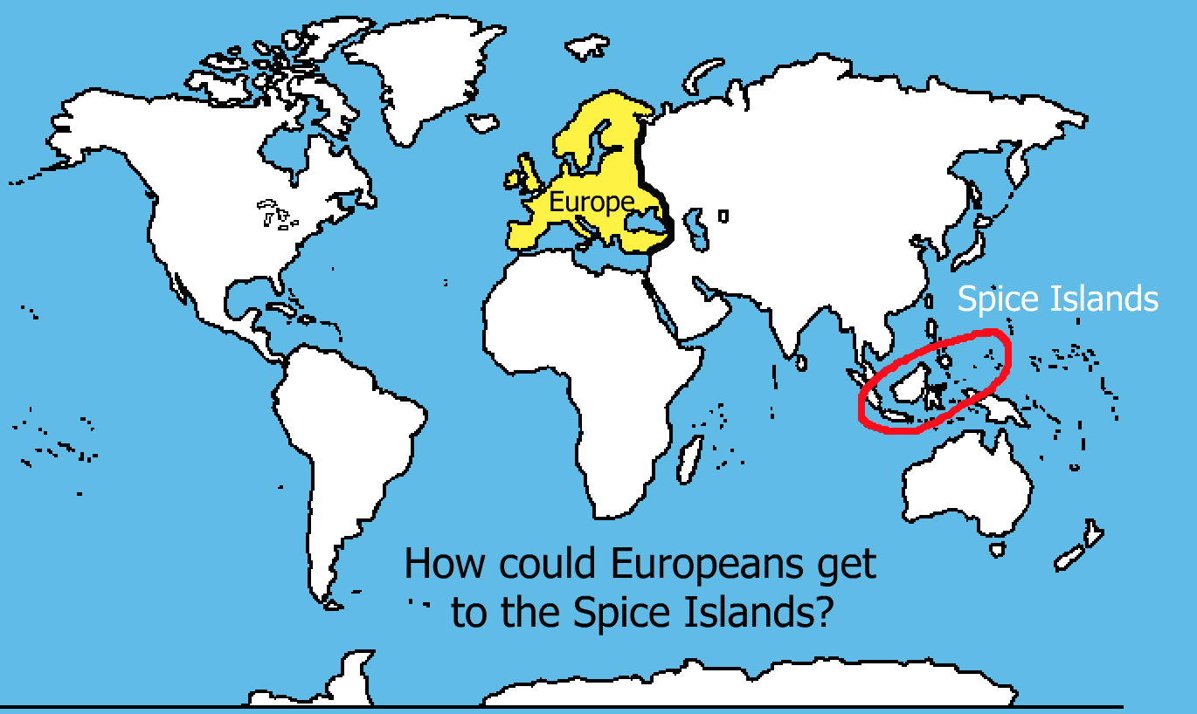

Slide 6
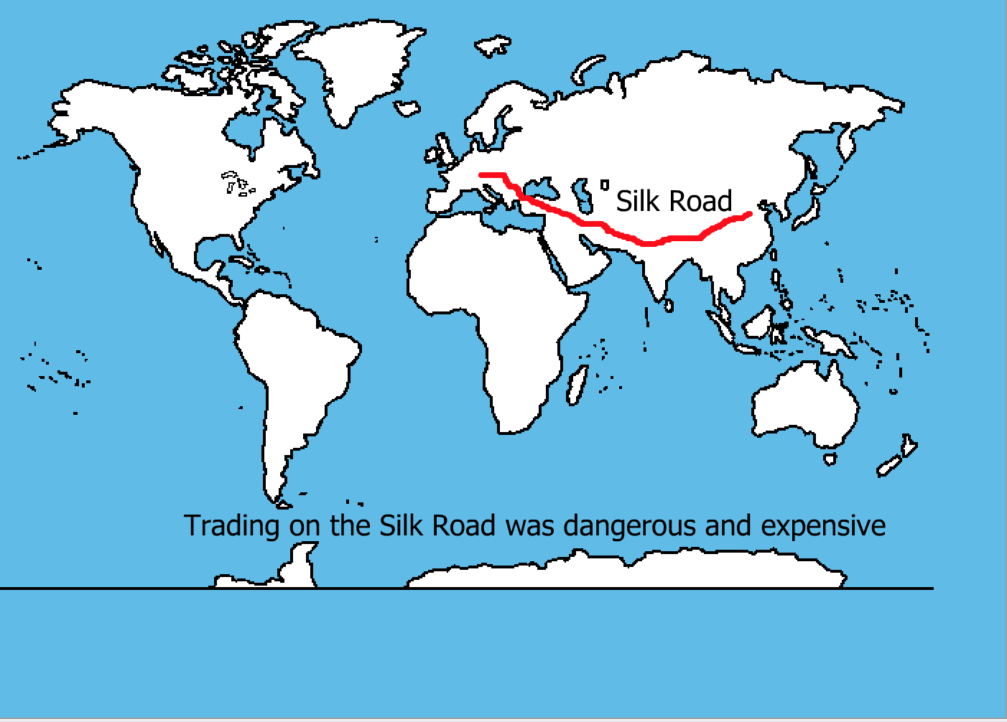

Slide 7
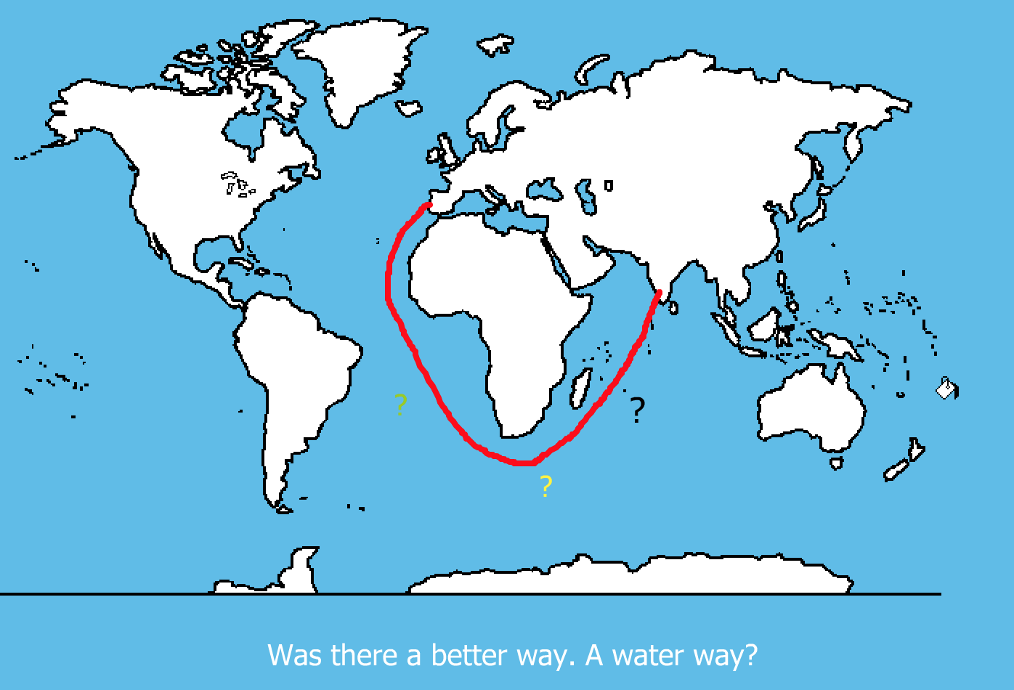

Slide 8

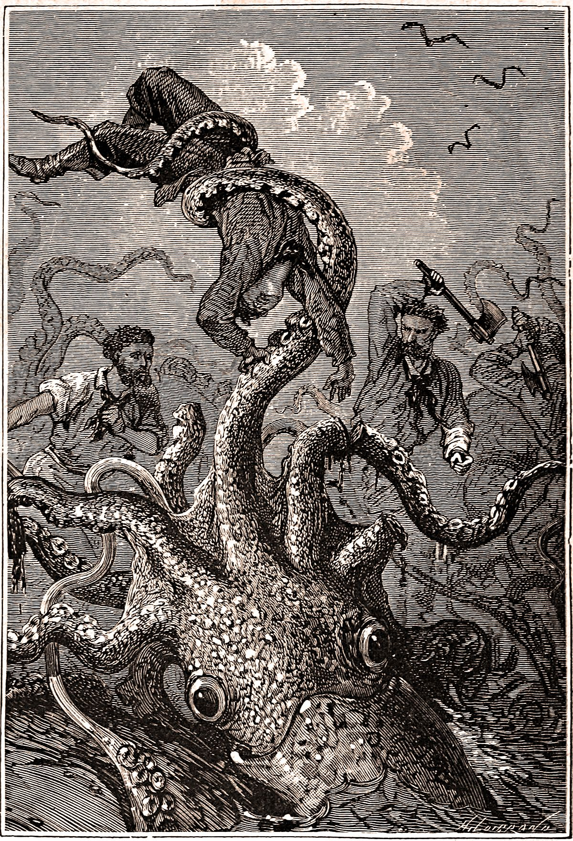
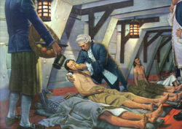
Portugal would try first, but there would be many obstacles!
Inaccurate Maps
Diseases on the
ships
Fear of Sea Monsters

Slide 9
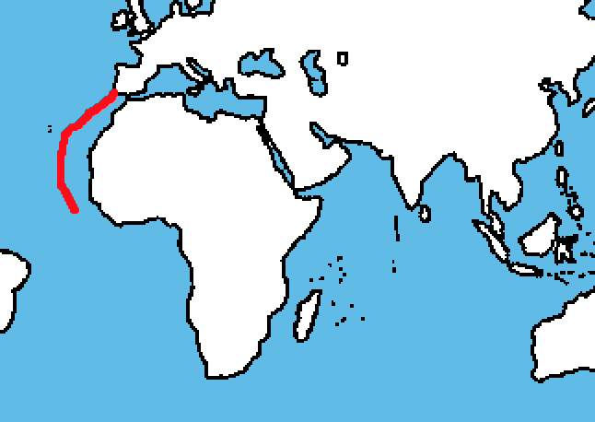
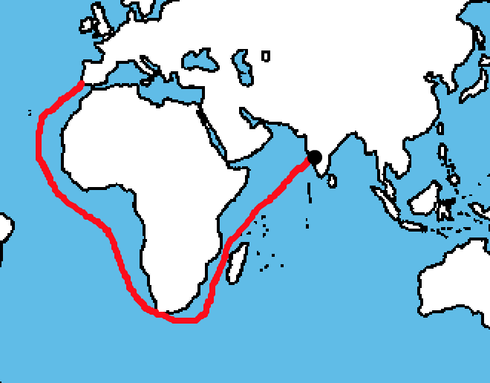
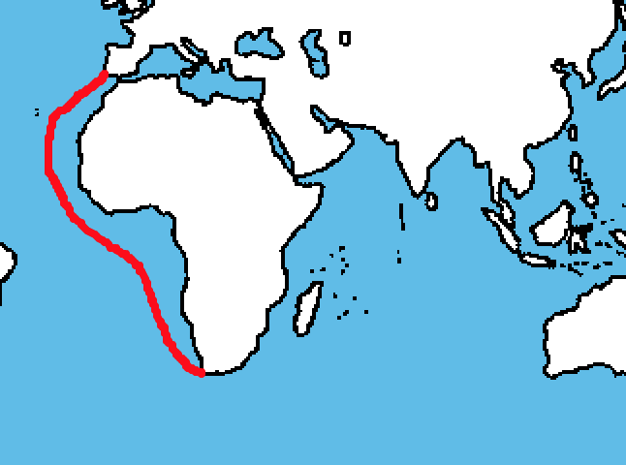
Portuguese explorers made steady progress until Vasco da Gama was successful!
Prince Henry
Bartholomeu Dias
Vasco da Gama

Slide 10
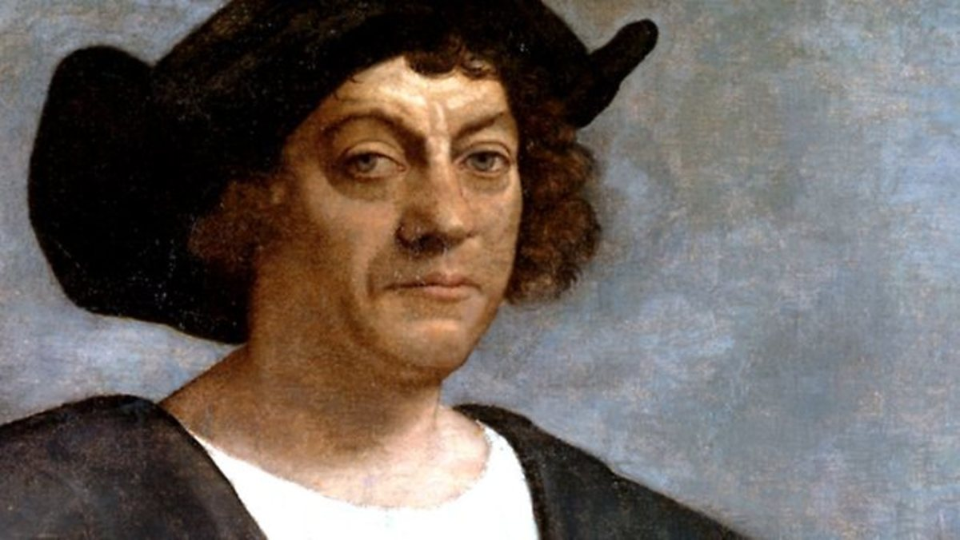
But, only five years before da Gama’s journey, Portugal made a mistake…

Slide 11
It refused to finance the voyage of Columbus, who instead sailed for Spain.

Slide 12
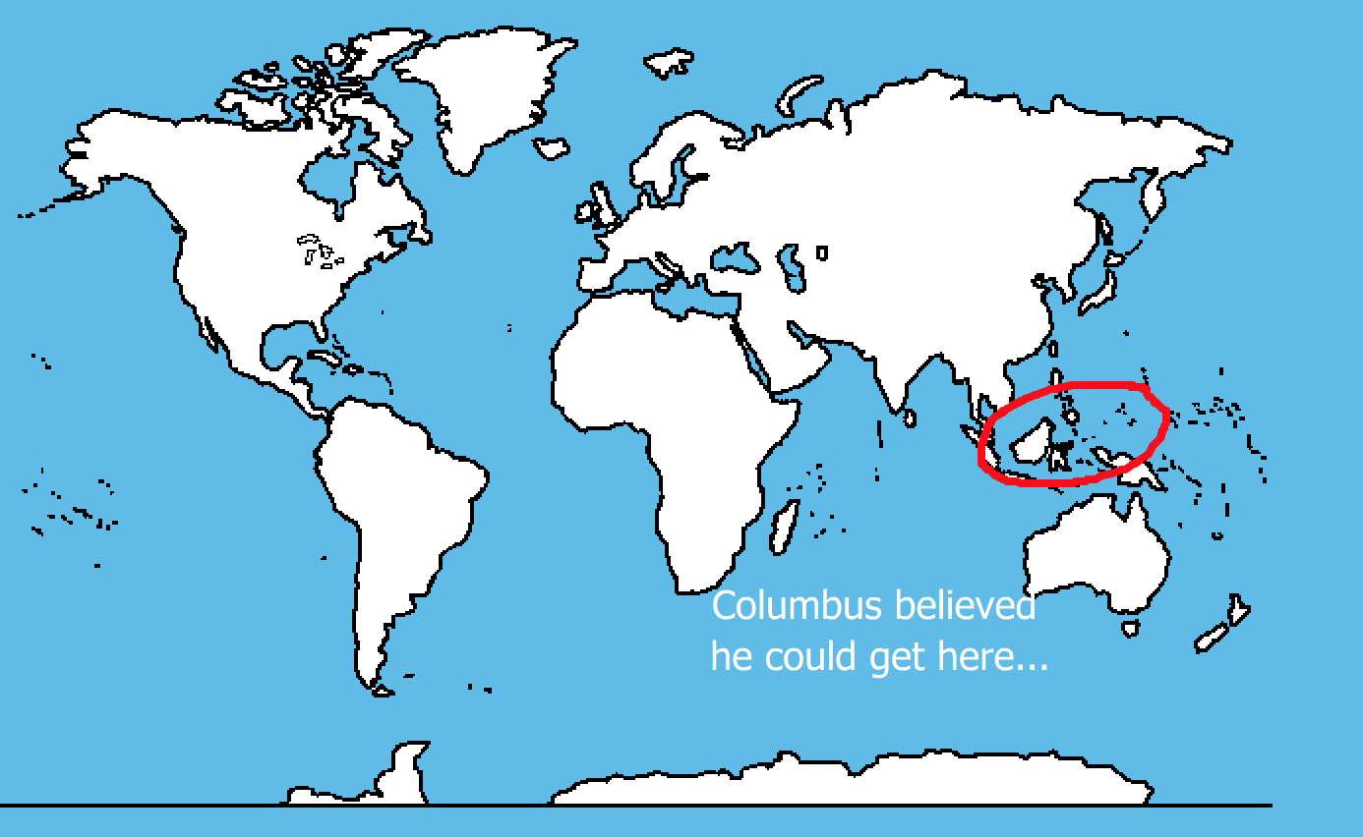

Slide 13
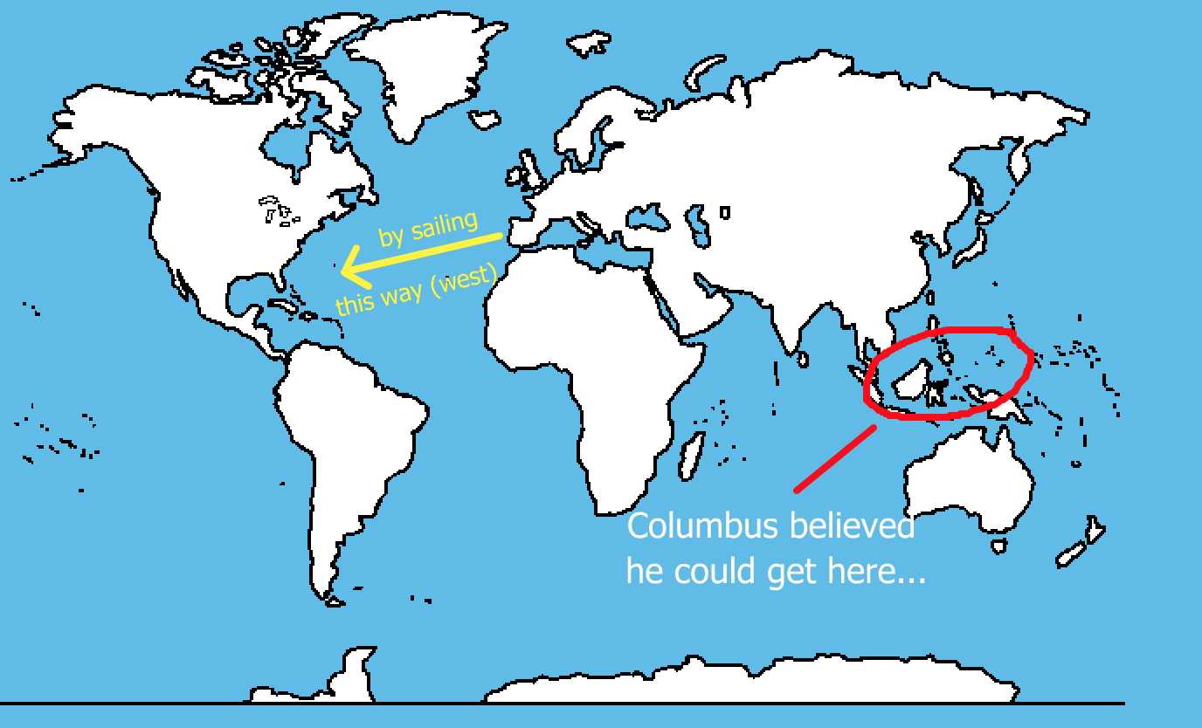

Slide 14
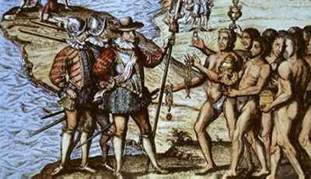
Columbus believed he had found the water route to the Spice Islands, otherwise known as the East Indies. Thus, he named the native people he met “Indians”

Slide 15
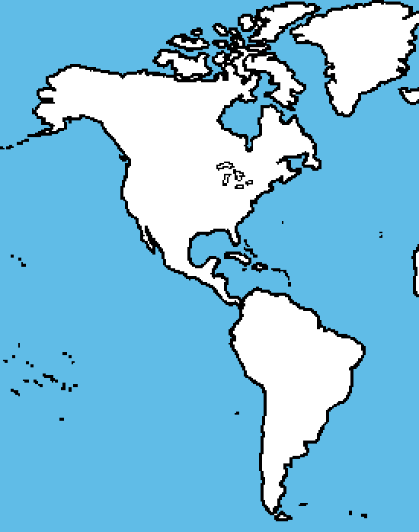
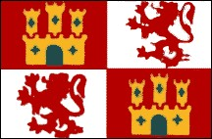
Today we know Columbus was wrong. He, in fact, found what was then called “The New World.”
Because of his findings, Spain would
control much of the New World. It
would send countless explorers
west.

Slide 16
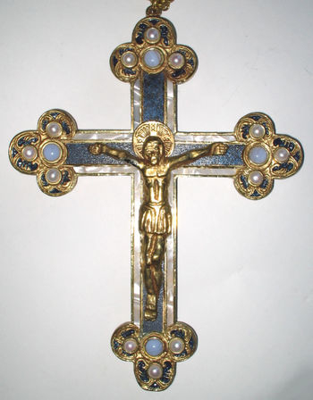
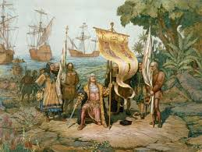
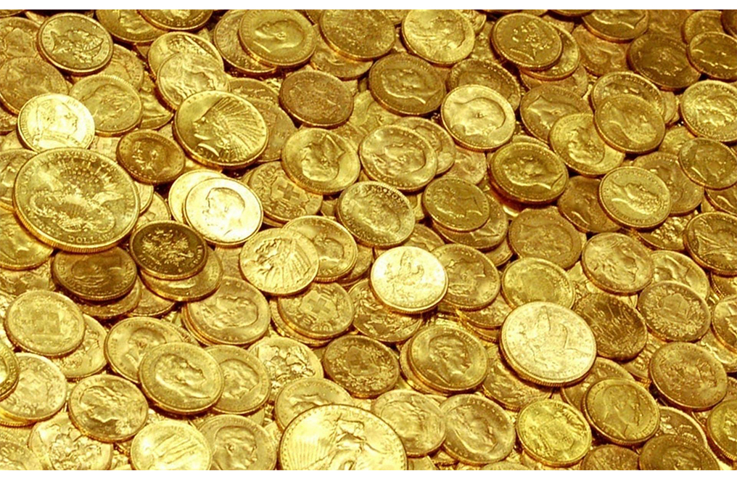
Spanish explorers heading to the New World had several goals:
Find Gold and Jewels
Spread Christianity
Obtain Glory

Slide 17
Many Spanish explorers were called “conquistadors” because they brutally conquered native peoples they encountered in their quest for gold and glory and in the name of religion.

Slide 18
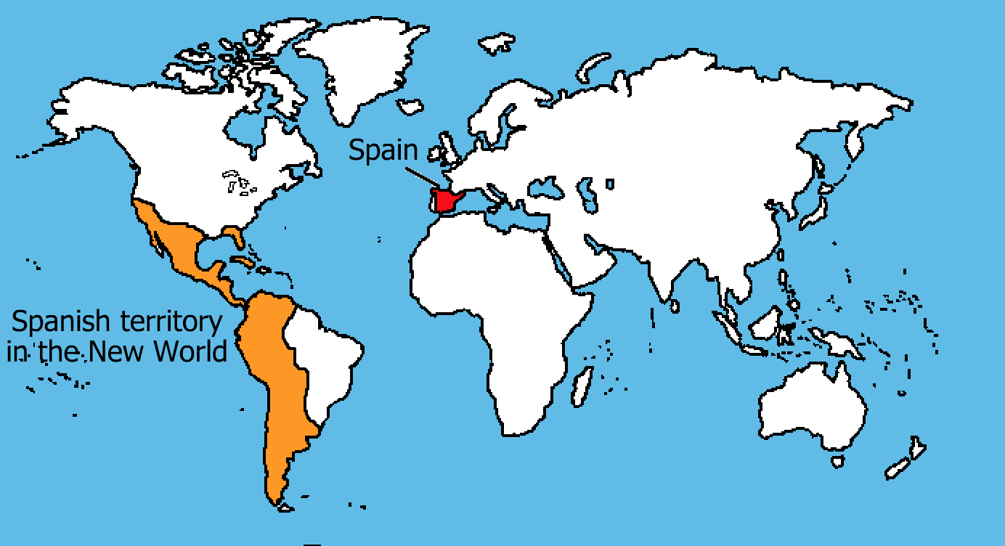

Slide 19
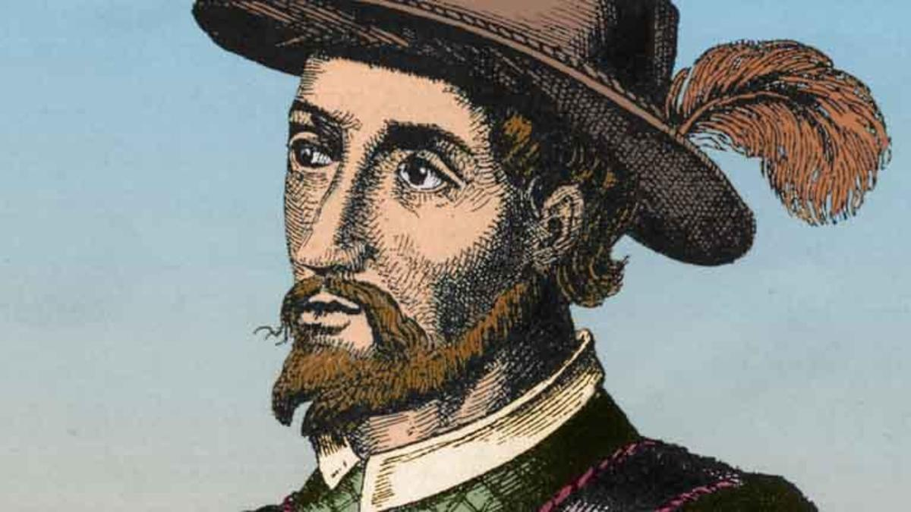
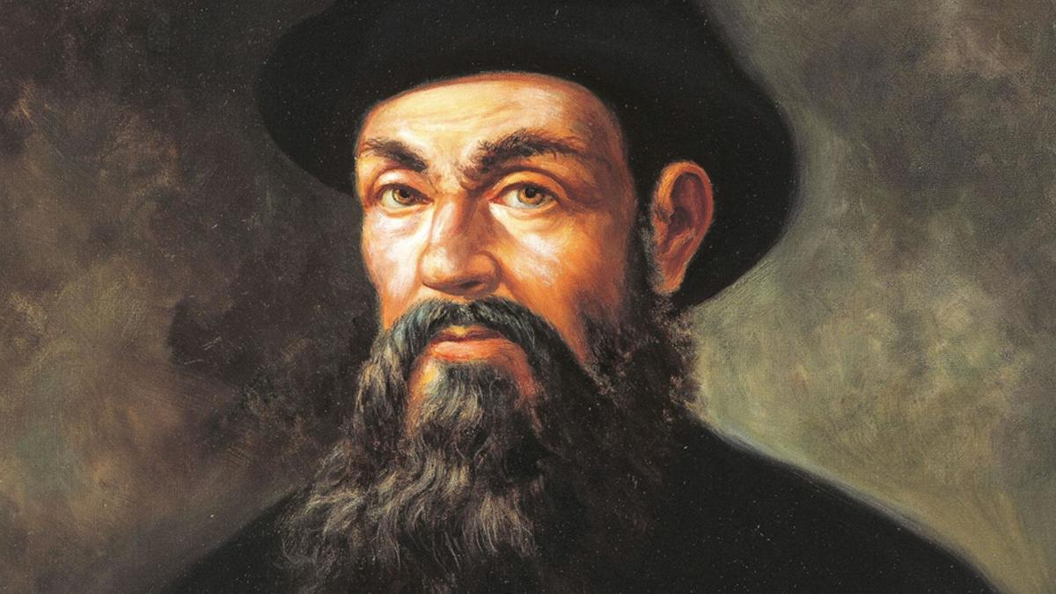
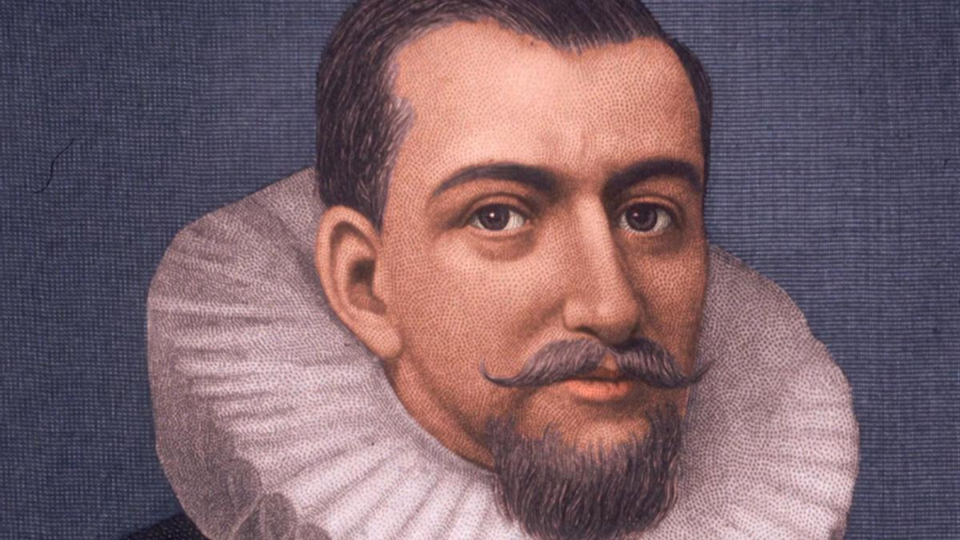
Notable Spanish Explorers
Ponce de Leon – Claimed the peninsula of Florida for Spain.
Ferdinand Magellan – Portuguese by birth, his expedition was the first to
Circumnavigate the world.
Francisco Coronado – Although he never found his seven golden cities, Coronado’s expeditions led to Spanish claims in the American southwest and Mexico. His expedition found the Grand Canyon.

Slide 20
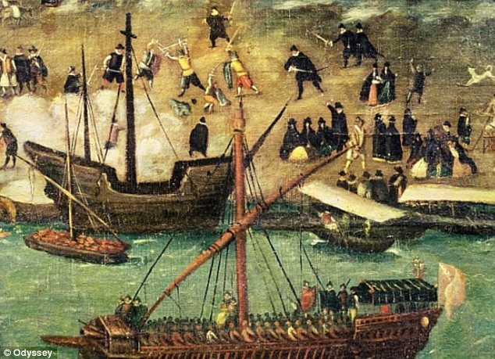
Not only did Spain expand its empire, but it became
one of the world’s richest nations.

Slide 21
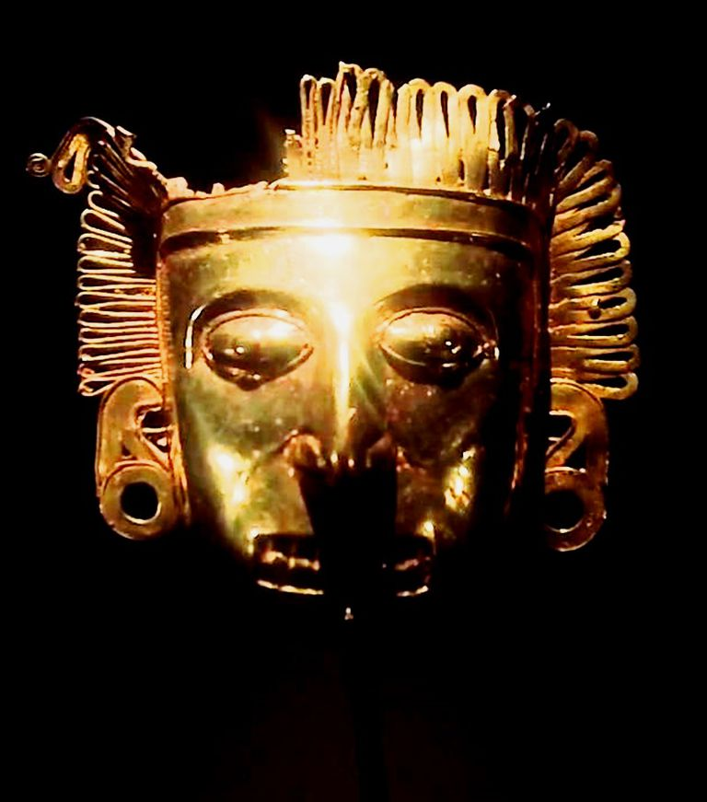
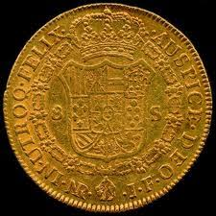
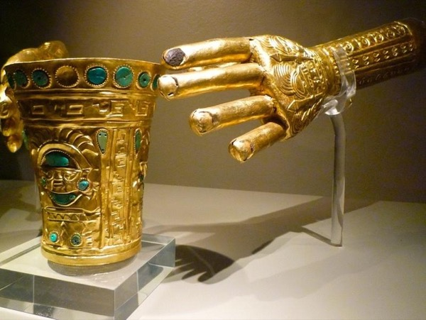
The Spanish conquest of the Aztec empire in Mexico
and the Incan empire in Peru yielded vast amounts of
Gold, previous metals, and jewels.

Slide 22

Eyes were watching however, as the massive amounts
of treasure was transported from the New World to Spain.

Slide 23
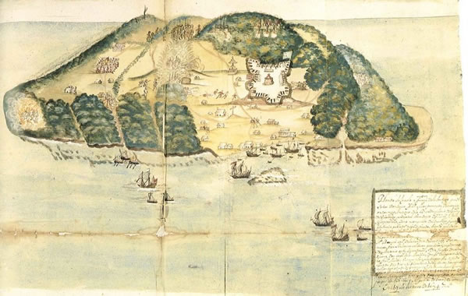
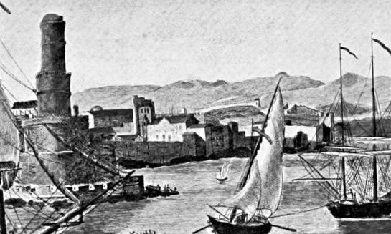
The Golden Age of Piracy was born as British privateers,
sanctioned by the Queen plundered Spanish treasure
galleons and ports.

Slide 24

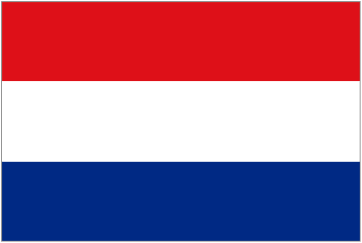

Meanwhile, other nations were busy exploring and
Colonizing the New World!
French
Dutch
English

Slide 25
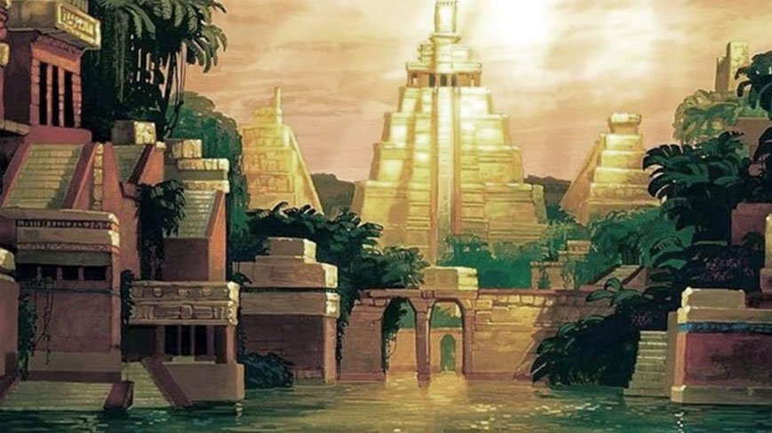
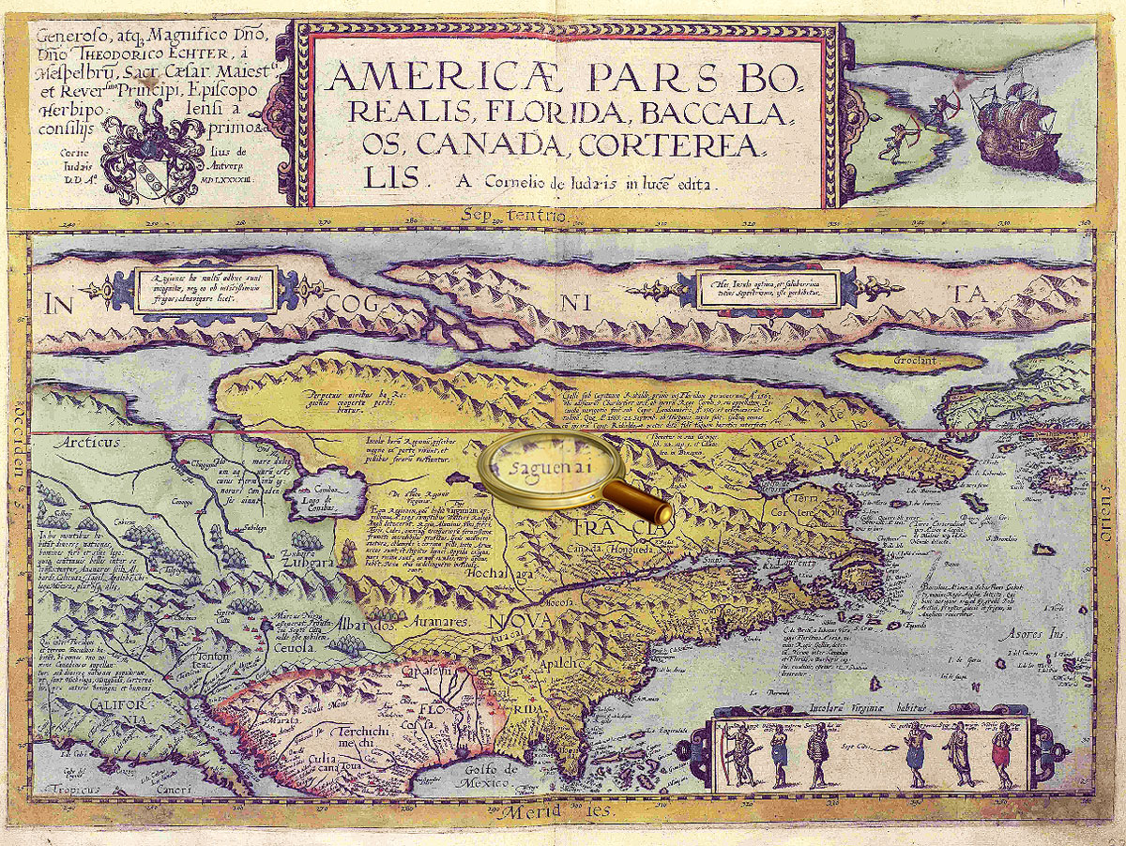
Some explorers searched for mythical places
Spanish explorer Francisco Coronado
Searched for the Seven Cities of Cibola
French explorer Jacques Cartier searched
for the mythical Kingdom of Saguenay

Slide 26
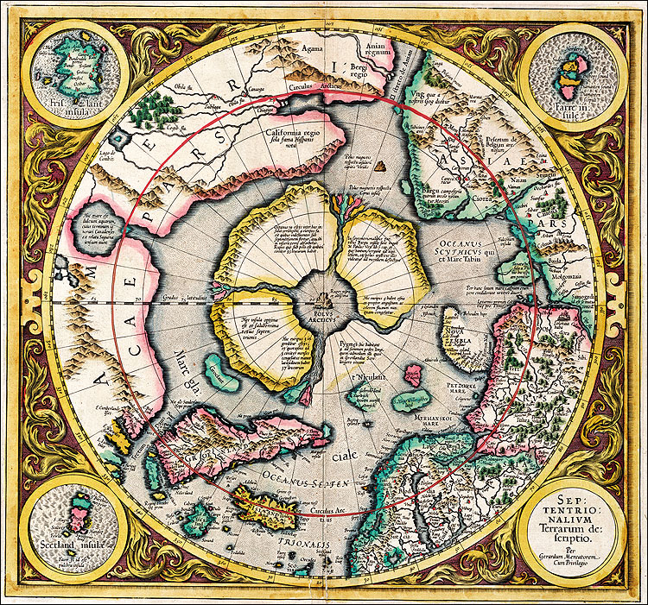
Still others hoped to find the elusive northwest passage – a mythical shortcut from the Atlantic to Pacific Oceans.

Slide 27
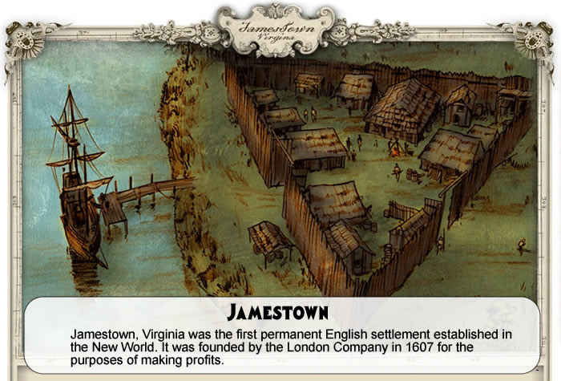
Jamestown, the first ENGLISH settlement in the NEW WORLD was founded in 1607.

Slide 28
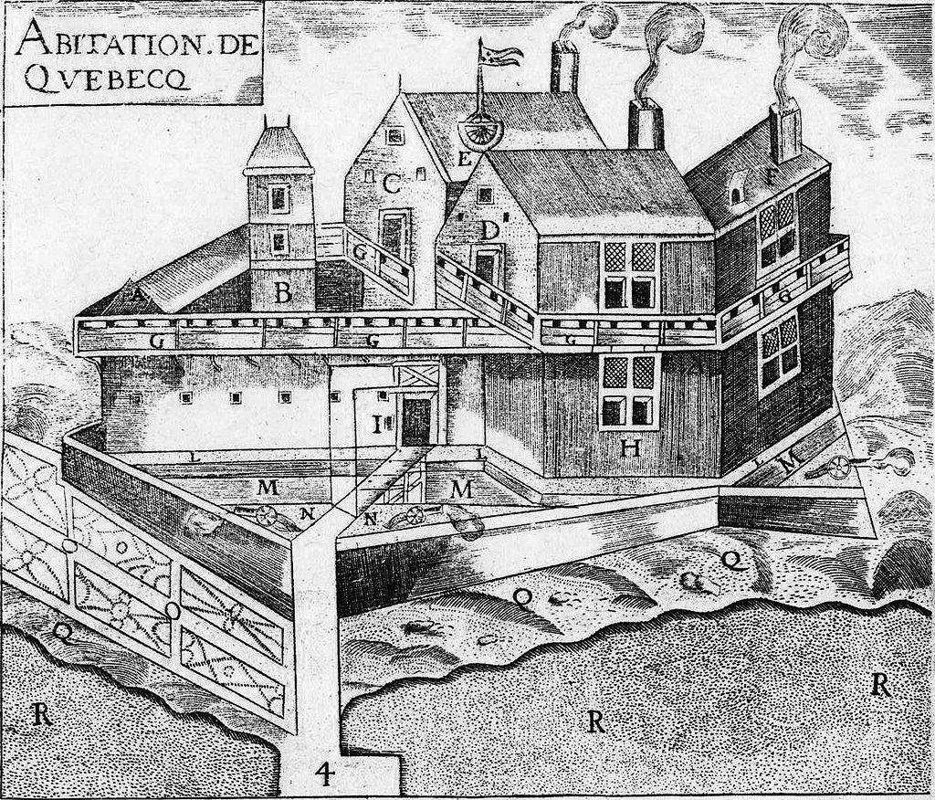
Quebec, the first FRENCH settlement in the NEW WORLD was founded by Samuel de Champlain in 1608 as a fur-trading center.

Slide 29
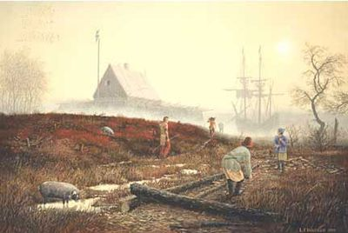
Fort Nassau, the first DUTCH settlement in the NEW WORLD was founded near Albany, New York in 1615.

Slide 30
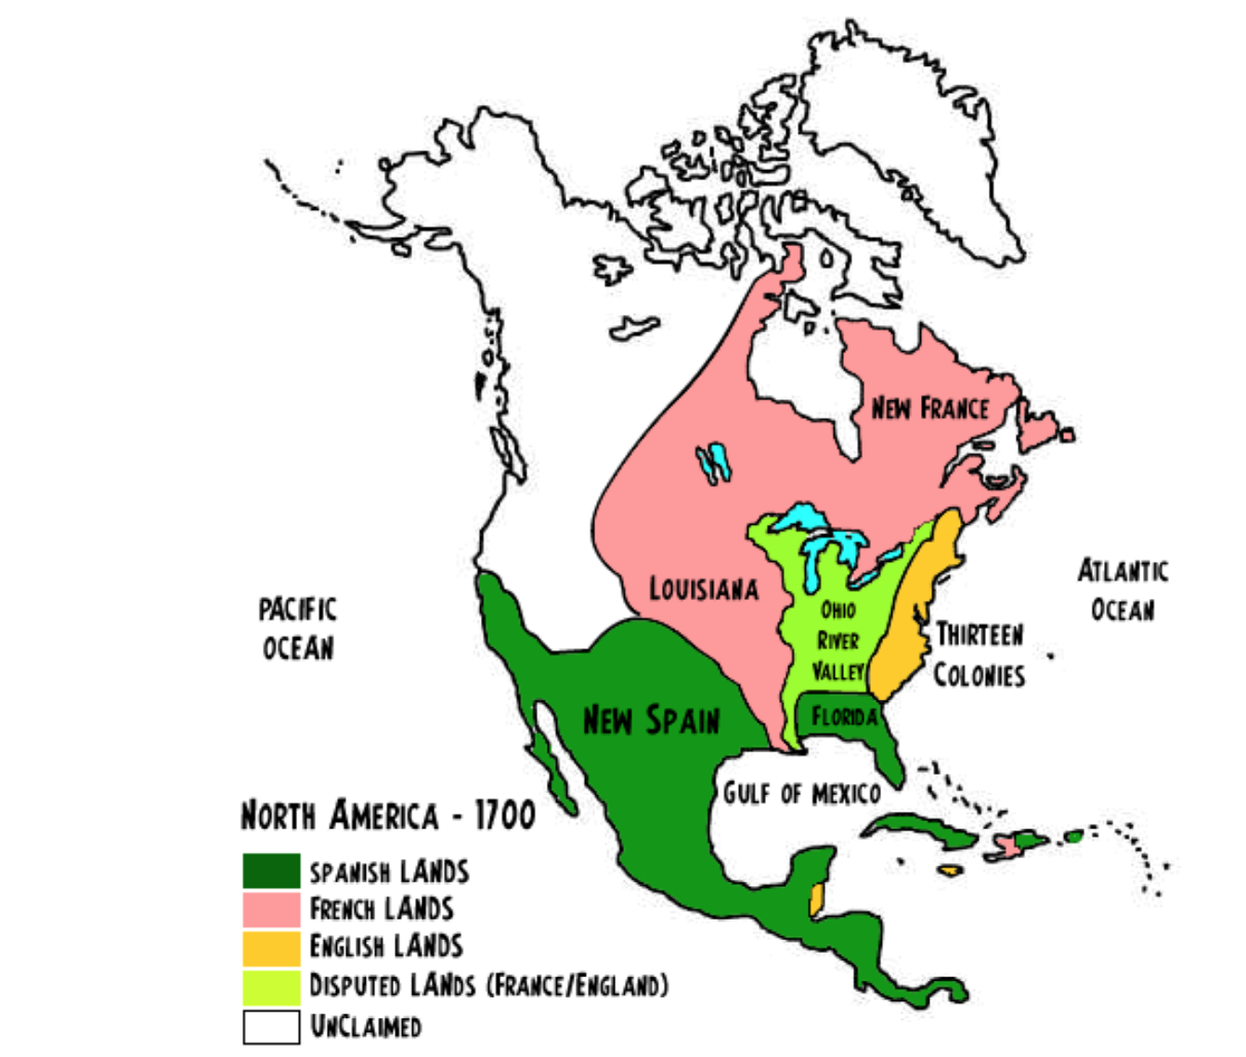
Within 100 years, all of South America and virtually all of North America was claimed by European powers.

Slide 31
The Age of Exploration gave way to the Age of Colonization

