Slide 1
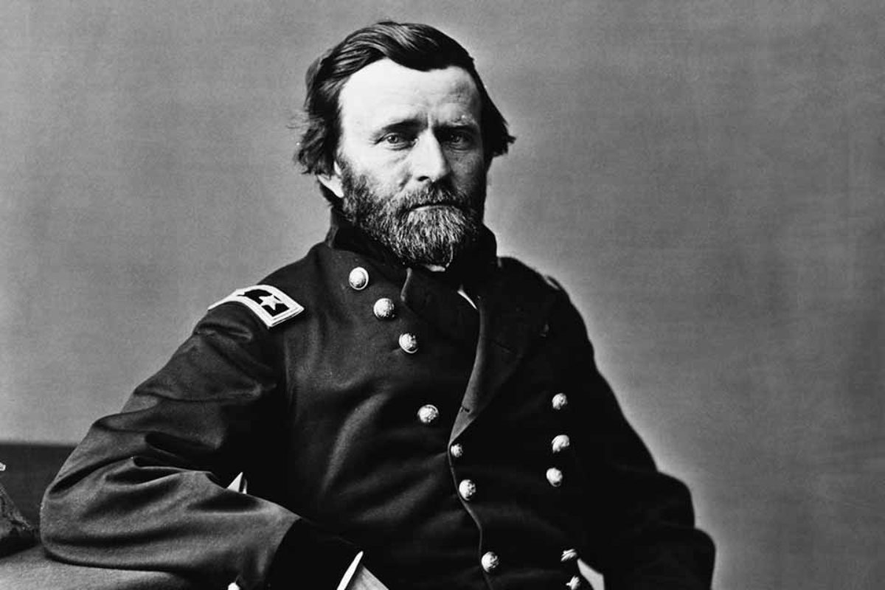

Petersburg and
Richmond

Slide 2
Where are we in the Civil War?
Confederate forces had suffered major defeats at Gettysburg and Vicksburg. The tide of the war had turned toward the Union.
Ulysses S. Grant’s Overland Campaign had weakened Confederate forces in 1864 in a series of devastating battles outside of Fredericksburg and Richmond.
Still, the Confederate capital of Richmond remained elusive for Union forces. Grant would turn his attention to its supply lines from the south, namely Petersburg.
We start in mid-1864

Slide 3
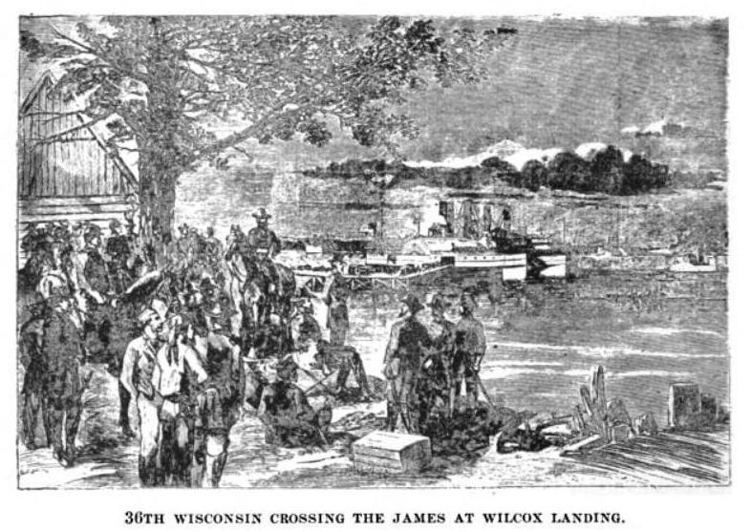
Petersburg
Located about 40 miles south of Richmond.
A Confederate railroad junction and critical supply line to Richmond. The city was supplied by three separate railroad lines.
Union forces under Grant would first try to assault the city, but all assaults were unsuccessful and a new strategy would slowly take hold.
Petersburg

Slide 4
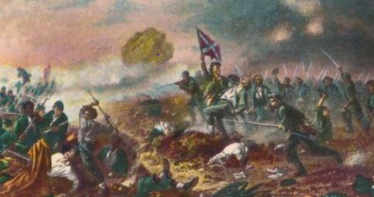
The Crater
Union forces endeavored to try a brand new strategy that took weeks of preparation.
Soldiers built a mine shaft under Confederate defenses that was 50 feet deep and 500 feet long.
It was equipped with a state-of-the-art air exchange system to allow soldiers to breathe fresh air deep underground.
The plan was to fill the mine with over 8,000 pounds of explosives to blow a Confederate fort apart from underground.

Slide 5
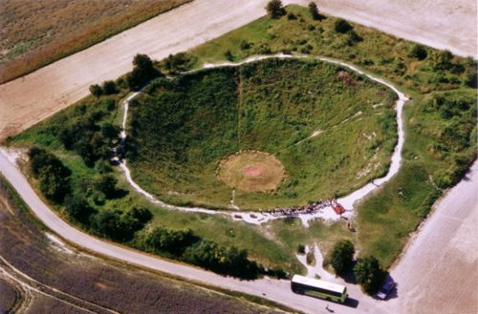
The Crater
On July 30th, at 4:44 A.M., the mine was detonated, immediately killing 278 Confederate soldiers.
It left a permanent crater 170 feet wide and 30 feet deep.
Union soldiers rushed through the mine in an attempt to take the fort. The bewildered Confederates, however, quickly regrouped.
Union soldiers, trapped in a “fishbowl,” made easy targets for Confederate gunners. 500 were killed, wounded, or captured.
The plan was an abject failure.

Slide 6
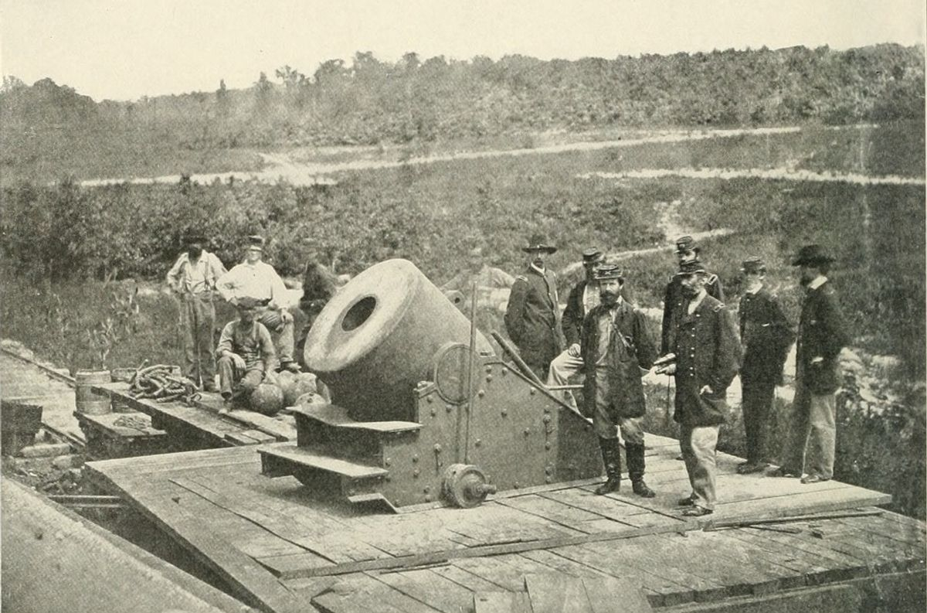
The Siege
Despite the failure at “the Crater,” Union forces proved successful in destroying the railroad lines that led to Petersburg.
Union forces would slowly extend their siege lines around the city.
Operations would be suspended for the winter, but the siege remained in place.
Morale in the Confederate Army declined with the onset of winter, disease, and hunger. Many deserted.

Slide 7
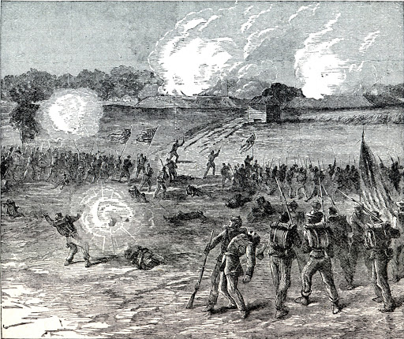
March, 1865
The Union siege took a deadly toll on the Confederates trapped within Petersburg.
By the end of March, the Union advantage in manpower was 125,000 to 50,000
Confederate attempts to break the siege resulted in failures.
Continuous Union assaults on the reeling Confederates resulted in the abandonment of Petersburg. Lee’s army fled to the southwest. Richmond was doomed. The Confederate government was forced to pack up and abandon Richmond.

Slide 8
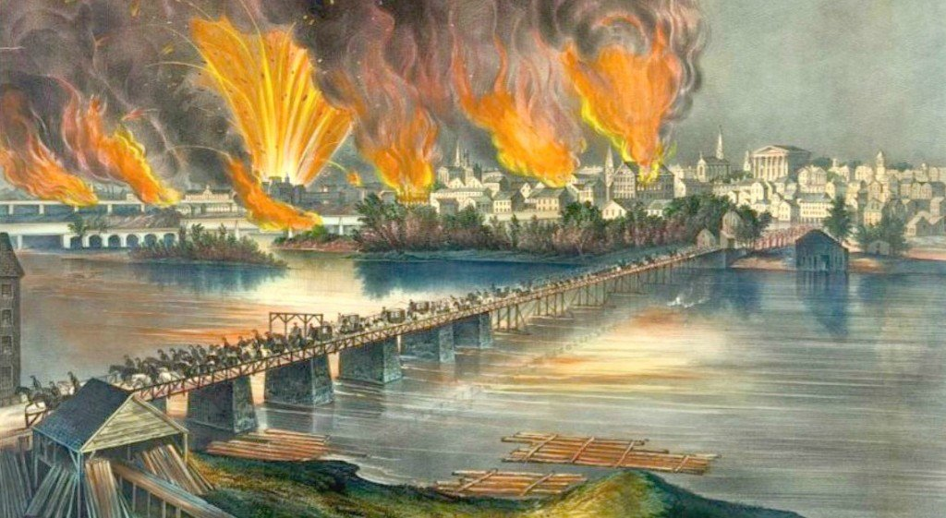
April 2, 1865
With the capture of Petersburg, Union forces occupied Richmond, the Confederate capital.
The fleeing Confederates set fire to bridges, armories, and supply stores.
The fire raged out of control and burned much of the capital city.
On April 4th, President Abraham Lincoln visited Richmond in a surreal scene. The newly liberated former slaves considered him their savior.

Slide 9
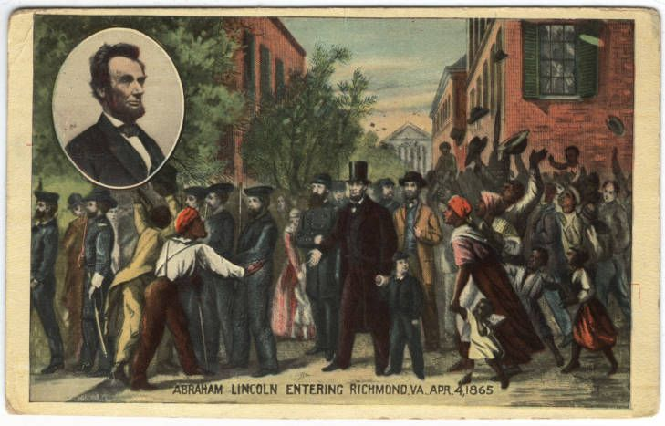
April 4, 1865
"Don't kneel to me," he told them, "You must kneel only to God, and thank him for your freedom. Liberty is your birthright. God gave it to you as he gave it to others, and it is a sin that you have been deprived of it for so many years."

