Slide 1
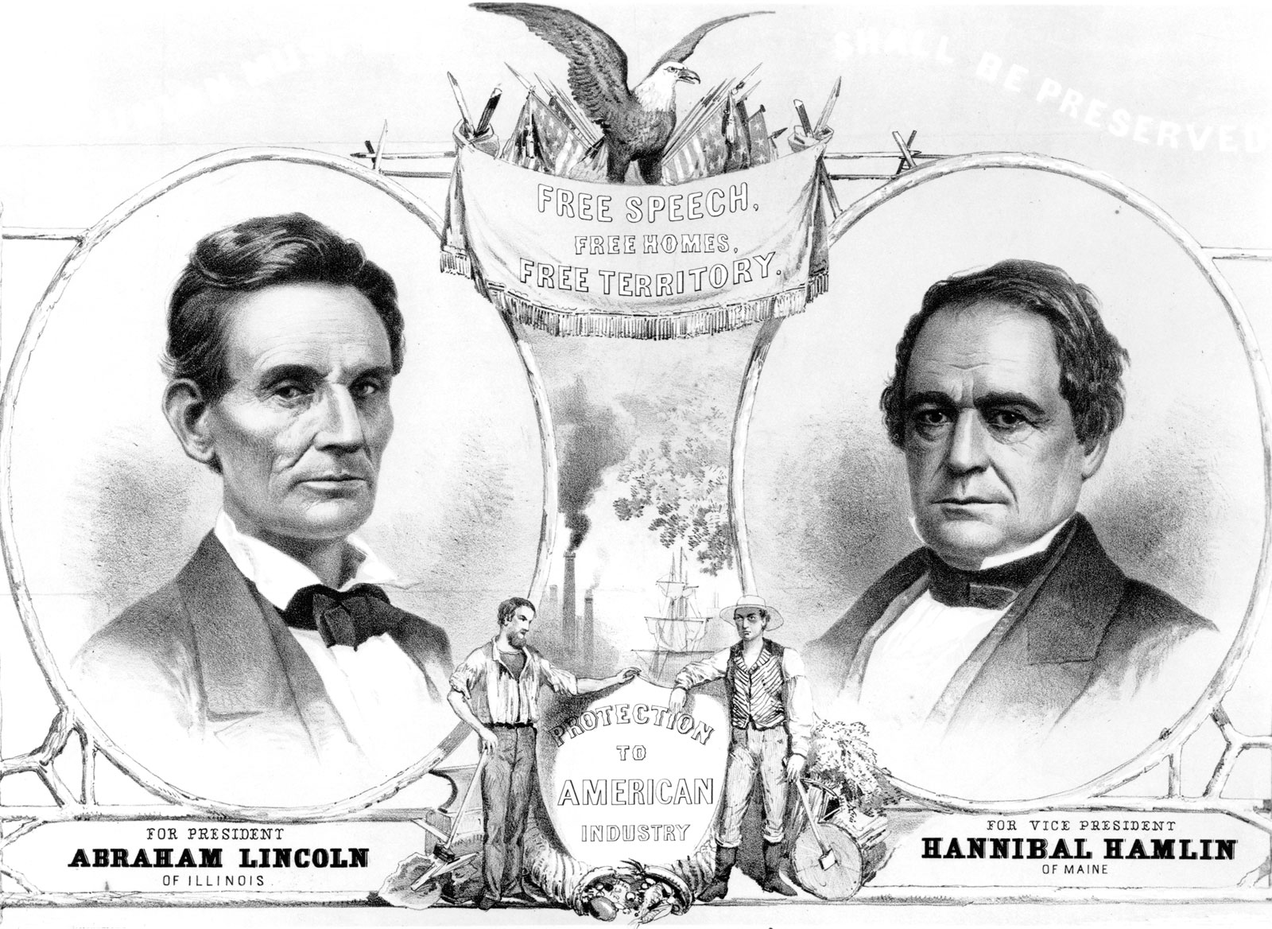

The Election of 1860 and Secession of Southern States
Causes of the Civil War

Slide 2
Where are we in the path to Civil War?
The Dred Scott Decision handed down by the United States Supreme Court reaffirmed that slaves were considered property and had no personal or civil rights. It also declared the territorial limits on slavery as defined by the Missouri Compromise unconstitutional.
The John Brown Rebellion made things even worse between the North and the South. Many in the South believed it to be a government conspiracy to free slaves and destroy the Southern Economy and way of life.
We Start in 1860

Slide 3
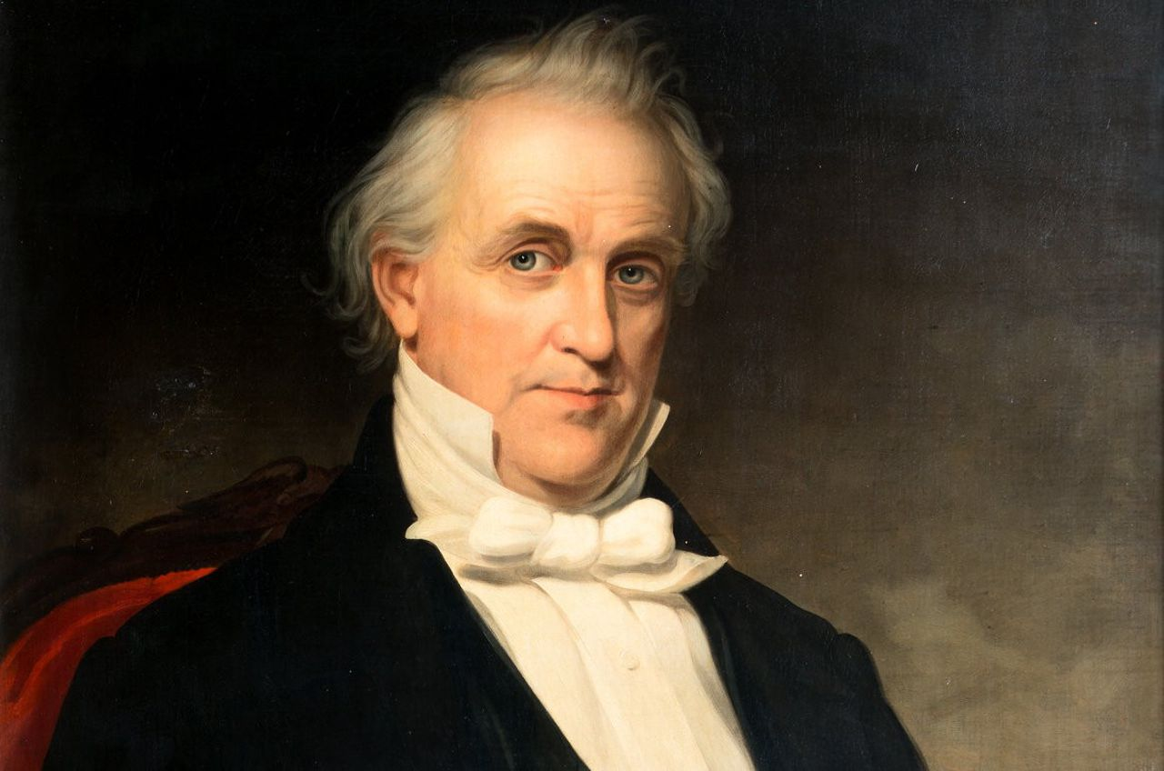
Who was James Buchanan?
15th President (1857-1861)
He was a Pennsylvanian who sympathized with Southern slaveholders
Considered one of the worst presidents in American history
Only President without a first lady
Failed to stem the rising tide of Civil War and failed to stop the secession of Southern states.
Did not seek a second term in office.

Slide 4
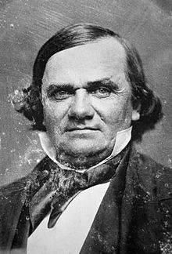
Northern Democrats
The Democratic Party had split into Northern Democrats and Southern Democrats
The Northern Democrats believed in popular sovereignty. Popular sovereignty simply means that people in the state or territory vote on whether to allow slavery.
Nominated “the little giant,” Stephen A. Douglas as their candidate for president.

Slide 5
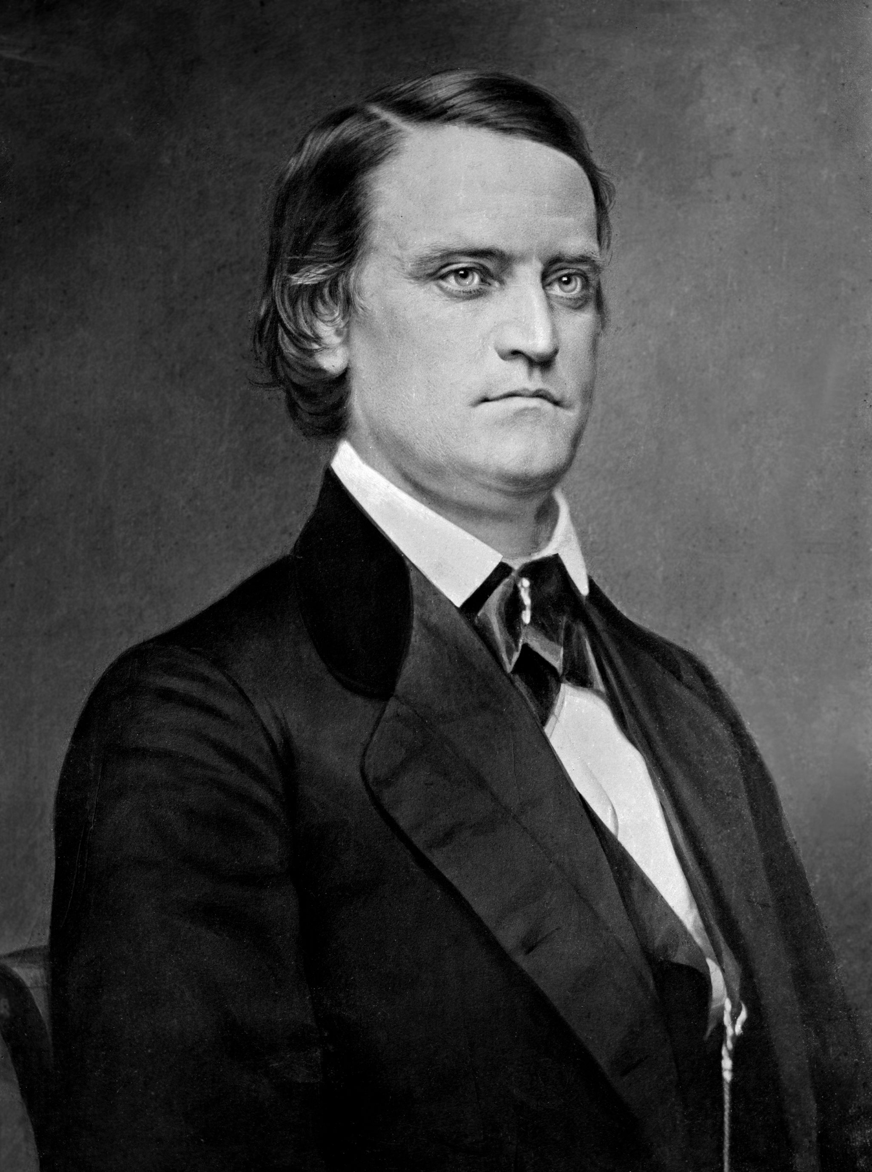
Southern Democrats
Believed the slavery was “national” and any attempt to marginalize it were illegal and unconstitutional.
They nominated John C. Breckenridge as their candidate for President.
The Southern Democrats would eventually become the party that instituted Jim Crow Laws in the South and that terrorized Black voters.

Slide 6
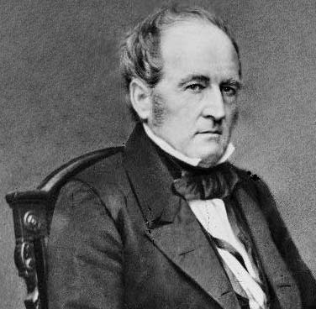
Constitutional Union Party
Made up largely of Southerners who opposed secession over the slavery issue.
Formed by former Whigs after the collapse of that party.
Believed in a strict interpretation of the United States Constitution.
Opposed both Republicans and Democrats
Nominated John Bell as President.

Slide 7
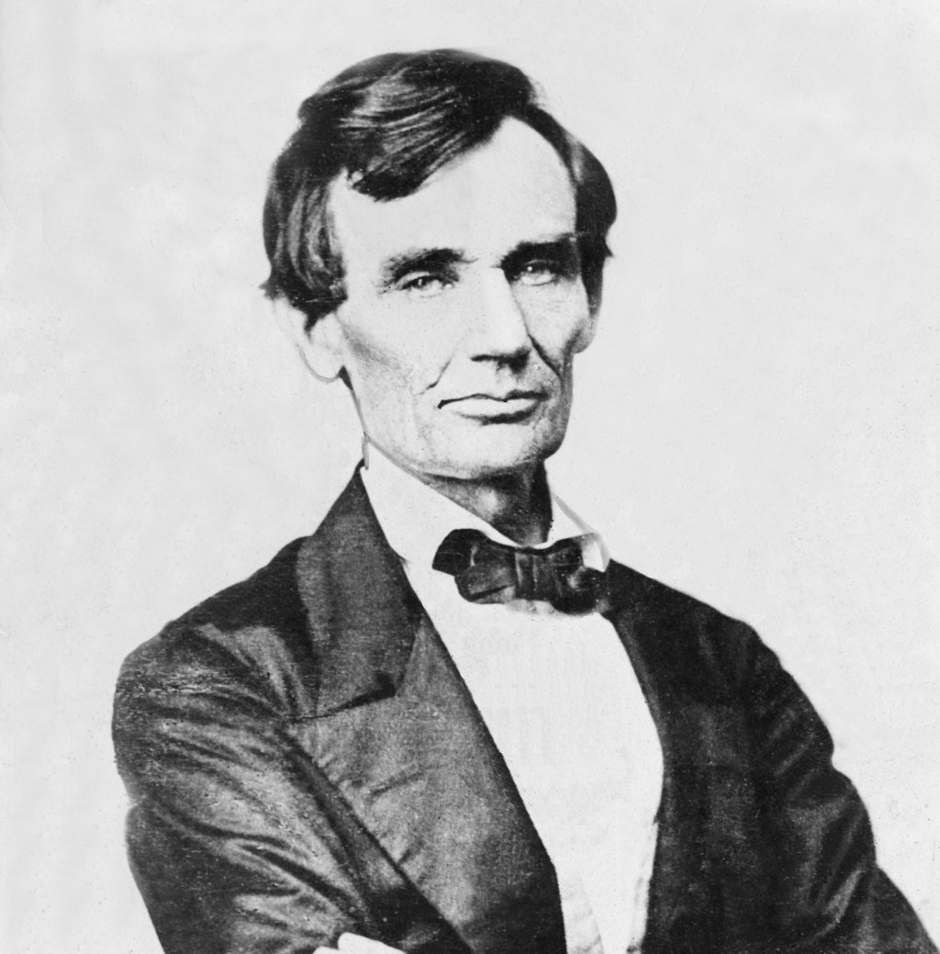
Republican Party
Northern politicians who favored limiting or abolishing slavery.
In a shocking development at the Republican National Convention, the Republicans nominated Abraham Lincoln as President over more well-known politicians such as William H. Seward and Salmon P. Chase.
Lincoln became known as the “rail candidate.”

Slide 8
The Election
Abraham Lincoln won the election with only 40% of the popular vote
He won 17 states including Pennsylvania, Ohio, and New York – the states with the highest electoral values.
Omitted from the ballot in all but two Southern States
He was the first Republican President.

Slide 9
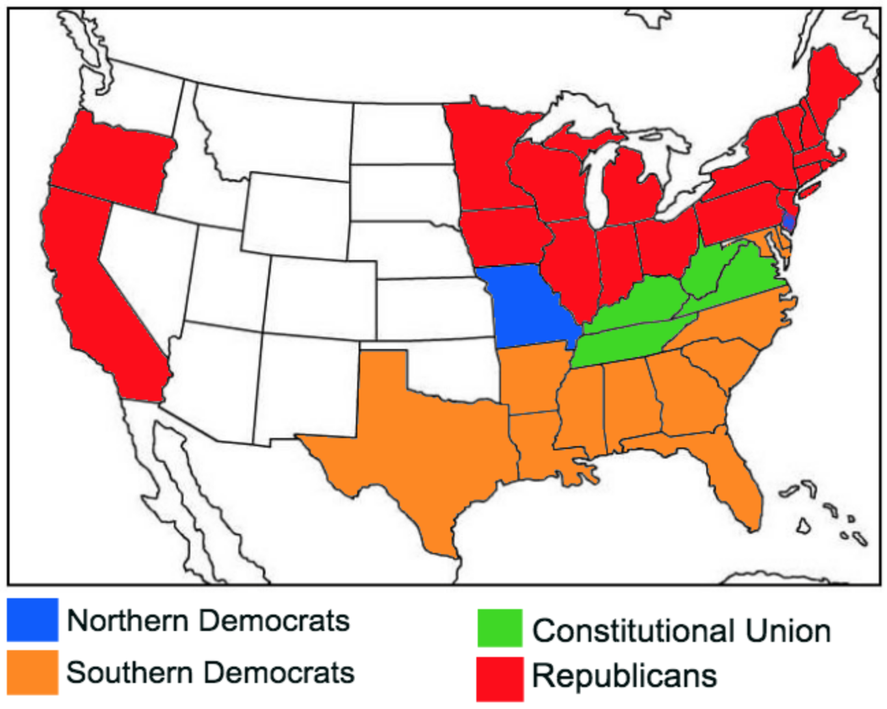
Electoral Map

Slide 10
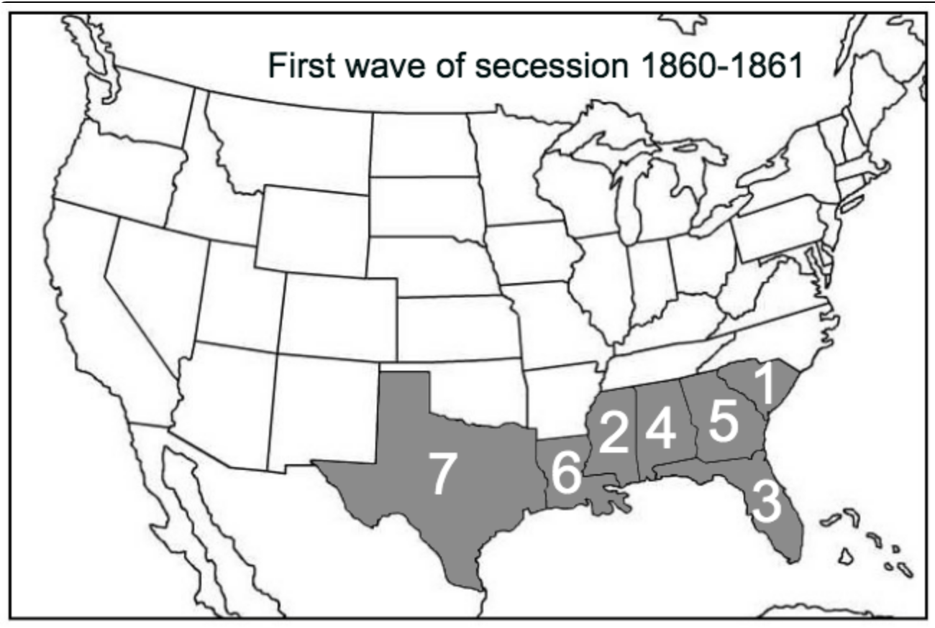
What did Lincoln’s Election Mean?
To the Southern states, it meant a certain limit on slavery and eventual prohibition of it.
South Carolina issued its Declaration of Secession on December 20, 1860, becoming the first state to secede from America. This meant it voted to leave the United States.
Six other states would soon follow South Carolina’s lead.
Civil War was a certainty

Slide 11
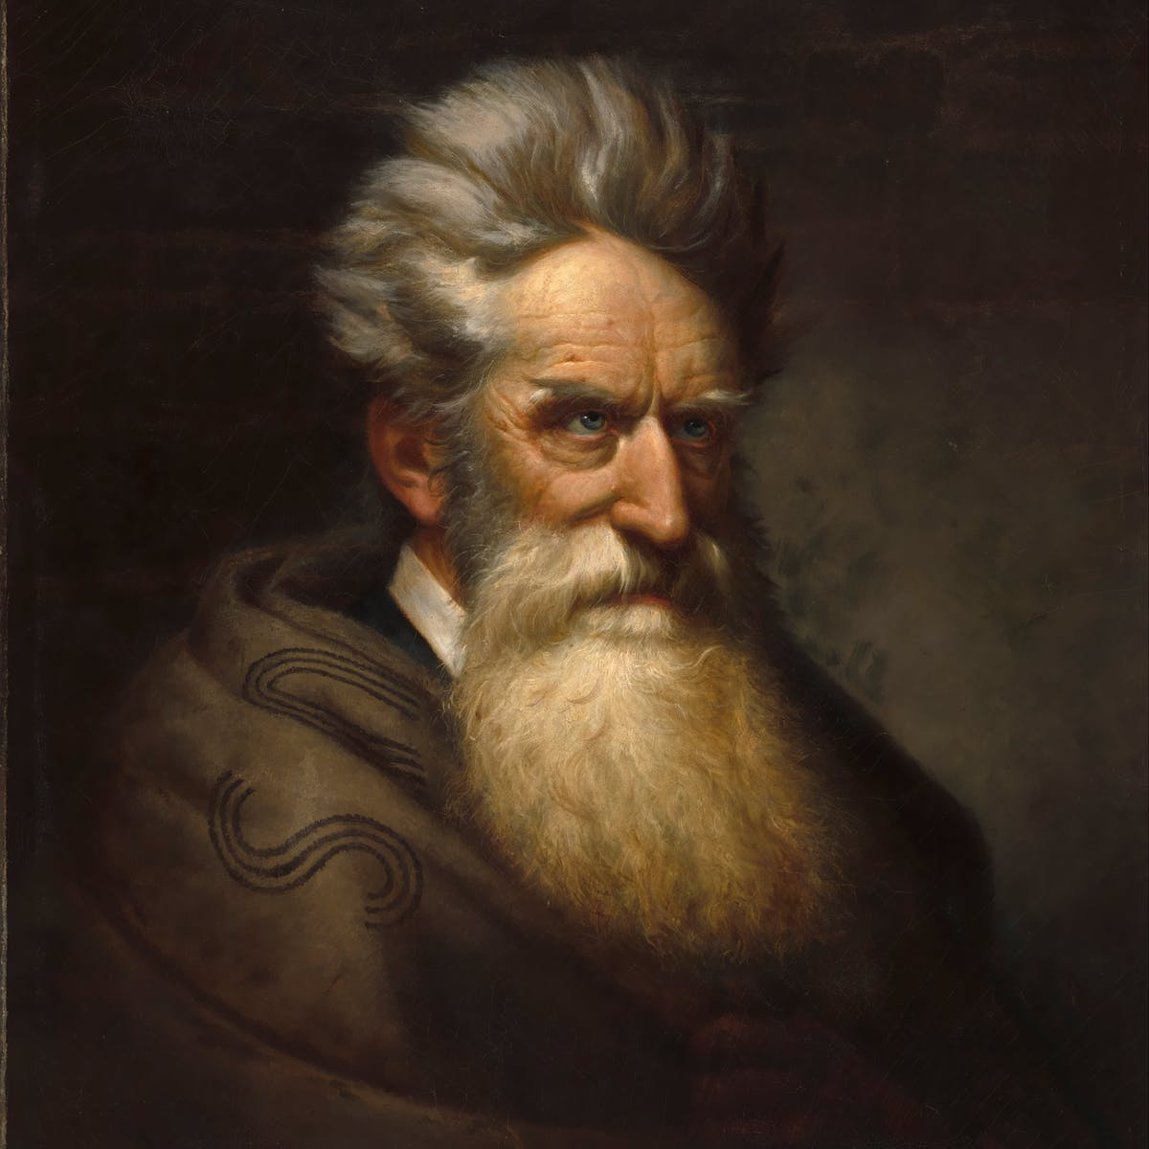
Effect of the John Brown Rebellion
Relations between the North and South deteriorated further.
Many southerners believed the John Brown Rebellion was sanctioned by the U.S. Government in an attempt to free the slaves.
Because no slaves had volunteered to help in the rebellion, Southern slaveholders took this to mean that slaves were content in their condition.

