Slide 1
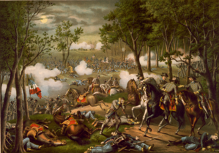

The Rise of the
Confederacy:
Twin Victories at
Fredericksburg and
Chancellorsville

Slide 2
Where are we in the Civil War?
The Confederate attempt to assert its will in the North was thwarted at Antietam, the bloodiest one-day battle in American history. Foreign recognition for the Confederacy would have to wait.
Following the Battle of Antietam, which was actually a tactical draw, President Abraham Lincoln issued his landmark Emancipation Proclamation, freeing all slaves in “enemy territory” and guaranteeing the end of slavery should America win the war.
We start in late 1862.

Slide 3
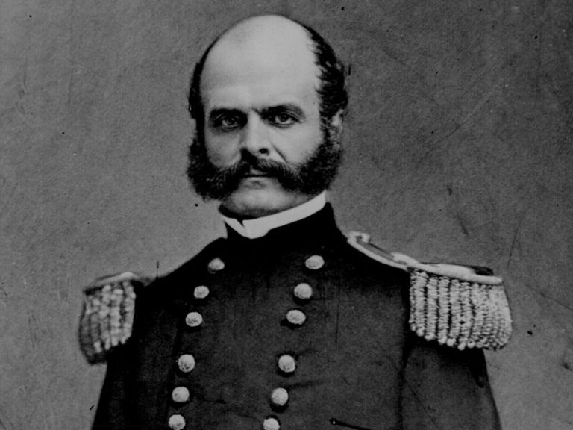
December 1862
President Lincoln had grown tired of General McClellan’s inaction, excuses, and insubordination, and replaced him as Commander of the Army of the Potomac with General Ambrose Burnside.
Following Antietam, Union forces endeavored to move on the Confederate capital of Richmond.
A move on Richmond first required Union forces to defeat Confederate armies that had collapsed north of Richmond along the Rappahannock River in and around the town of Fredericksburg.
Ambrose Burnside

Slide 4
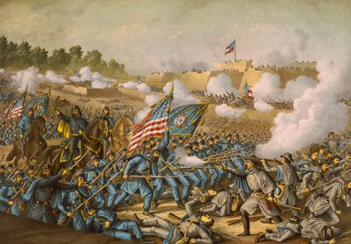
December 11-15 1862
As the Army of the Potomac neared, Confederate General Robert E. Lee ordered his forces to occupy the high ground around Fredericksburg.
Union General Burnside ordered repeated assaults on the heights, resulting in mass casualties for both sides. Union forces were unable to dislodge the Confederates from their positions and hence, could not make progress toward Richmond.
A truce was called on December 14th, so both sides could tend to the injured and dead. Burnside made the decision to retreat to the north side of the Rappahannock River.
The Battle of Fredericksburg, thus, was a decisive Confederate victory and an embarrassment for the Union.

Slide 5
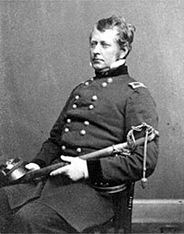
Take II
Following the destruction at Fredericksburg, Lincoln appointed Joseph Hooker as Commander of the Army of the Potomac.
The Union strategy continued to center on the Confederate capital of Richmond. Lincoln believed that if Richmond could be taken, the war would quickly end.
Unfortunately, Hooker was inexperienced, brash, and ill-suited for such a massive responsibility.

Slide 6
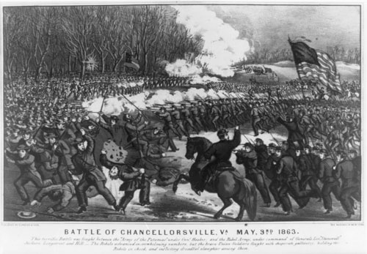
The Plan
Hooker decided to launch a massive assault on Confederate positions from both the front and rear.
Hooker’s Army was twice the size of Lee’s Army of Northern Virginia.
The battle would center just a few miles from the Battle of Fredericksburg, at a tiny hamlet known as Chancellorsville.

Slide 7
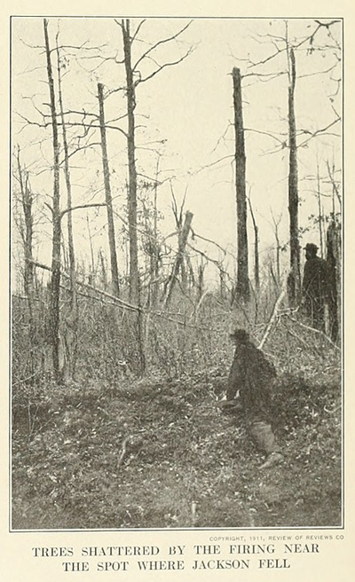
Confederate Dominance
Robert E. Lee, realizing he was outnumbered, decided to split his army, and attacked Hooker with about 80 percent of his forces.
The inexperienced Hooker was likely confused by Lee’s maneuvers, and inexplicably ordered his forces to retreat and take defensive positions during Lee’s assaults.
On May 2, 1863, Confederate General Stonewall Jackson routed Union forces, who were eating dinner, crushing its right flank!
That night, however, Jackson was accidently shot in the arm by one of his own men. He would develop pneumonia and die a week later. Jackson’s death was a major blow to the Confederate Army.

Slide 8
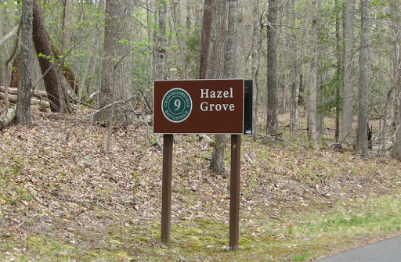
Union Incompetence
Despite the setbacks, Union forces still had a major advantage in manpower at Chancellorsville. Hooker’s army, which had occupied the high ground at Hazel Grove, numbered 76,000 – compared to only 43,000 men available to Lee.
Hooker (again) inexplicably ordered his men off the high ground, which was immediately occupied by Confederate forces with their heavy guns and artillery.
Confederate forces engaged in a massive attack on May 3rd, aided by their newly installed guns, which sparked fires in the nearby forests, and which overwhelmed their counterparts.
Hooker ordered a retreat north of the Rappahannock River, resulting in a second decisive Confederate victory.

Slide 9
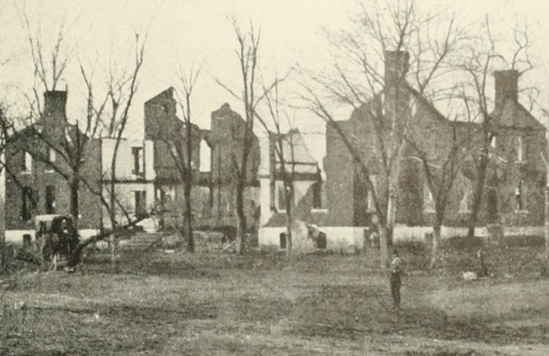
Effect of the Battle
Chancellorsville is often called “Lee’s Greatest Victory.”
Lee believed his army was “invincible” and that it was God’s will for his army to defeat the enemy wherever it fought.
Lee endeavored to invade the North again, setting the stage for the epic Battle of Gettysburg.
Joseph Hooker would be replaced as Commander of the Army of the Potomac by George Meade.
Support for the continuation of the war began to wane in the North.

Slide 10
Activities
Battle of Chancellorsville Reading Comprehension - Online - This activity requires includes a reading passage and seven multiple choice questions. It gives immediate feedback .
Battle of Chancellorsville Reading Comprehension - Printable - This activity requires includes a reading passage and seven multiple choice questions. The answers are included in the PDF.
Lee's Greatst Victory - Writing Prompt - This activity requires students to relate to Lee's "Greatest Victory" at Chancellorsville, by describing their greatest moment at sports, music, dance, or even video games.
Famous Last Words -This activity describes Stonewall Jackson's famous last words after being shot at the Battle of Chancellorsville and challenges students to pen their own final words, or, those of a character in movies or literature.

