Slide 1
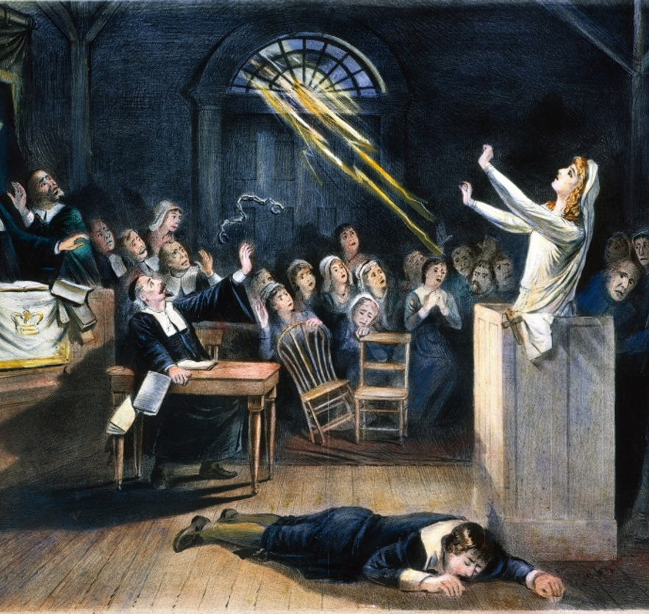
The Salem Witch Trials (1692–1693)
https://learnaboutamerica.com

Slide 2

LearnAboutAmerica.com
*For our presentations, lesson plans, articles, printables, interactives, stories, and games related to the Salem Witch Trials, please visit:
https://learnaboutamerica.com/american-history/13-colonies/events-of-the-13-colonies/salem-witch-trials
* For the greatest American History website for teachers, parents, and students, visit:
https://learnaboutamerica.com

Slide 3
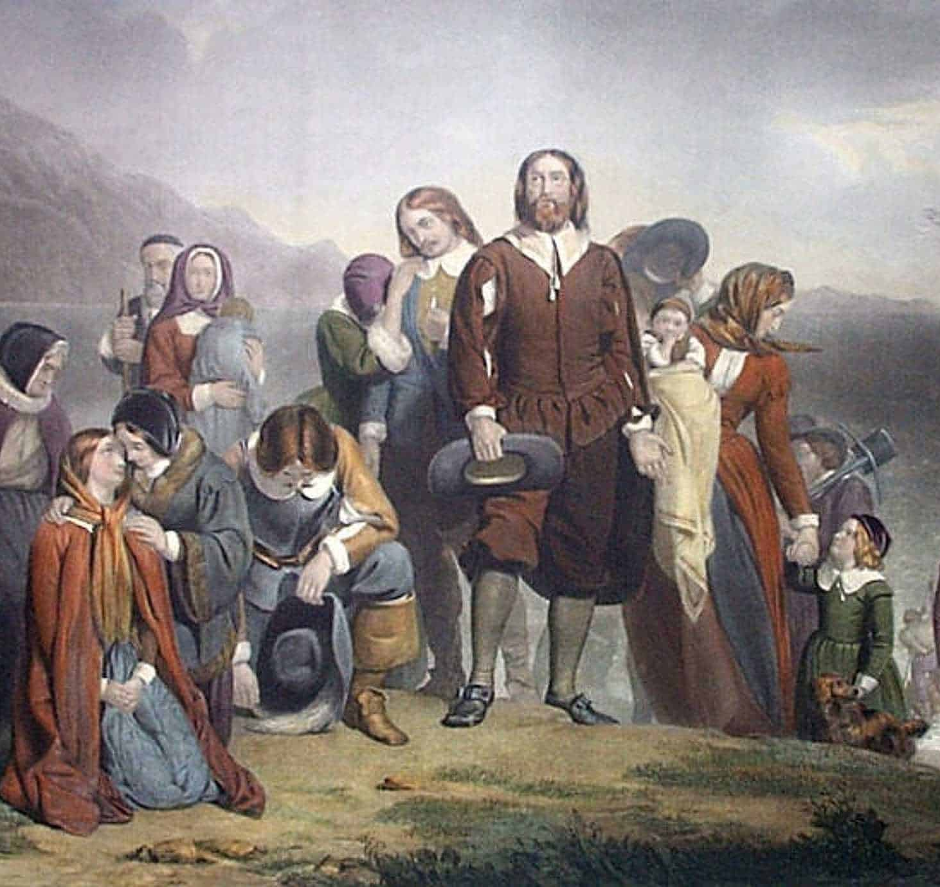
Life in Puritan New England
Puritans lived strict, religious lives
They believed God controlled events
Illness and misfortune were often blamed on sin
Superstitions were common

Slide 4
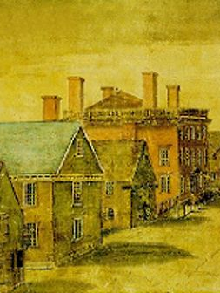
Where Did the Trials Take Place?
Mainly in Salem Village and Salem Town
Located in Massachusetts Bay Colony
Tension existed between rural and town residents
Economic and social conflicts added stress

Slide 5
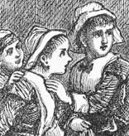
How Did the Accusations Begin?
Young girls showed strange behavior
Doctors could not explain the illness
Witchcraft was blamed
Accusations quickly spread

Slide 6
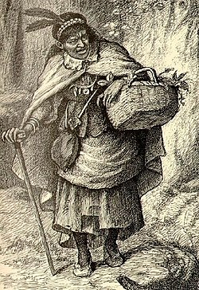
Who Was Accused?
Women, men, and even children
Often social outsiders
Some were accused because of grudges
No one was truly safe

Slide 7
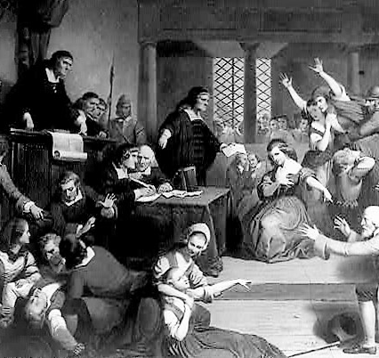
The Trials and Evidence Used
Special courts were created
Spectral evidence was allowed
Accused people had few rights
Confessions were sometimes forced

Slide 8
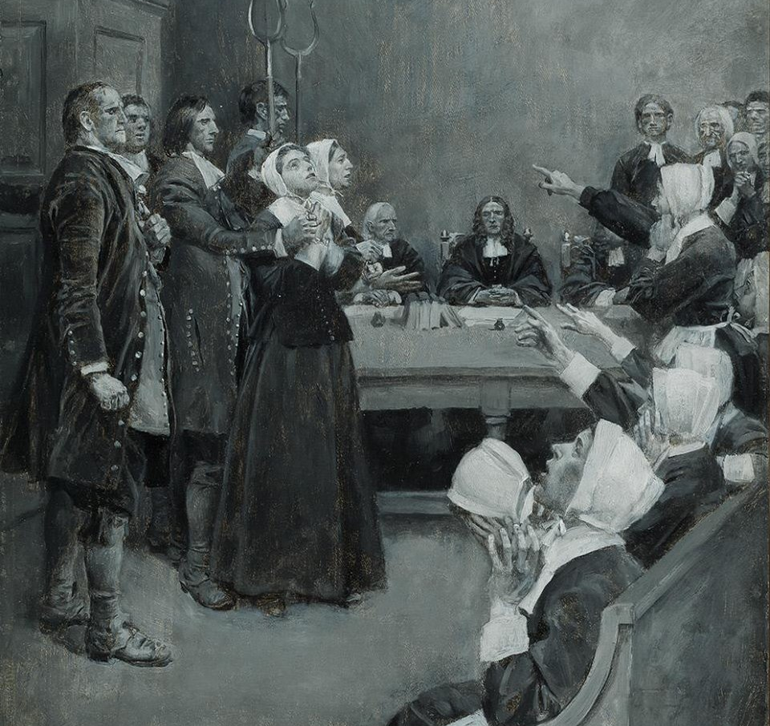
Punishments and Executions
19 people were hanged
One man was pressed to death
Others died in prison
Fear led to tragic outcomes

Slide 9
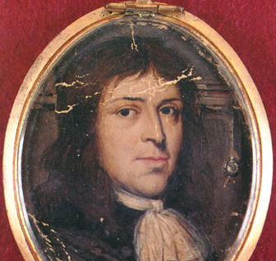
Why Did the Trials End?
Leaders began to question the evidence
Public opinion started to change
Governor ended the trials
Courts later admitted mistakes

Slide 10
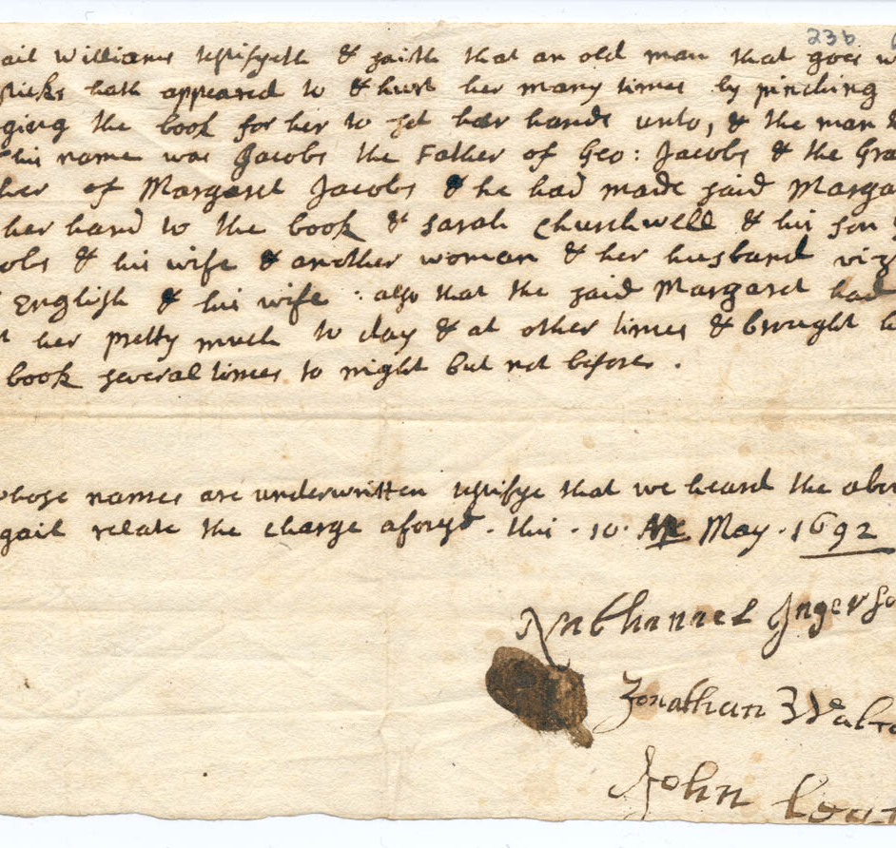
Impact of the Salem Witch Trials
Showed dangers of fear and mass hysteria
Innocent lives were lost
Damaged trust in government and courts
Became a warning from history

Slide 11
Lessons from the Salem Witch Trials
Fear can override reason
Accusations need strong evidence
Protecting rights is important
History can teach us to think critically

