Slide 1
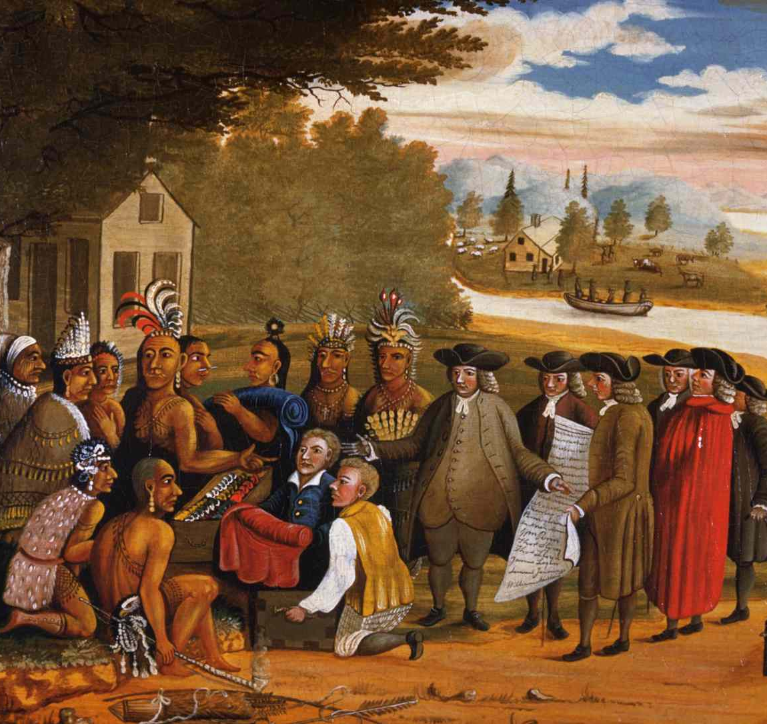
William Penn and the Quakers
https://learnaboutamerica.com

Slide 2

LearnAboutAmerica.com
*For our presentations, lesson plans, articles, printables, interactives, stories, and games related to the Quakers, please visit:
https://learnaboutamerica.com/american-history/13-colonies/people-of-the-13-colonies/who-were-the-quakers
* For the greatest American History website for teachers, parents, and students, visit:
https://learnaboutamerica.com

Slide 3
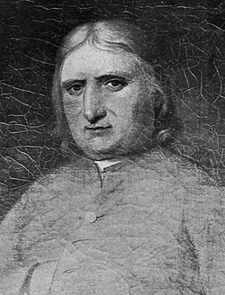
George Fox and the Beginnings of Quakerism
George Fox founded the Quaker faith
Believed God spoke directly to individuals
Experienced spiritual 'openings'
Traveled across Europe spreading his beliefs

Slide 4
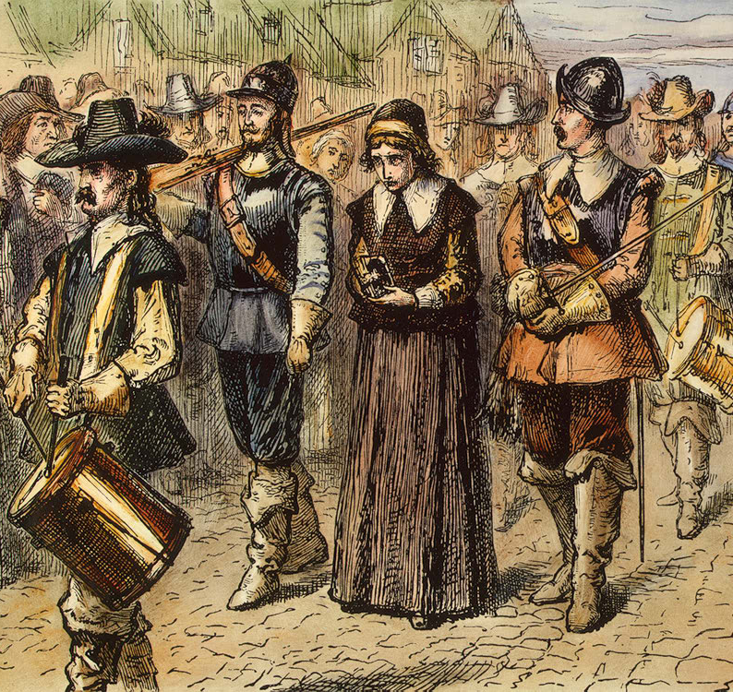
Persecution of Early Quakers
Fox was imprisoned for blasphemy
Followers were harassed and punished
The name 'Quaker' began as an insult
They were said to tremble during prayer

Slide 5
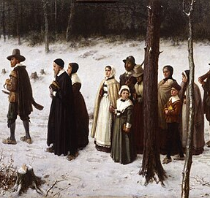
Quaker Beliefs vs. Puritan Beliefs
Quakers rejected church hierarchy
Believed in direct connection to God
Women seen as spiritually equal to men
Rejected mandatory church attendance

Slide 6
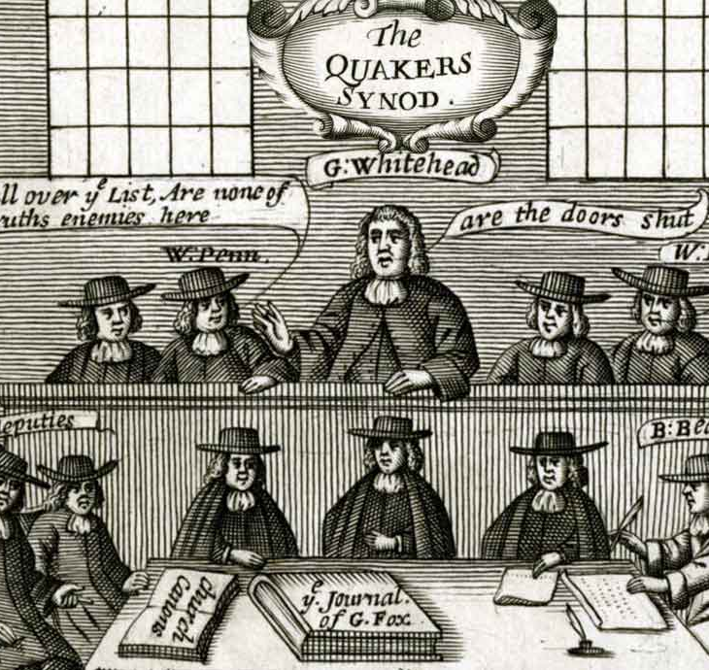
Other Core Quaker Beliefs
Pacifism – refusal to fight in wars
Rejected religious taxes and ceremonies
Refused to swear oaths or sign legal papers
Focused on simple worship

Slide 7
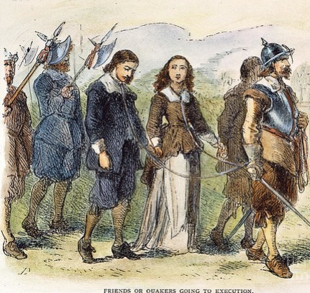
The Boston Martyrs
Quakers faced persecution in New England
Mary Dyer executed in 1660
Three Quakers executed by Puritans
Known as the Boston Martyrs

Slide 8
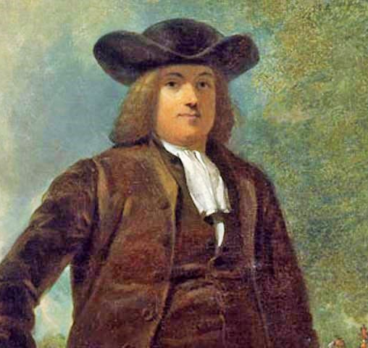
William Penn and the Holy Experiment
William Penn became a Quaker
King Charles II owed Penn’s father money
Penn received 29 million acres of land
Land became the colony of Pennsylvania

Slide 9
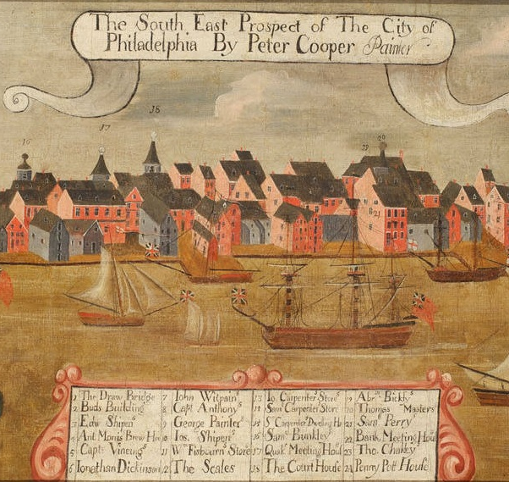
Pennsylvania: A Refuge for the Persecuted
Pennsylvania welcomed many religions
Included Quakers, Jews, and Mennonites
Promoted religious freedom
Large numbers of settlers arrived

Slide 10
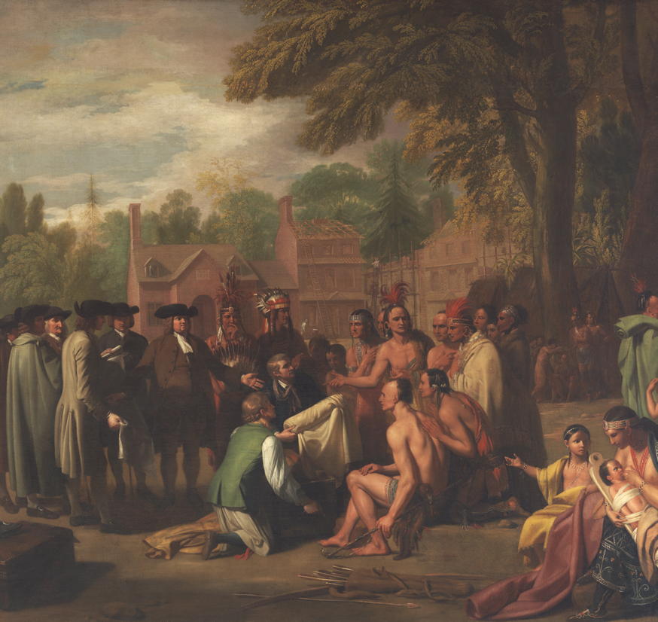
Quakers and Native Americans
Quakers promoted fair treatment
Purchased land instead of taking it
Maintained peaceful relations
Respected Native American rights

Slide 11
Quaker Legacy
Opposed slavery
Helped enslaved people escape
Supported the Underground Railroad
Focused on service and community improvement

