Slide 1
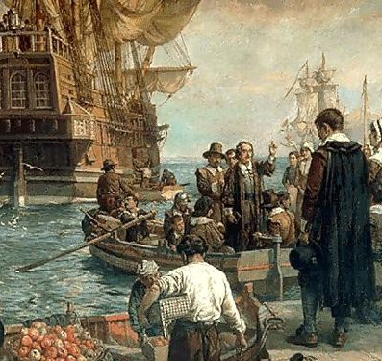
The Puritans of New England
https://learnaboutamerica.com

Slide 2

LearnAboutAmerica.com
*For our presentations, lesson plans, articles, printables, interactives, stories, and games related to the Puritans, please visit:
https://learnaboutamerica.com/american-history/13-colonies/events-of-the-13-colonies/life-in-puritan-massachusetts
* For the greatest American History website for teachers, parents, and students, visit:
https://learnaboutamerica.com

Slide 3
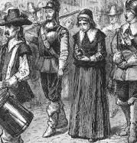
Who Were the Puritans?
English Protestants who wanted to purify the Church of England
Believed the church still had too many Catholic traditions
Faced persecution in England
Came to America to practice their religion freely

Slide 4
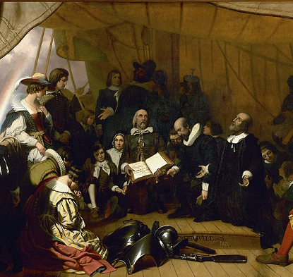
Why Did the Puritans Come to New England?
Wanted religious freedom for their beliefs
Sought to build a godly society
Believed they were creating a model Christian community
New England offered land and distance from English control

Slide 5
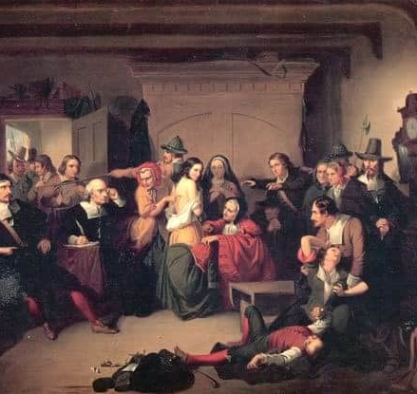
Puritan Beliefs
Bible was the ultimate authority
Valued hard work, discipline, and self-control
Church attendance was required
Entertainment and luxury were discouraged

Slide 6
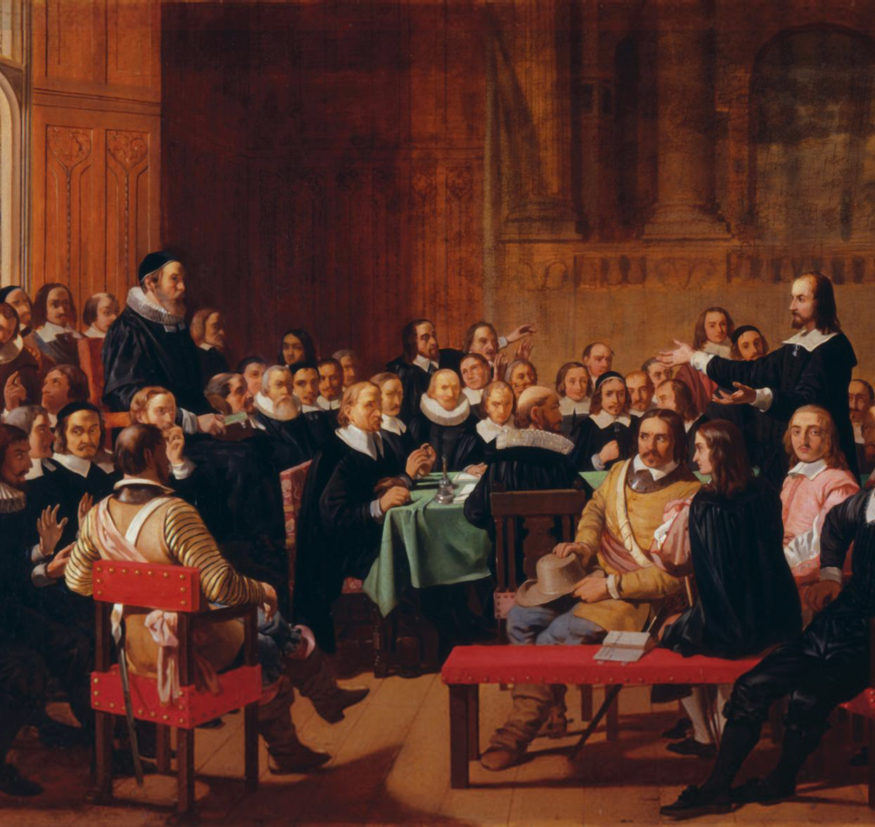
Puritan Government and Society
Church and government were closely connected
Only church members could vote in many towns
Laws were based on religious beliefs
Community behavior was closely monitored

Slide 7
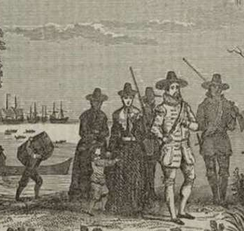
Daily Life in Puritan New England
Most lived in small towns and villages
Families worked together on farms or trades
Education was important to read the Bible
Harvard College was founded by Puritans

Slide 8
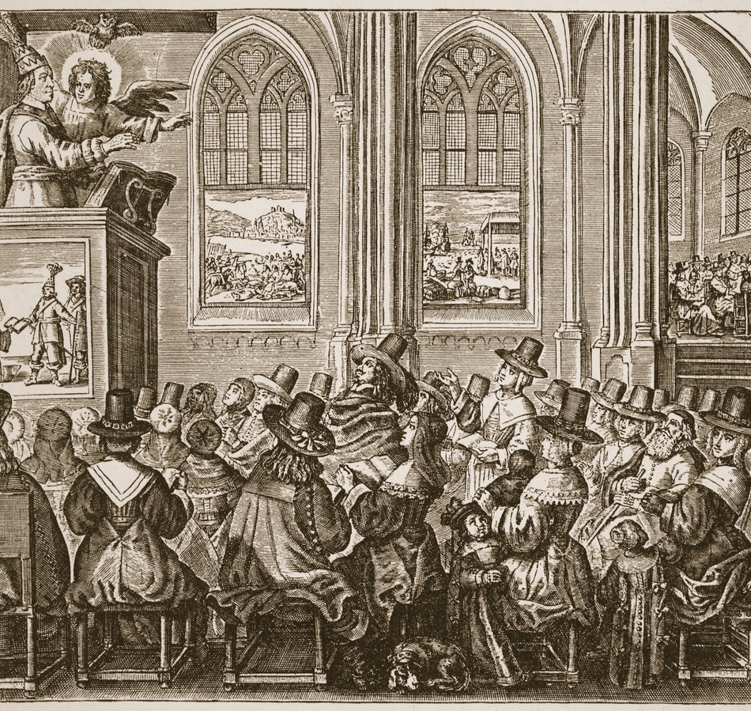
Puritan Religion in Practice
Long and serious church services
Ministers were powerful leaders
Sermons focused on sin and obedience
Religious dissent was not tolerated

Slide 9
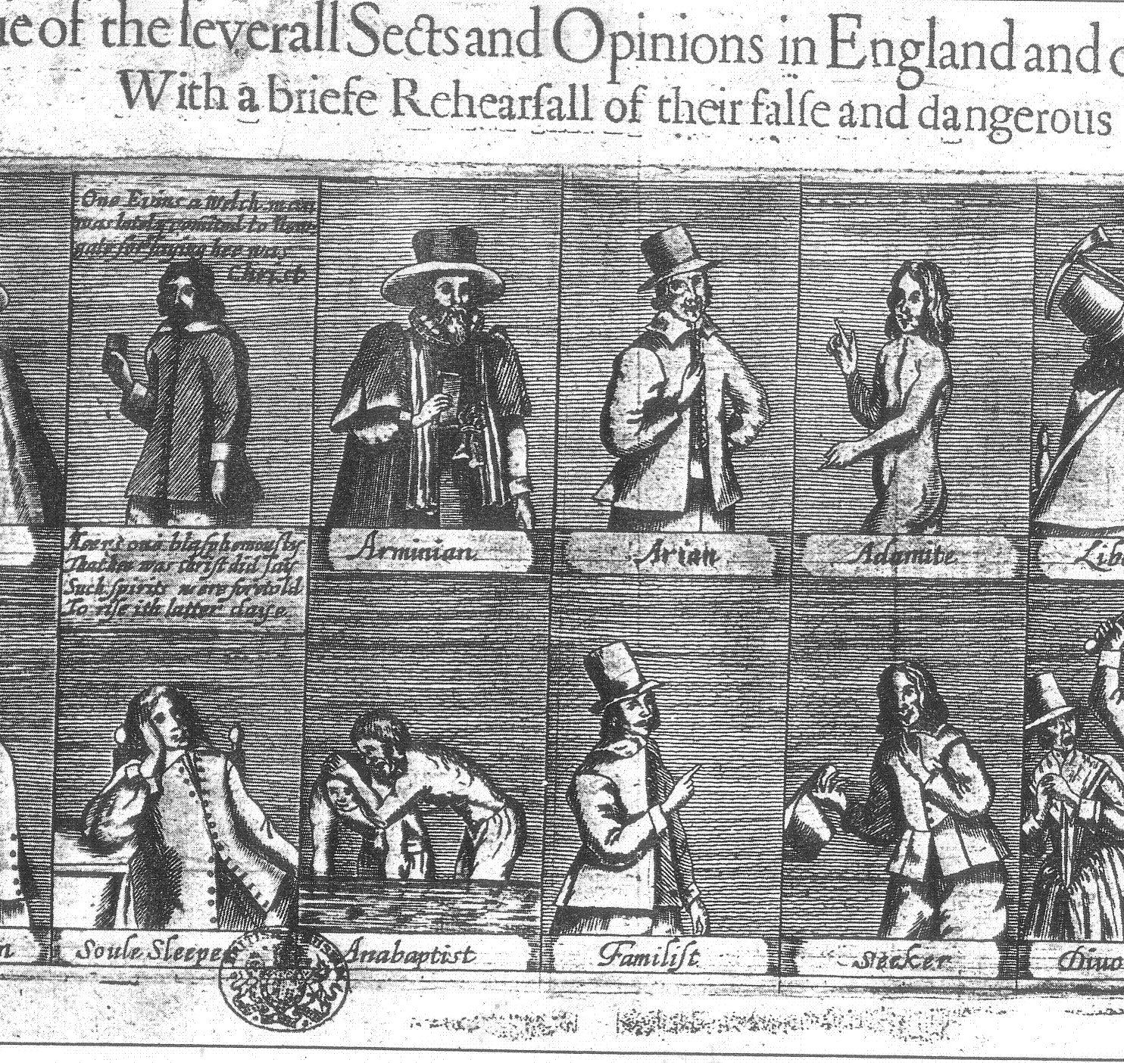
Puritans and Dissenters
Not everyone agreed with Puritan beliefs
Roger Williams supported religious freedom
Anne Hutchinson challenged church leaders
Both were banished from Massachusetts

Slide 10
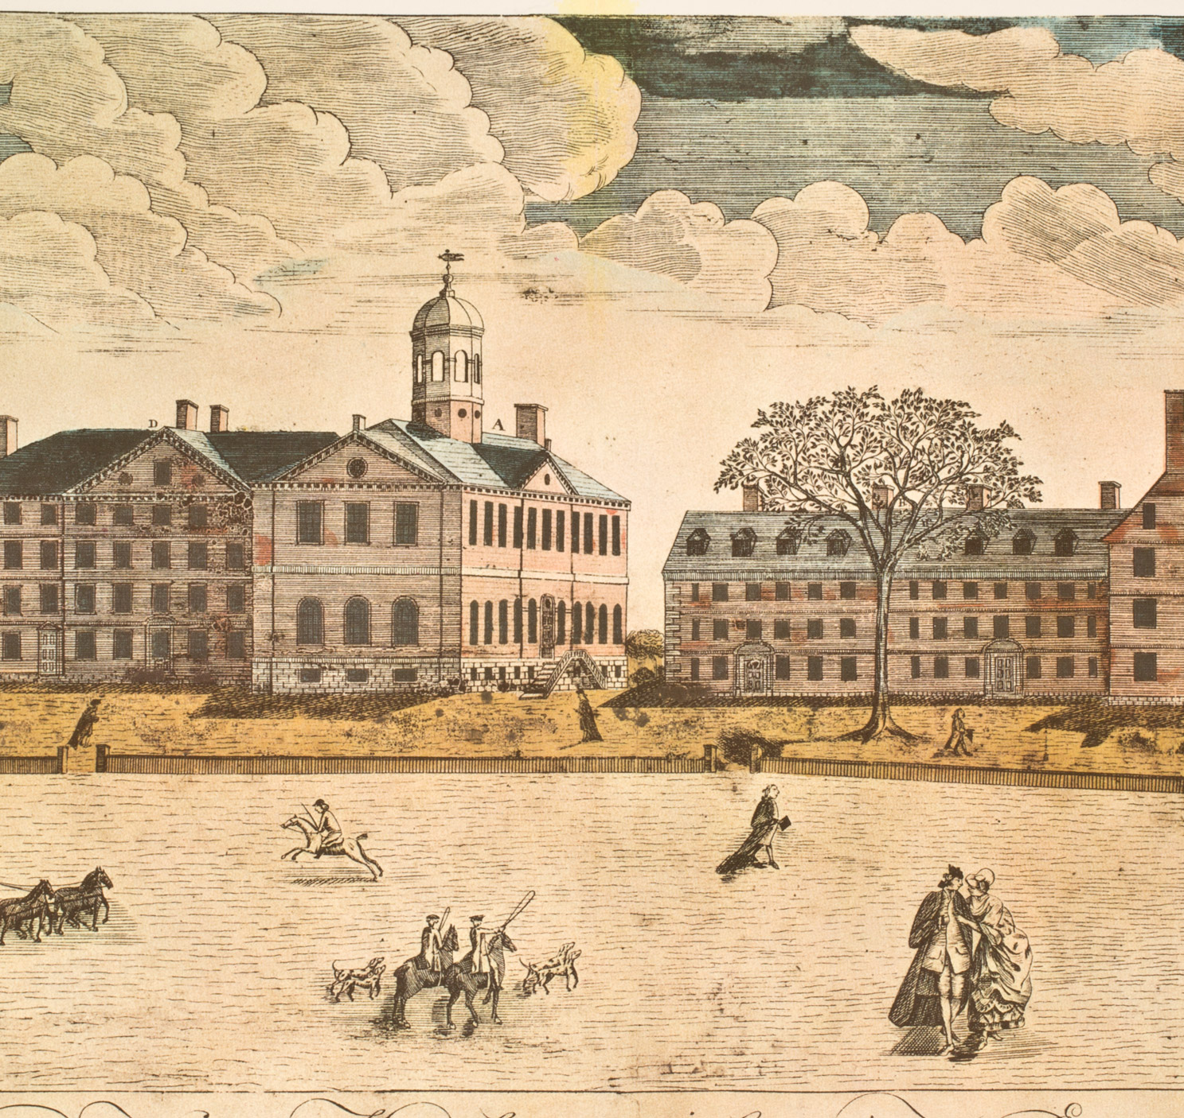
The Puritan Legacy
Strong influence on New England culture
Emphasized education and community responsibility
Strict rules limited personal freedoms
Showed tension between freedom and control

Slide 11
Discussion Questions
Why did the Puritans leave England?
How did religion shape Puritan government?
Why was education so important to the Puritans?
Was New England truly a place of religious freedom? Why or why not?

Slide 12
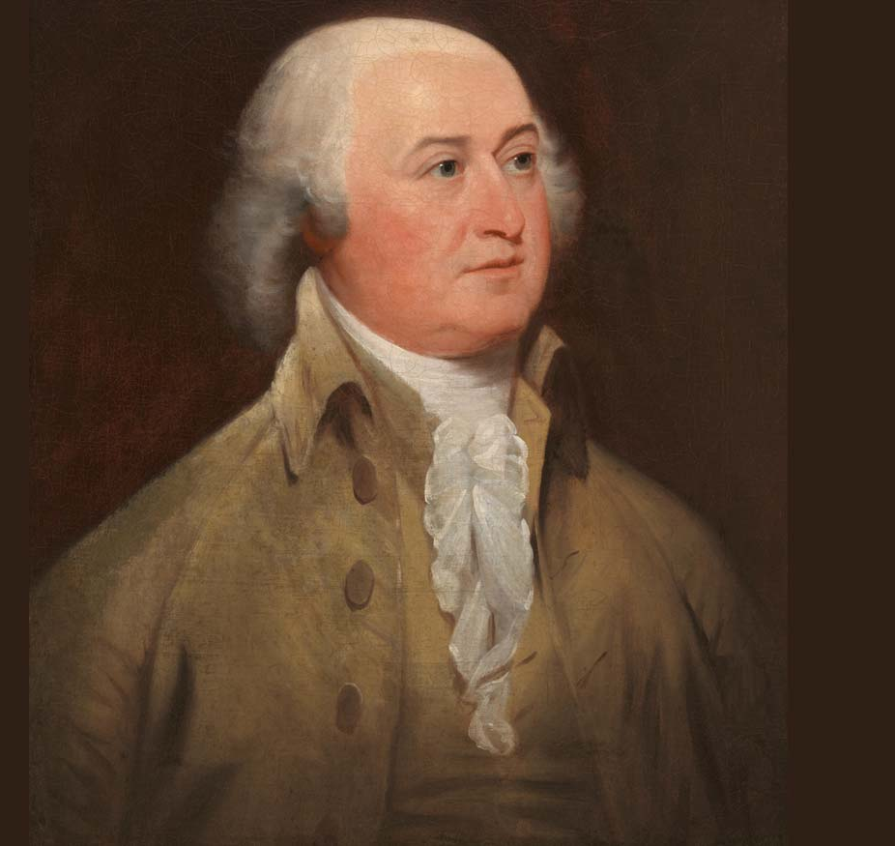
Famous Patriots of Puritan Heritage
John Adams – Leader of independence and 2nd U.S. President
Samuel Adams – Organizer of protests and resistance
John Hancock – President of the Continental Congress
Paul Revere – Patriot messenger and silversmith

